Slide 1
In the Twenty-First Century, Colonialism and Apartheid Are Doomed to Failure
Colonialism, settler expansion, and the continuing displacement of the Palestinian people have constituted the central political and moral question of the modern Middle East for over a century. Within a territory of merely 27,000 square kilometers, the colonial practices first imposed under British rule and later perpetuated by the State of Israel have resulted in profound and ongoing dispossession. The broader history of empire—characterized by uprooting, enslavement, and extermination—has shaped four centuries of the modern world, echoing still earlier patterns of imperial domination under the Roman, Ottoman, and Mongol empires

Slide 2
America-both North and South, Africa, Asia or Australia
Across these centuries, millions perished under colonial rule in the pursuit of territorial expansion and racial supremacy. The victims were the Indigenous peoples of the Americas, Africa, Asia, and Australia—those whose lands were seized and whose cultures were targeted for erasure. Algeria, for instance, lost approximately 15 million lives during the 132 years of French occupation. To this day, the Algerian people await an official apology from France—let alone any measure of compensation or reparations for the victims and their descendants. In a contemporary parallel, European authorities have sought to restrict or prohibit pro-Palestinian demonstrations in countries such as Germany, the United Kingdom, and even the United States, thereby silencing voices that challenge this enduring colonial legacy.

Slide 3
The 1619 project & Slave-Ships
Nikole Hannah-Jones’s The 1619 Project recalls that the first ship carrying enslaved Africans arrived in Virginia 113 years before the birth of George Washington and 244 years before the Emancipation Proclamation (p. xix). The Danish writer Thorkild Hansen, in his three-volume study of the Atlantic slave trade, similarly documents the brutality of European enslavement. Beginning in 1699, Danish ships carried human cargo from Guinea and Fida to the Caribbean and back to Copenhagen. On one voyage, Captain Jørgen Graber departed with 549 enslaved people; upon reaching St. Thomas Island, 196 were dead (p. 23). On another, Captain Collingwood of the British slave ship Zong ordered 133 enslaved Africans thrown overboard—54 of them because the remaining water was reserved for the white crew (p. 57). Danish vessels frequently included clergy among their crew, whose role was to pray for the “peaceful completion” of these voyages, thus revealing the profound moral contradictions that underpinned Europe’s so-called civilizing missions.

Slide 4
Today, over 14 million Palestinians possess the unequivocal right to have their history acknowledged, their lands restored, and their destroyed towns and villages rebuilt. Their Right of Return and Reparation is enshrined in international law, most notably in United Nations General Assembly Resolution 194 (1948). The Swedish diplomat Count Folke Bernadotte, who sought to ensure the implementation of this resolution, was assassinated for his efforts; his killers were never brought to justice.
It took the United States 106 years to recognize the Armenian Genocide, and many more decades for states to acknowledge the atrocities committed against the Aboriginal Tasmanians, the Māori of Aotearoa/New Zealand, and the victims of colonial genocide in the Congo and Namibia. The German genocide against the Ovaherero and Nama peoples (1904–1908)—the first genocide of the twentieth century—stands as a precursor to later forms of racial extermination and imperial violence. The European record of conquest and massacre across continents remains one of the most underexamined foundations of modern world history.

Slide 5
All major international organizations—from the reports of UN Special Rapporteur Francesca Albanese to those of Amnesty International, Human Rights Watch, B’Tselem, the International Criminal Court (ICC), and the International Court of Justice (ICJ)—have meticulously documented the systemic discrimination and oppression of Palestinians. These investigations have consistently characterized Israel’s regime as one of apartheid, defined by domination and segregation. Moreover, an international panel of genocide scholars meeting in Australia recently concluded by majority that the events in Gaza meet the criteria of genocide under international law.
The persistence of denial regarding the Palestinian right to self-determination represents one of the most striking moral failures of the international order. As Rosemary Sayigh’s Too Many Enemies vividly records, Palestinians have endured decades of dispossession and violence. Yet, paradoxically, the global movement for Palestine demonstrates that they also possess “too many friends”—millions who continue to march each week in cities around the world, calling for justice, equality, and peace between the river and the sea.
Avi Shlaim’s Three Worlds (2023) further illuminates the historical complexity of Jewish-Arab relations. The book recounts how his Iraqi Jewish family—one of 150,000 members of a 2,000-year-old community—was forced to emigrate under political and social pressure, leading to the disappearance of this ancient community “in less than 2,000 hours.” Shlaim’s life, shaped across Iraq, Israel, and Britain, reflects the intertwined histories of exile and belonging. His epilogue advocates a one-state solution in which all inhabitants, regardless of faith or ethnicity, would enjoy equal democratic rights—a vision he acknowledges is currently embraced by a minority, yet one he sees as the only path toward lasting peace and justice

Slide 6
Seventy-seven years separate the destruction of my own village, Lubya—the site of the Crusaders’ defeat in 1178 in Galilee—from the 2021 attempts to evict the remaining families of Sheikh Jarrah, themselves refugees from West Jerusalem, Lydda, and Ramla. Since then, al-‘Araqib village in the Naqab has been demolished over 240 times, while Gaza—the world’s largest refugee camp—has endured continuous bombardment and siege. Seventy-three percent of Gaza’s 2.4 million residents are descendants of those expelled during the Nakba of 1948, the largest ethnic cleansing operation in the aftermath of the Second World War. Europe’s historical construction of the “other” has merely shifted: the Jews of Europe, once persecuted as outsiders, have been symbolically replaced by Palestinians, Arabs, and Muslims in the postwar Middle East. As Ilan Pappé has argued, “Europe, instead of resolving its racism against Jews, exported it to the Middle East.”

Slide 7
The following visual and textual materials document the historiography of a single village—Lubya, one among 675 destroyed in 1948.
Title: Yesterday Lubya, Today Gaza, Tomorrow...?
. https://vimeo.com/184372241
http://mahmoud.dk
https://mahmoud.dk/wp-content/uploads/2020/02/Lubya-manus-pdf-2020-feb..pdf

Slide 8
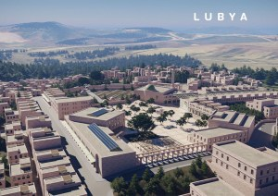

Slide 9
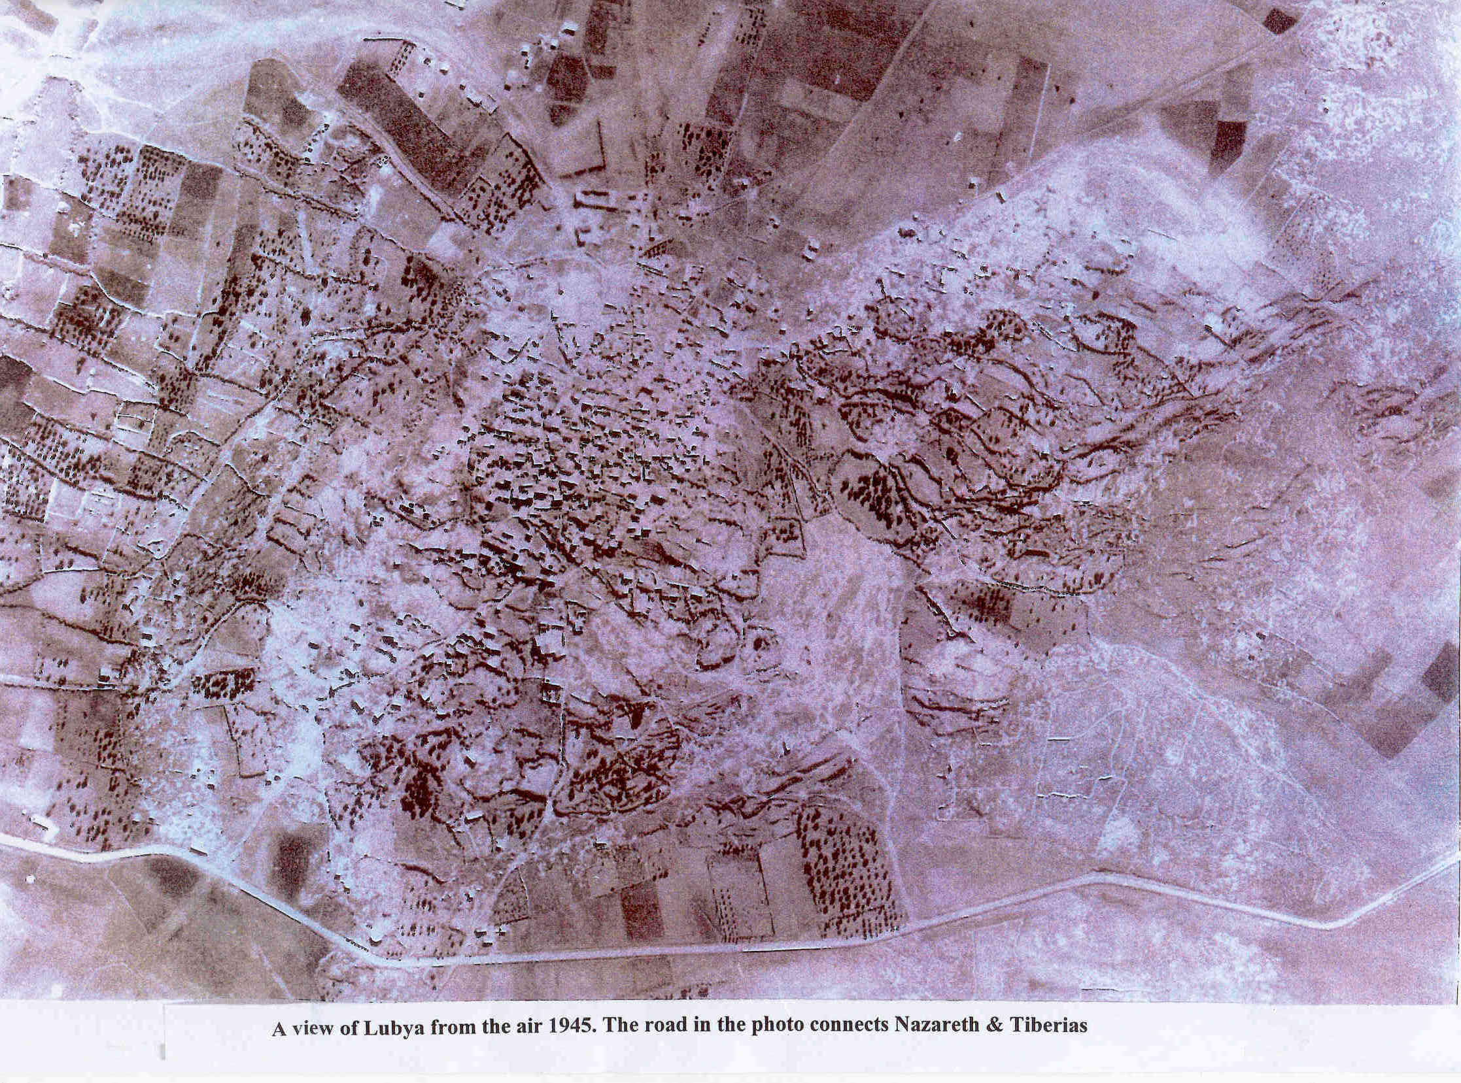
Lubya before demolition

Slide 10
Rebuilding Lubya 2021
Common project between Jordan & Palestine Univ. Engineers
اعادة بناء لوبيه 2021

Slide 11
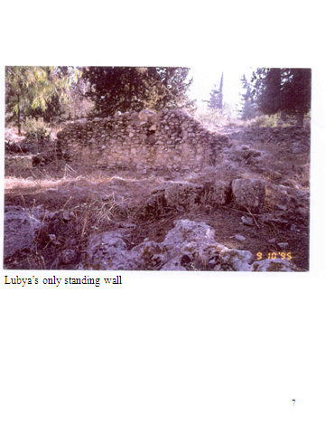
Memories of the Past the only standing wall
Out of 1000 rooms in Lubya in 1948, all that remains for refugees, are merely memories of the past & landscape: the vertibral column of their existence.

Slide 12
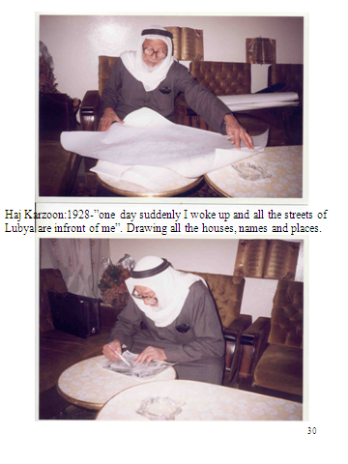
Haj Karzon and Map of Lubya
Oral history will remain one of the main sources of our perceptions and understanding of the various social and historical facts related to a specific time in a specific period, whenever classical historical means of analysis are unavailable. See film: “Village under Forest” at mahmoud.dk

Slide 13
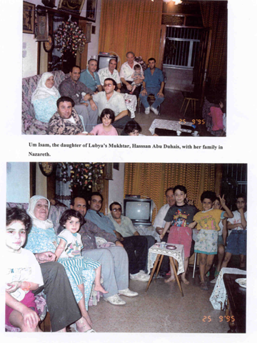
Necessity of Oral History to Recover Hidden Histories of the Past
The neglected narratives and memories of the marginalized and alienated are invisible to official historiography.

Slide 14
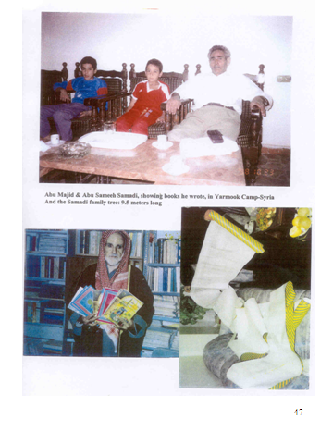
Around 50.000 Living in 23 Countries
Refugees from Lubya live and reside in as many as twenty-three countries around the world
Fayiz Fawaz and Abu Sameeh(from Yarmook refugee camp) geneological tree of his family-tracing back to Hassan, son of the fourth Khalif in Islam

Slide 15
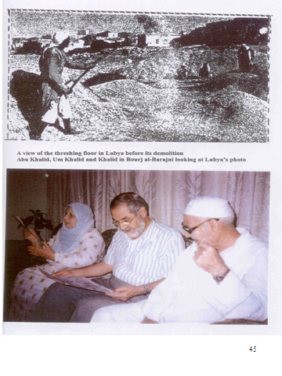
Suppressed Memories - Khalid Said Vivid Memory After 42 Years in Exile
After 42 years Khalid Said visited Lubya found his family´s home debris although he was only 8 years old in 1948, when he left Lubya.

Slide 16
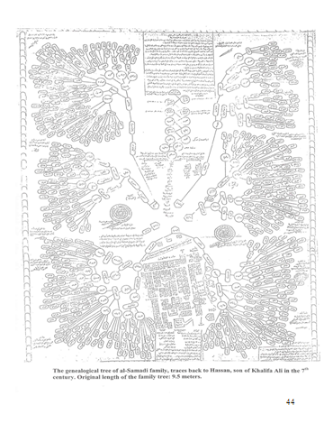
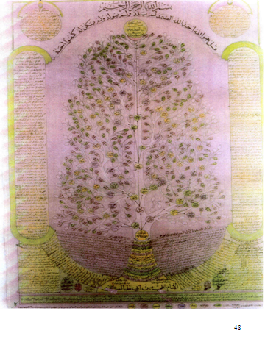
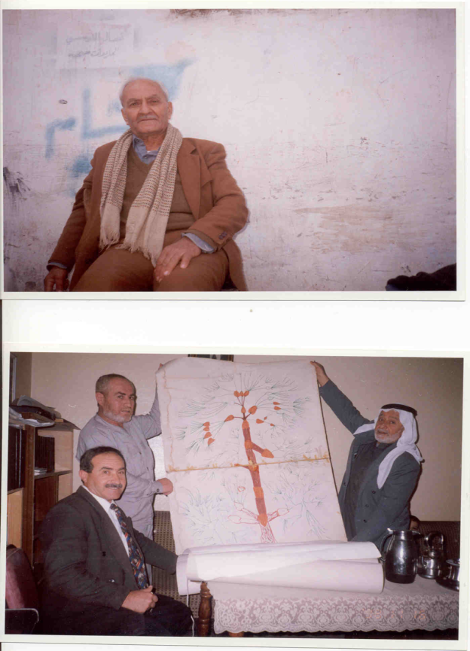
Geneological Tree of Samadi & Atwat Family-Abu Dhais residing in Hama’s refugee camp author of a book on Lubya

Slide 17
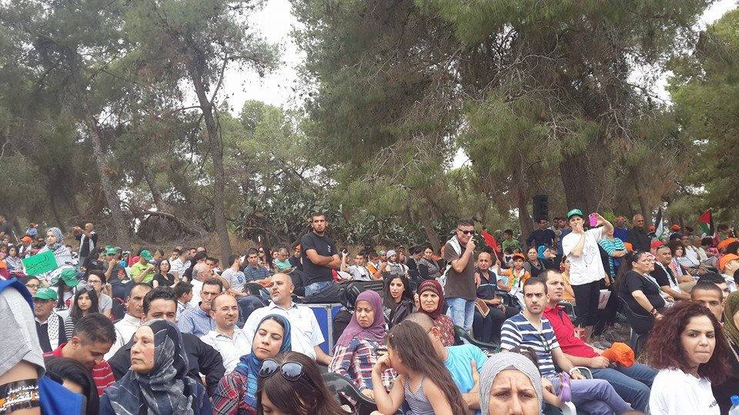
Around 20.000 gathered on Lubya debris-Named now South African Forest, commemorating the 66th anniversary of Nakba Day in 2014

Slide 18
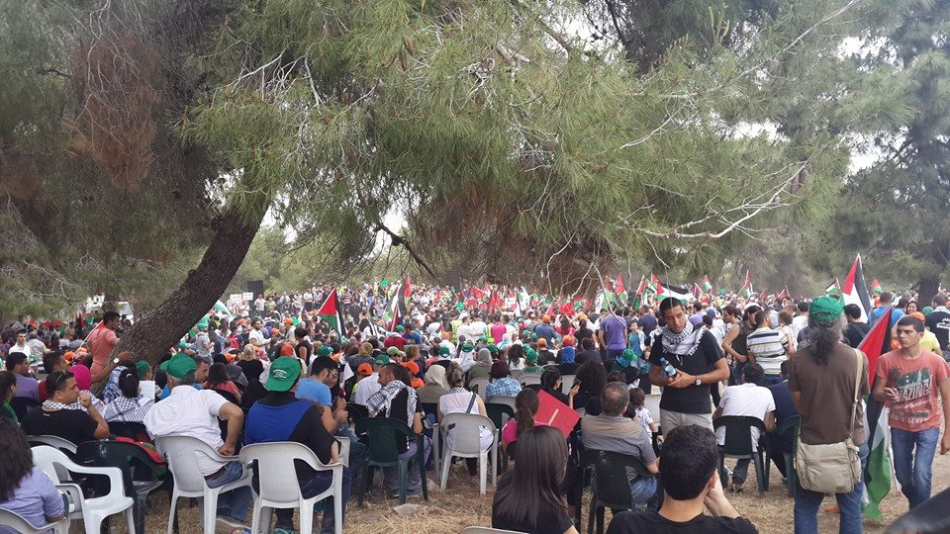

Slide 19
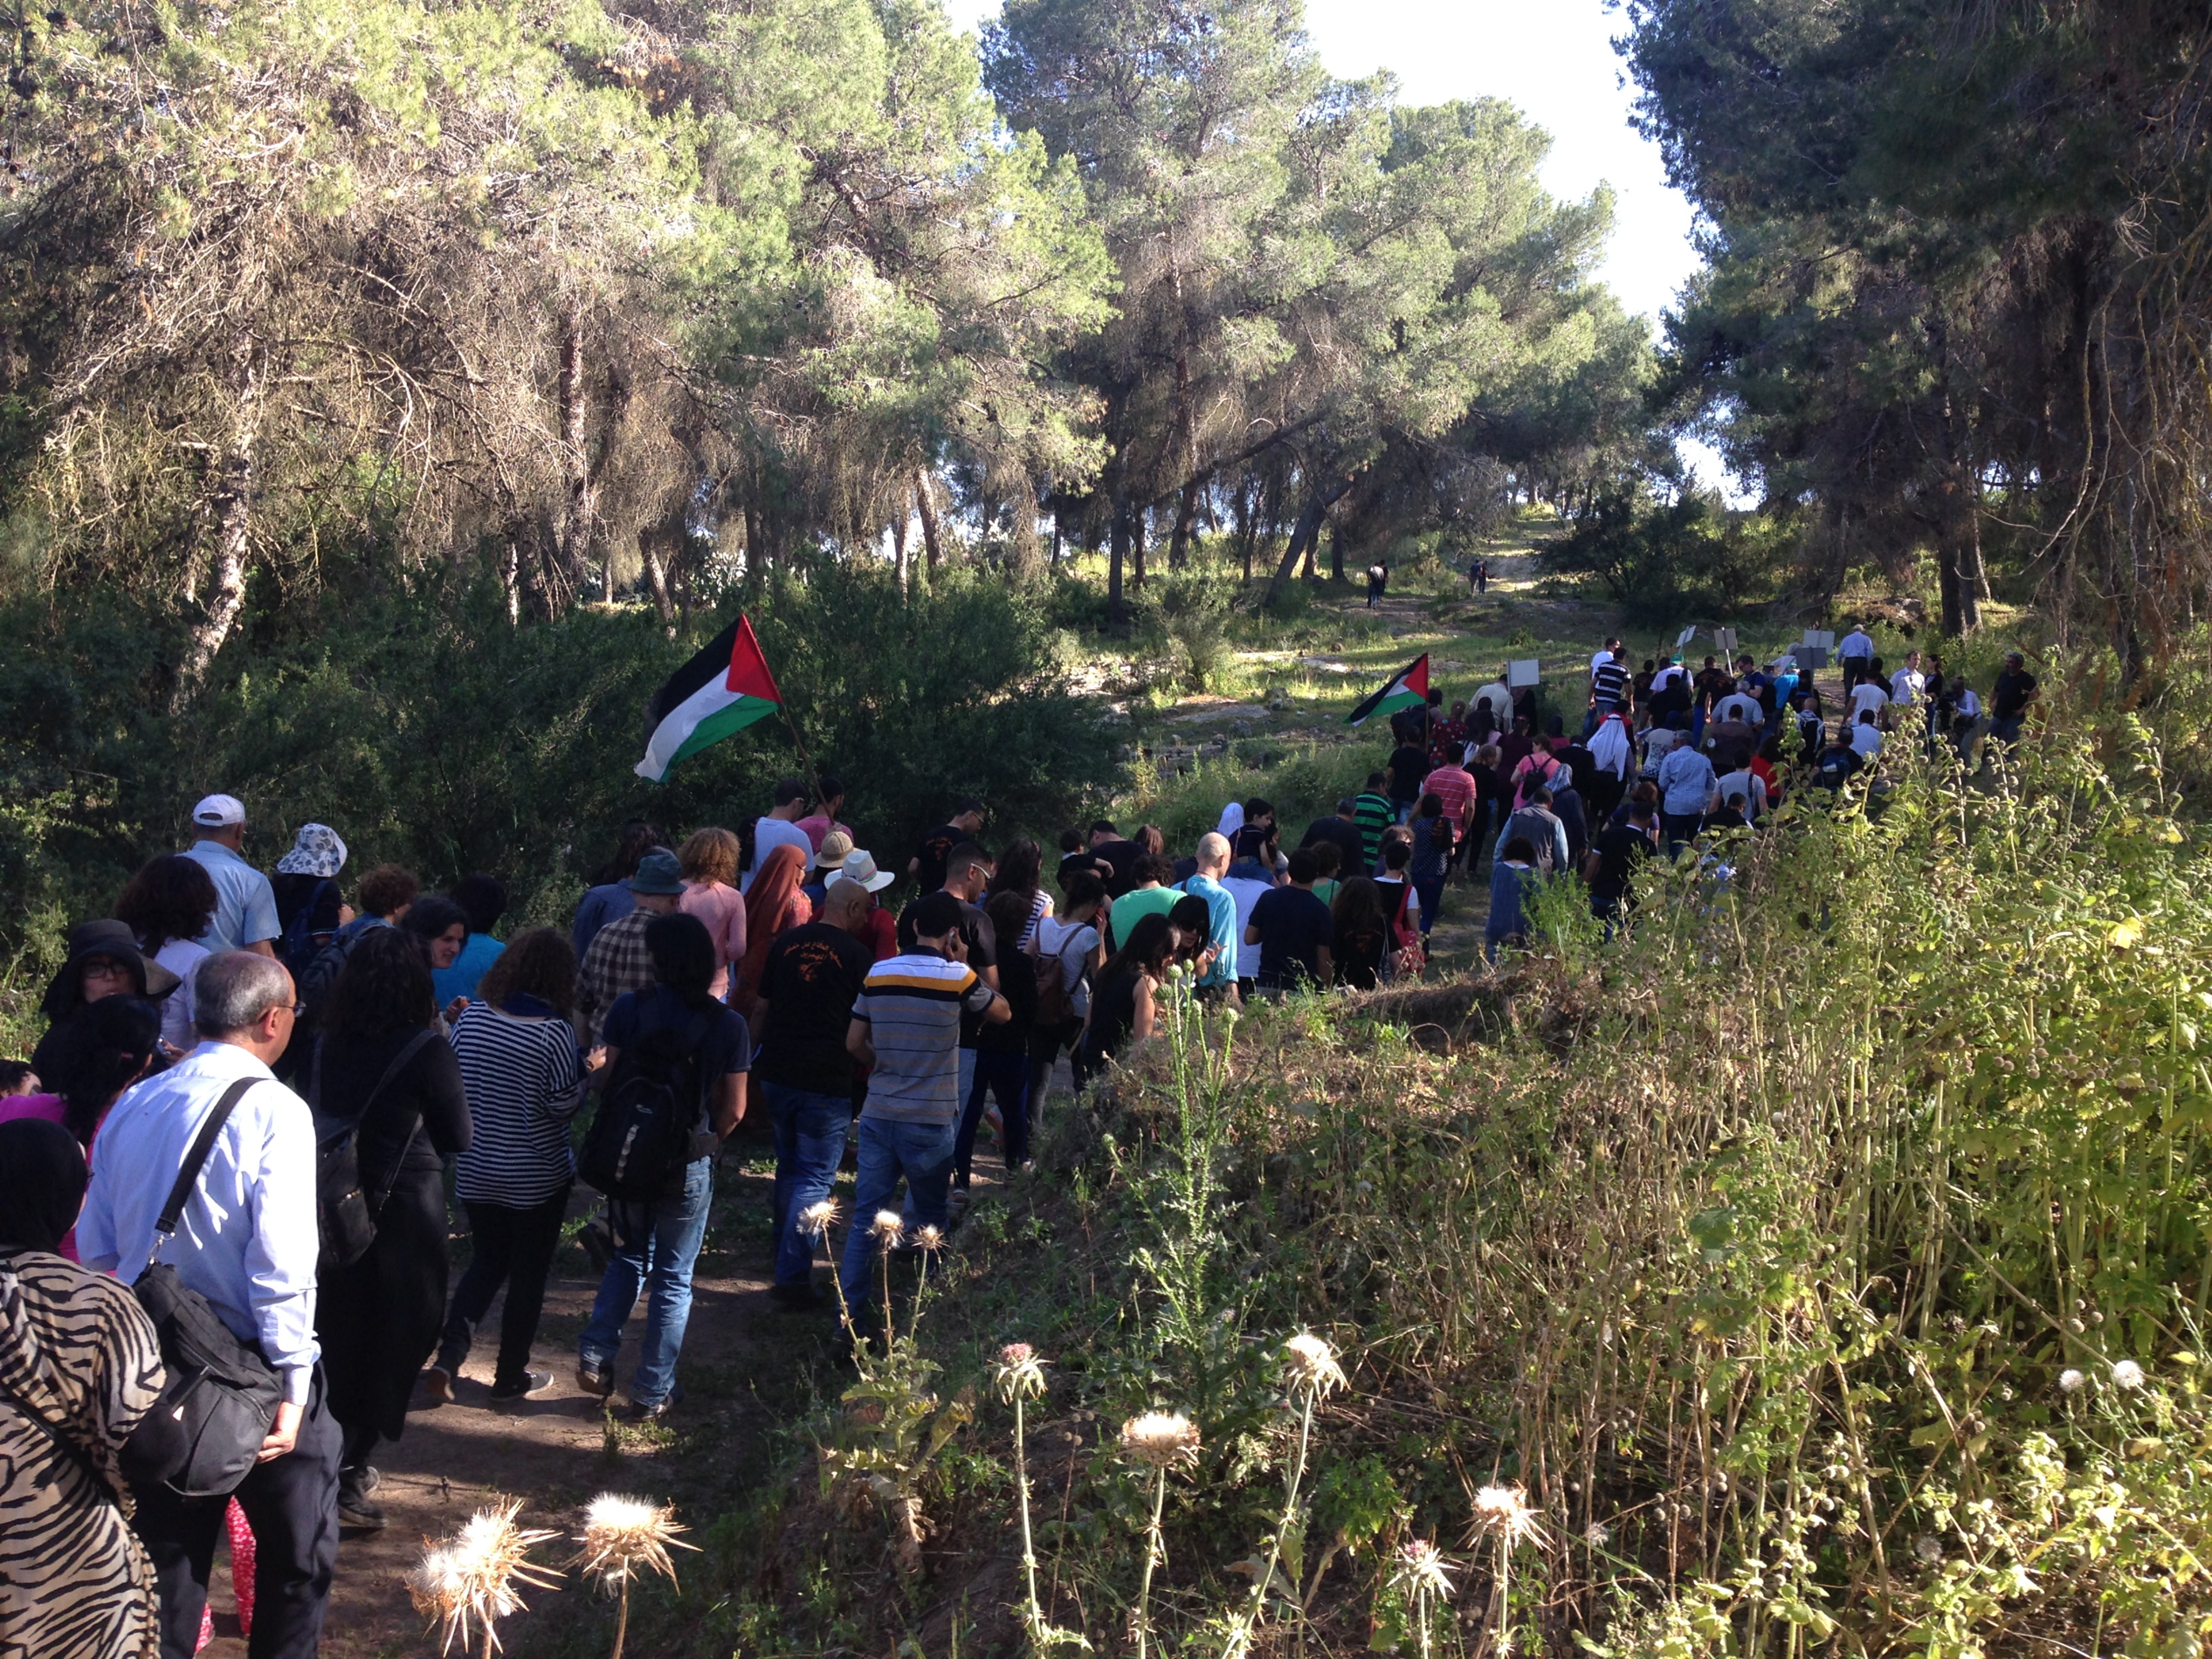
Notes:
Demostration on the first of May on Lubya land, by Lubyans from Europe, Palestine and South African Delegation and Israelis as well.

Slide 20

A well documented film by Mark Kaplan & Heidi Grunebaum, from South African, protesting the renaming of Lubya’s ruins to “South African Forest” after its demolition and ethnic cleansing in 1948 – to obliterate the historiography of the village under greening policies-The film is based on my counselling and research.

Slide 21
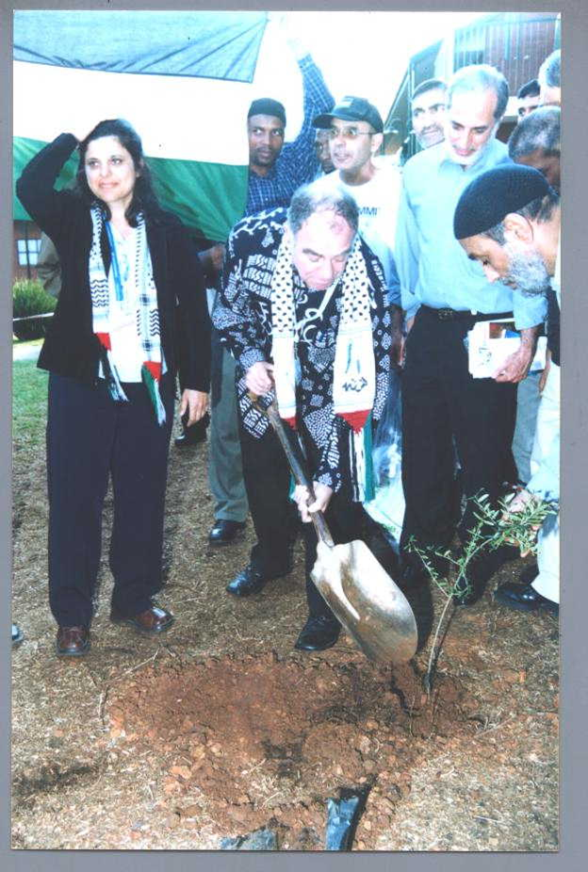
South African minister Ronnie Kasril´s Dedication to Lubya: planting olive tree
“Lubya: dedicated by the honourable minister, Ronnie Kasrils (minister of water affairs and forestry) in South Africa:

Slide 22
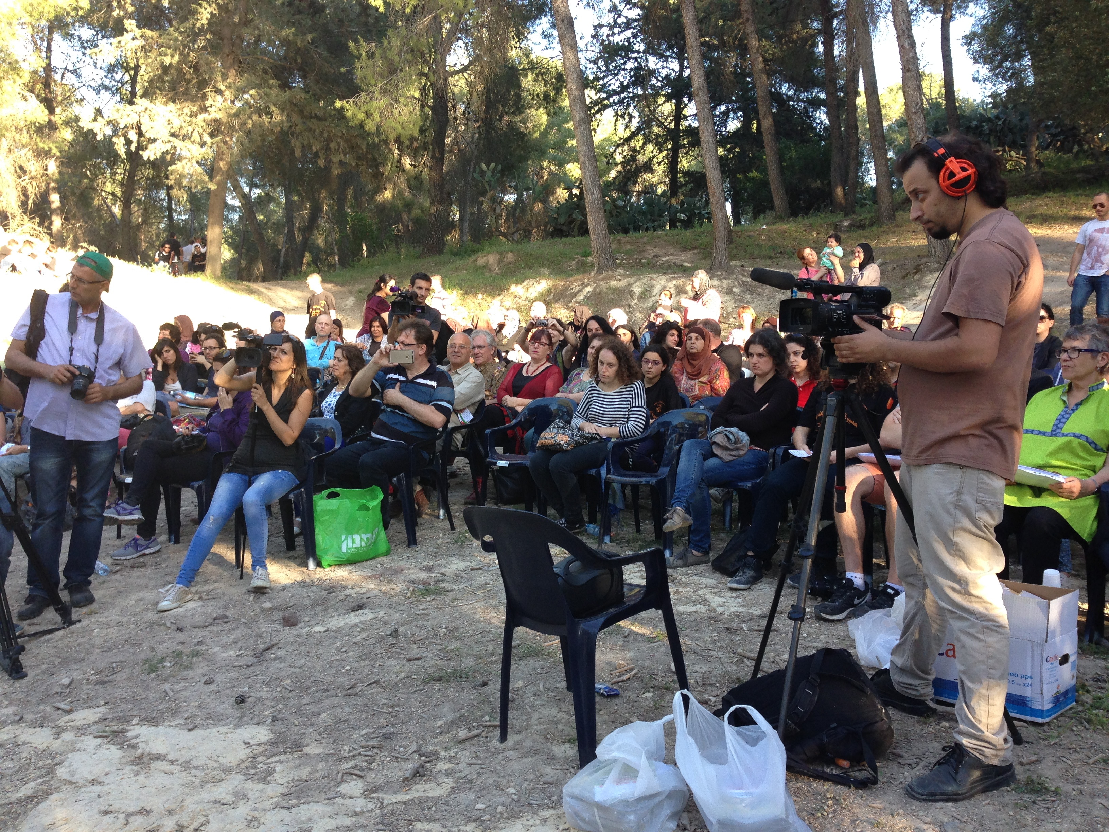
Demostration on the first of May on Lubya land, by Lubyans from Europe, Palestine and South African Delegation and Israelis as well.
Notes:
Ceremony of apology from South African Jews to Lubyans.

