Slide 1
Lubya ”Lieu de memoire” revisited
Lecture at Dar Al-Kalima-Bethlehem 26th International Conference–
Mahmoud Issa
October 2023

Slide 2
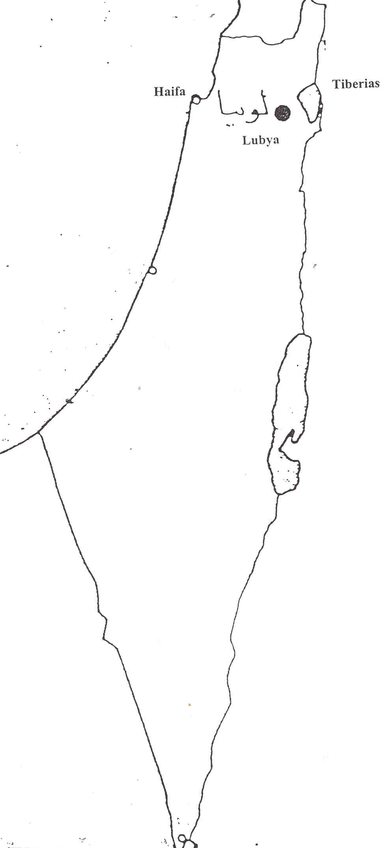

Slide 3
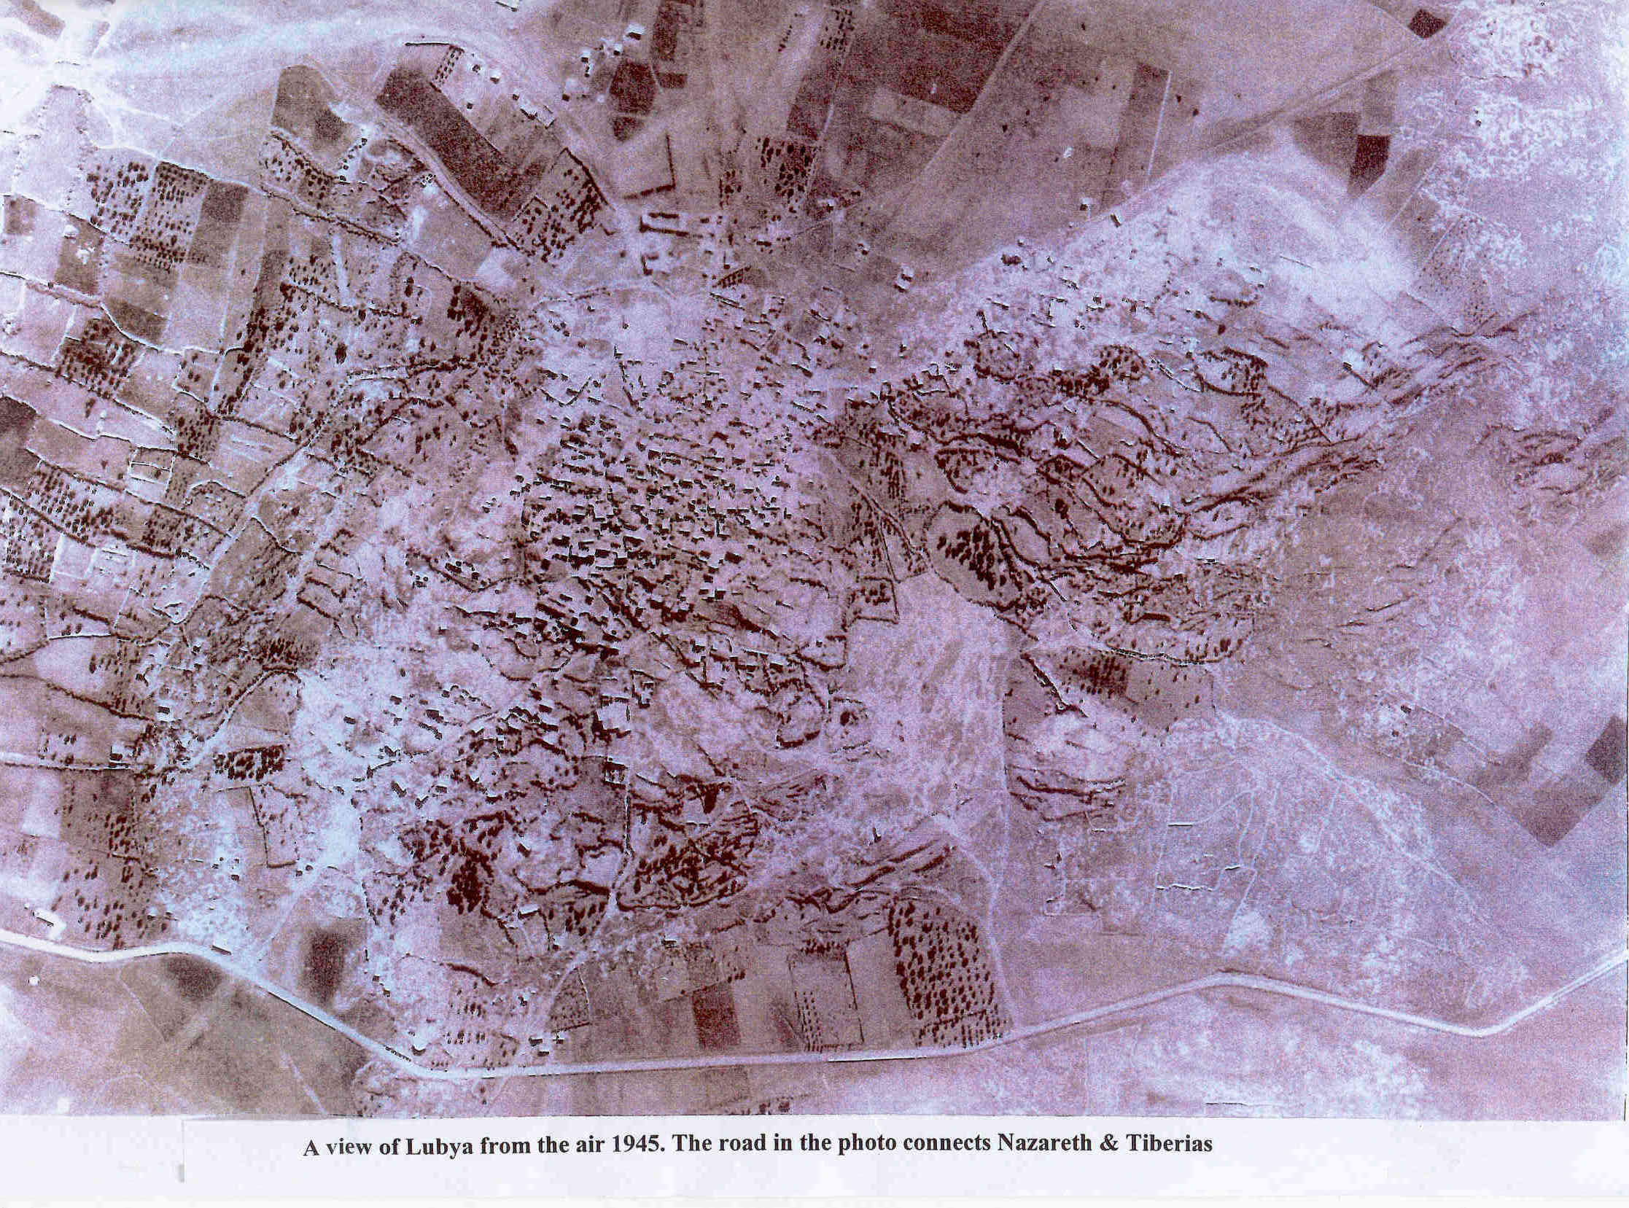
Lubya-a Palestinians Village: Historiography, Culture and Identity

Slide 4
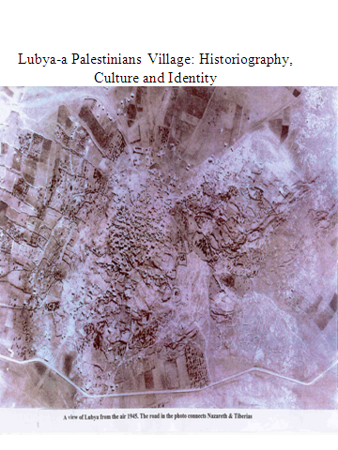
The Only Photo of Lubya Before Destruction
Documents on Lubya in British and Zionist archives in London, Jerusalem and Tel Aviv reveal the number of houses, wells, camels, cows, deeds of land and income of the people of the village.

Slide 5
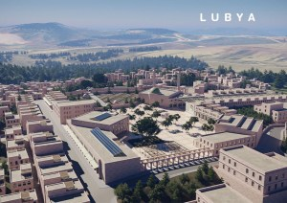

Slide 6
Lubya Rebuilt in 2021 by Palestinian Architects
اعادة بناء لوبيه 2021. مشروع يفتح أفق جدي لفلسطين المستقبل – آمل ان يشمل ال 675 قريه و مدينه التي دمرت منذ 1948 https://www.plands.org/en/competition-news/competition-history-and-operation-year-5 Following is a video meeting of 1:18 min. of Lubyans in & out of Palestine with the Architects. A courageous project that should continue to cover the 675 demolished towns and villages from 1948. (Lubya is the fifth reconstructed village).

Slide 7
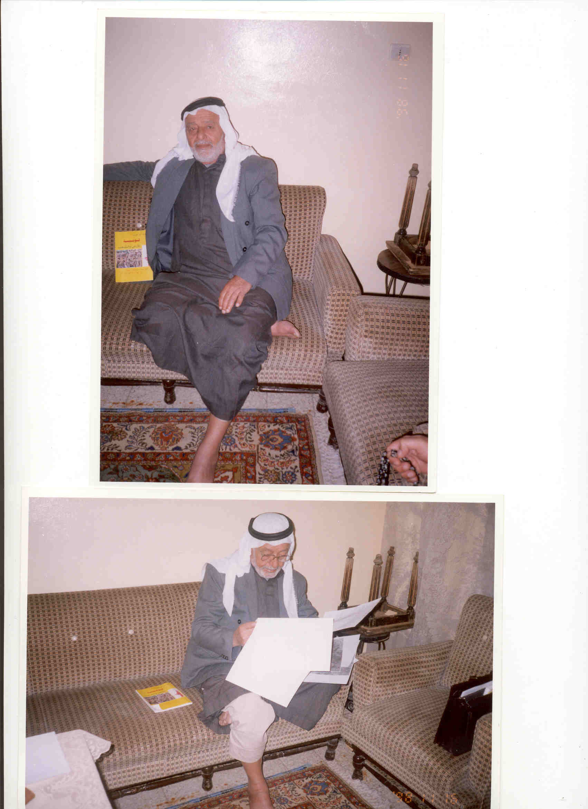
Youssef Abu Dhais, 1928, author of book: Lubya-land & people. Hama refugee camp-Syria

Slide 8
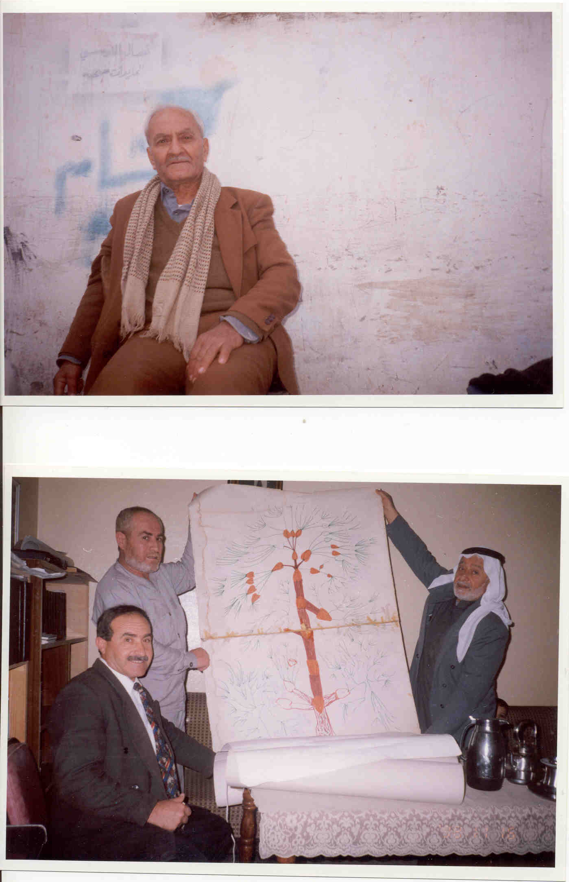
Abu Dhais showing his geneological family tree-alAtwat.

Slide 9
Haj Karzoon:1928-”one day suddenly I woke up and all the streets of Lubya are infront of me”. Drawing all the houses, names and places.

Slide 10
Mohamad Theeb, 1918, closed his shop in Lubya in 48, and opening another in Burj-al-Shimali, Lebanon, still keeping the book with names who owed him money:
“our life here is a permanent torture. Exile is death, death, death, nothing is more worse than living as a stranger”, interviewed on 11.2.1999

Slide 11
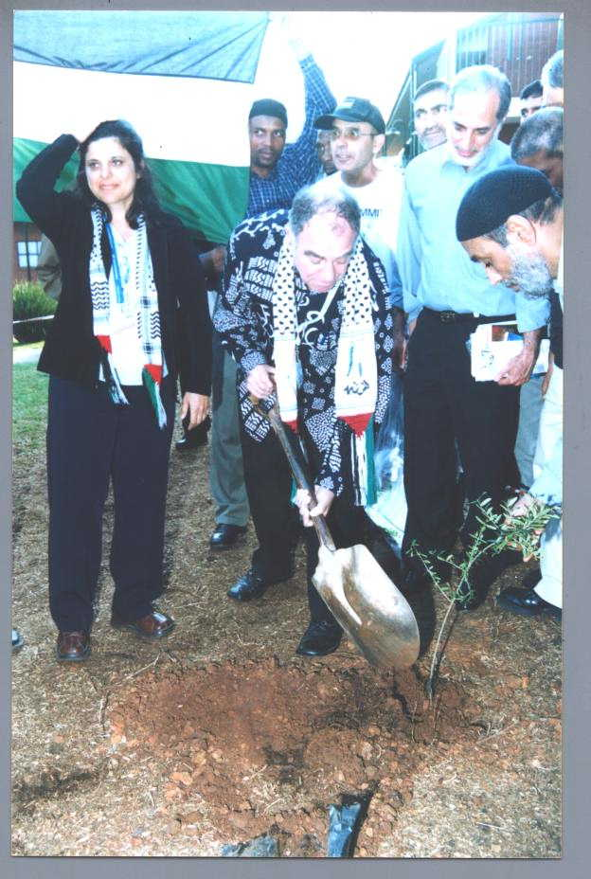
In the year 2000, South African minister Ronnie Kasrils planted a memorial tree for Lubya in Pretoria

Slide 12
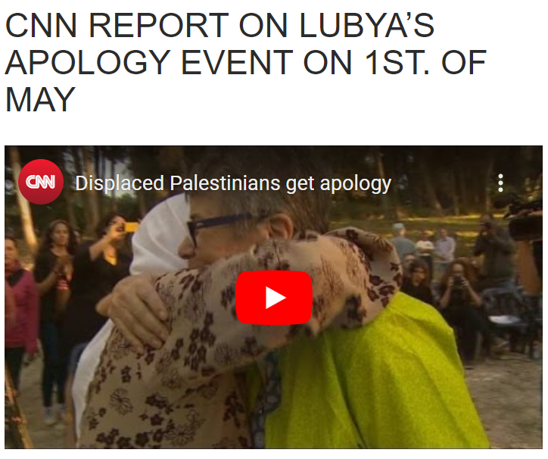

Slide 13
Trees planted before expulsion, identified again in 1994.

Slide 14
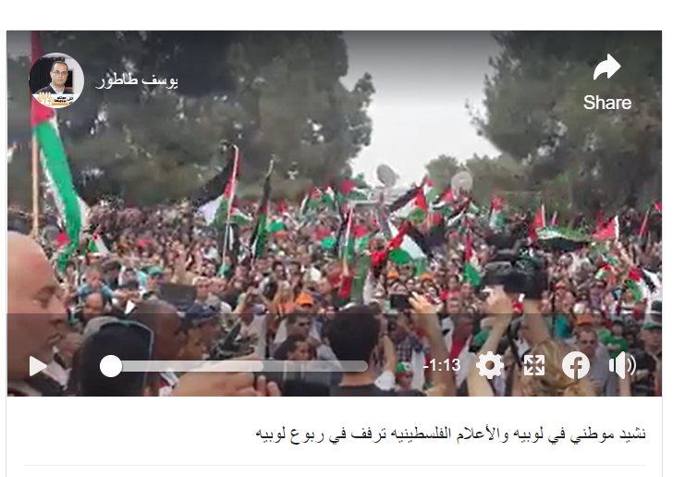

Slide 15
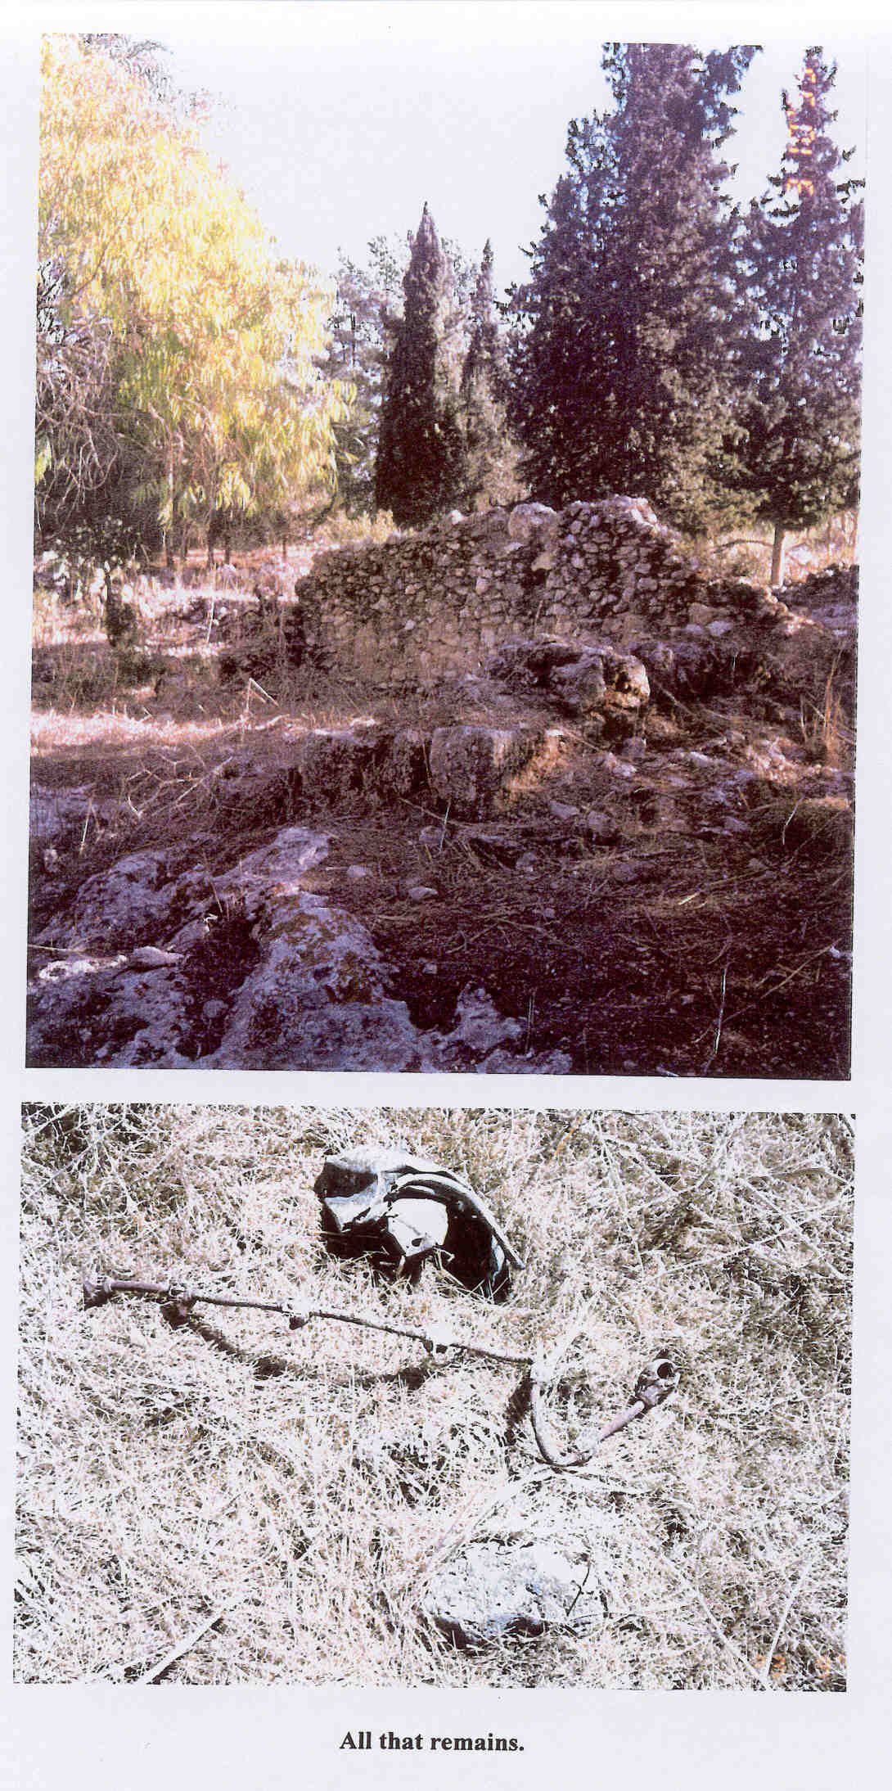

Slide 16
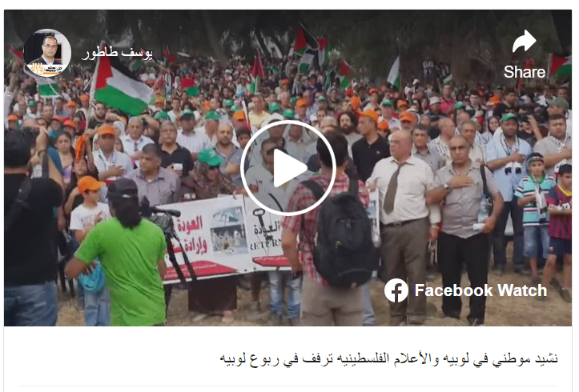

Slide 17
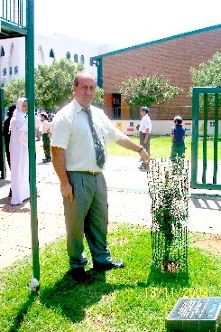
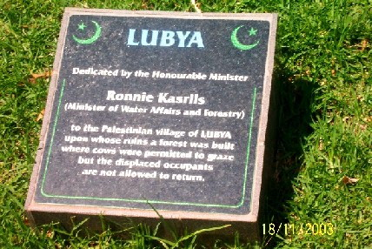

Slide 18
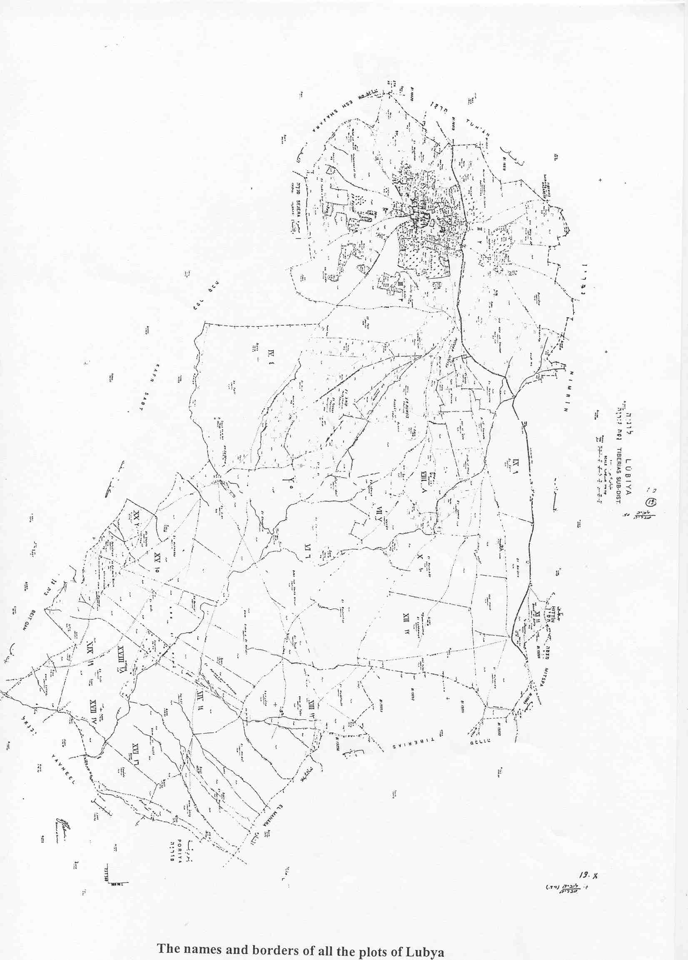

Slide 19
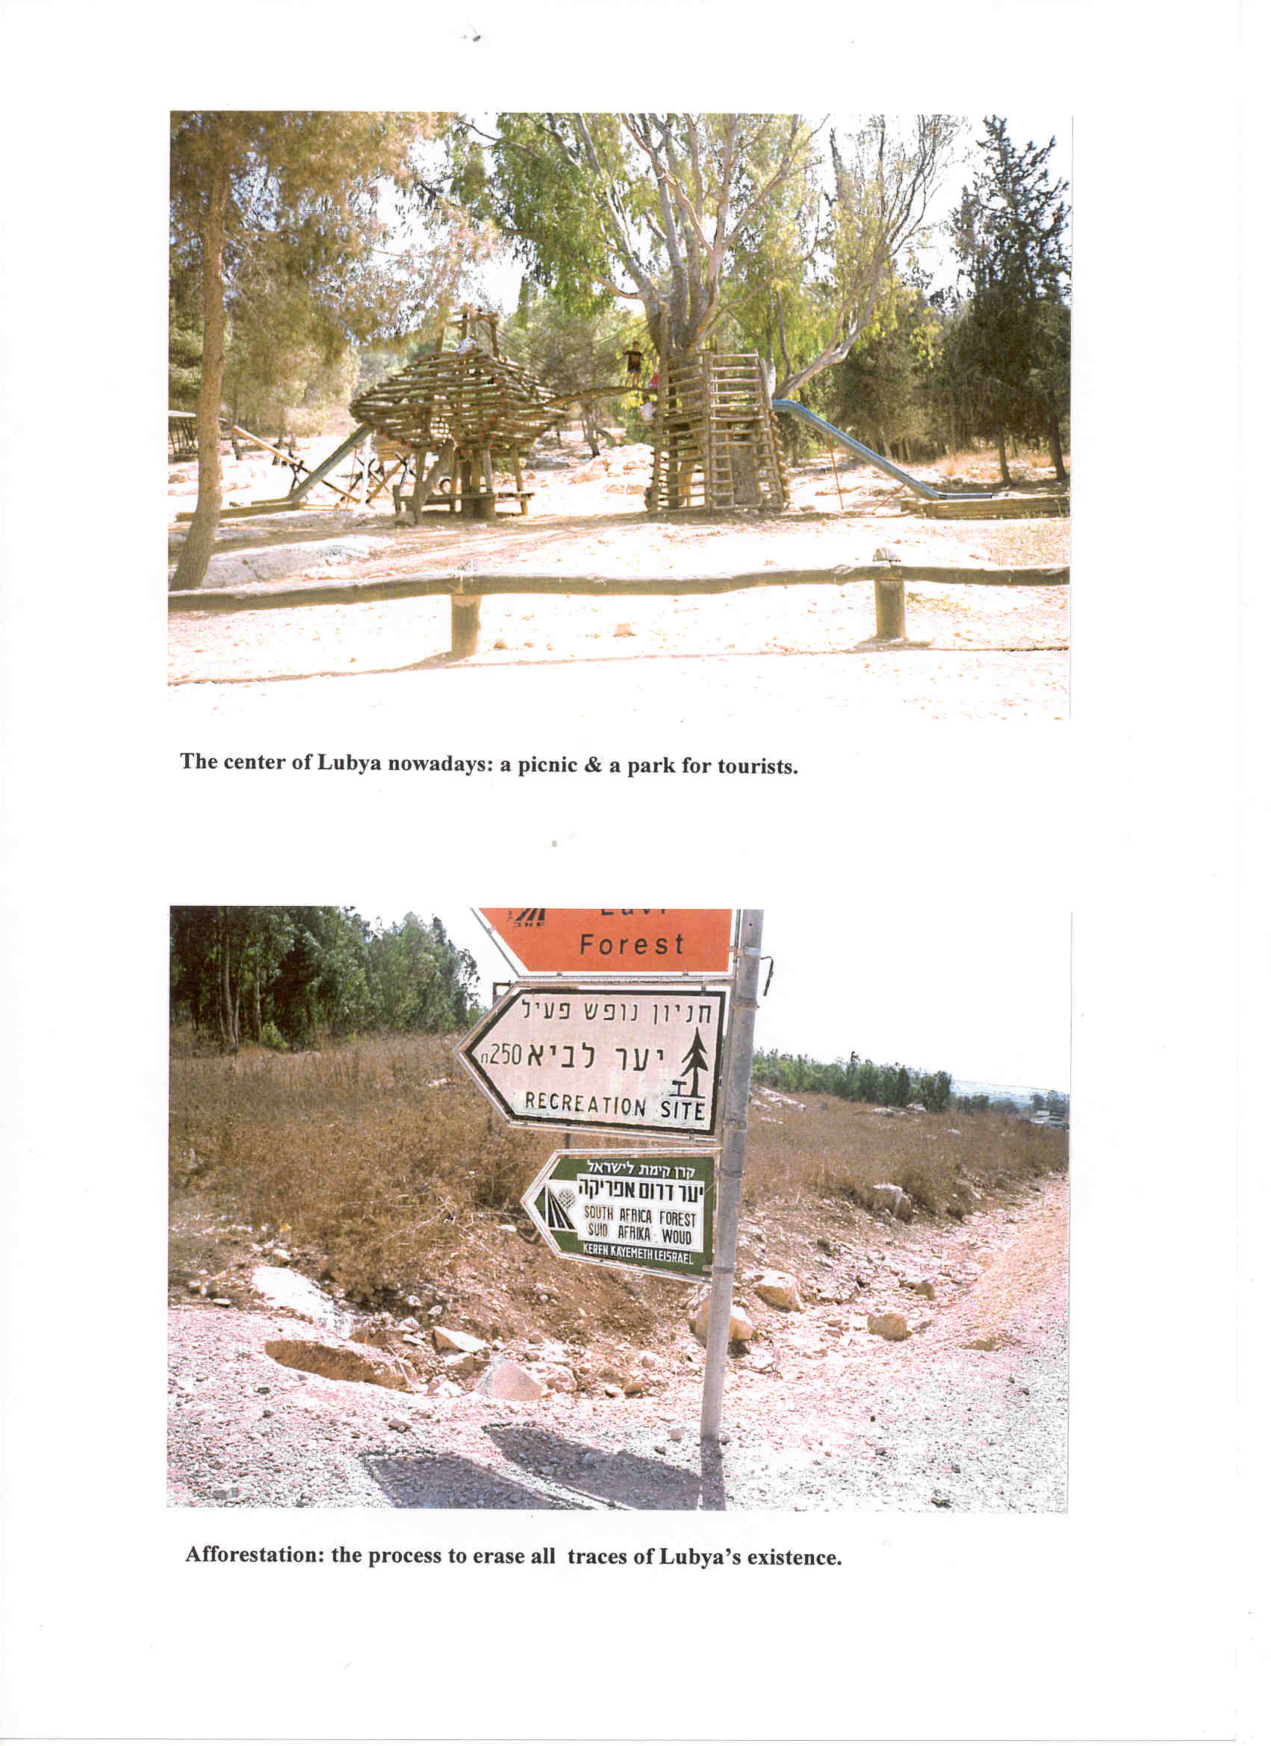

Slide 20
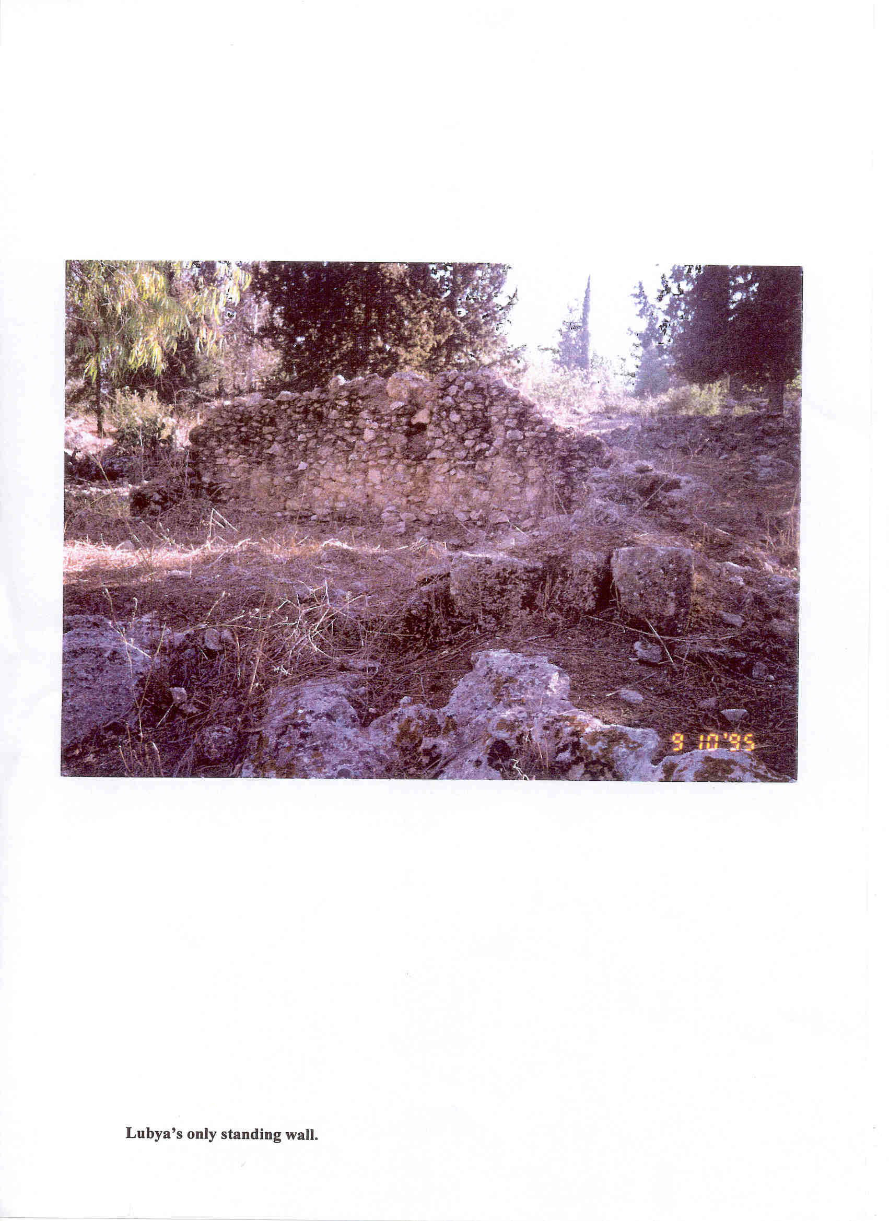
bmajmouid
Lubya’s only standing wall

Slide 21
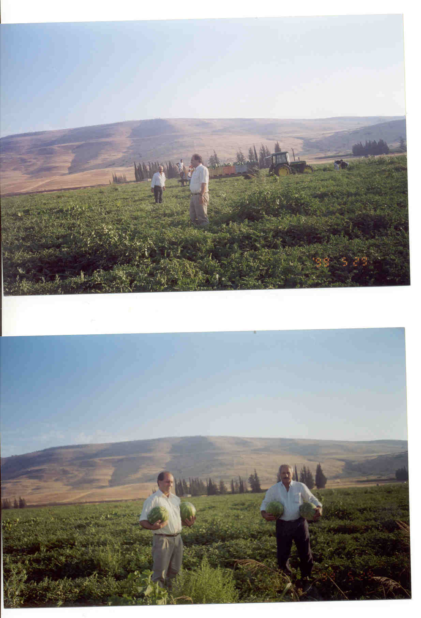

Slide 22
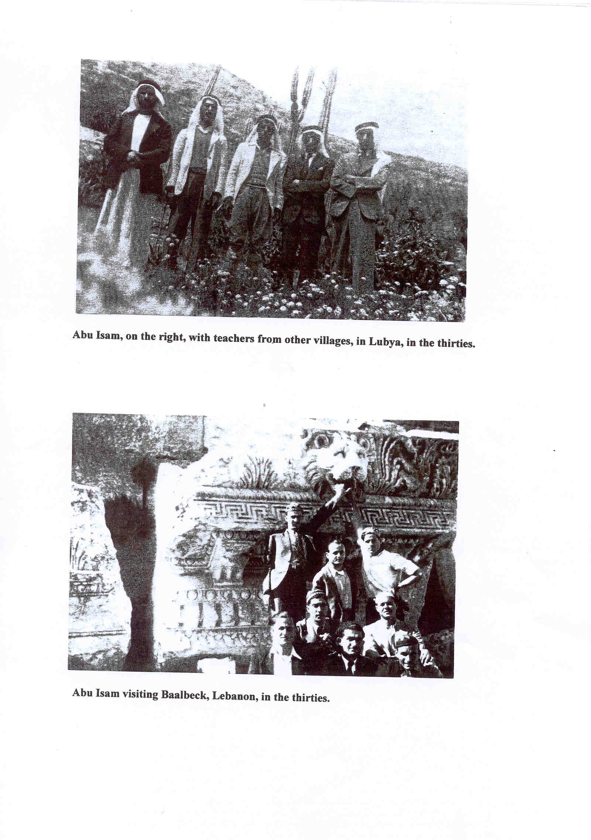

Slide 23
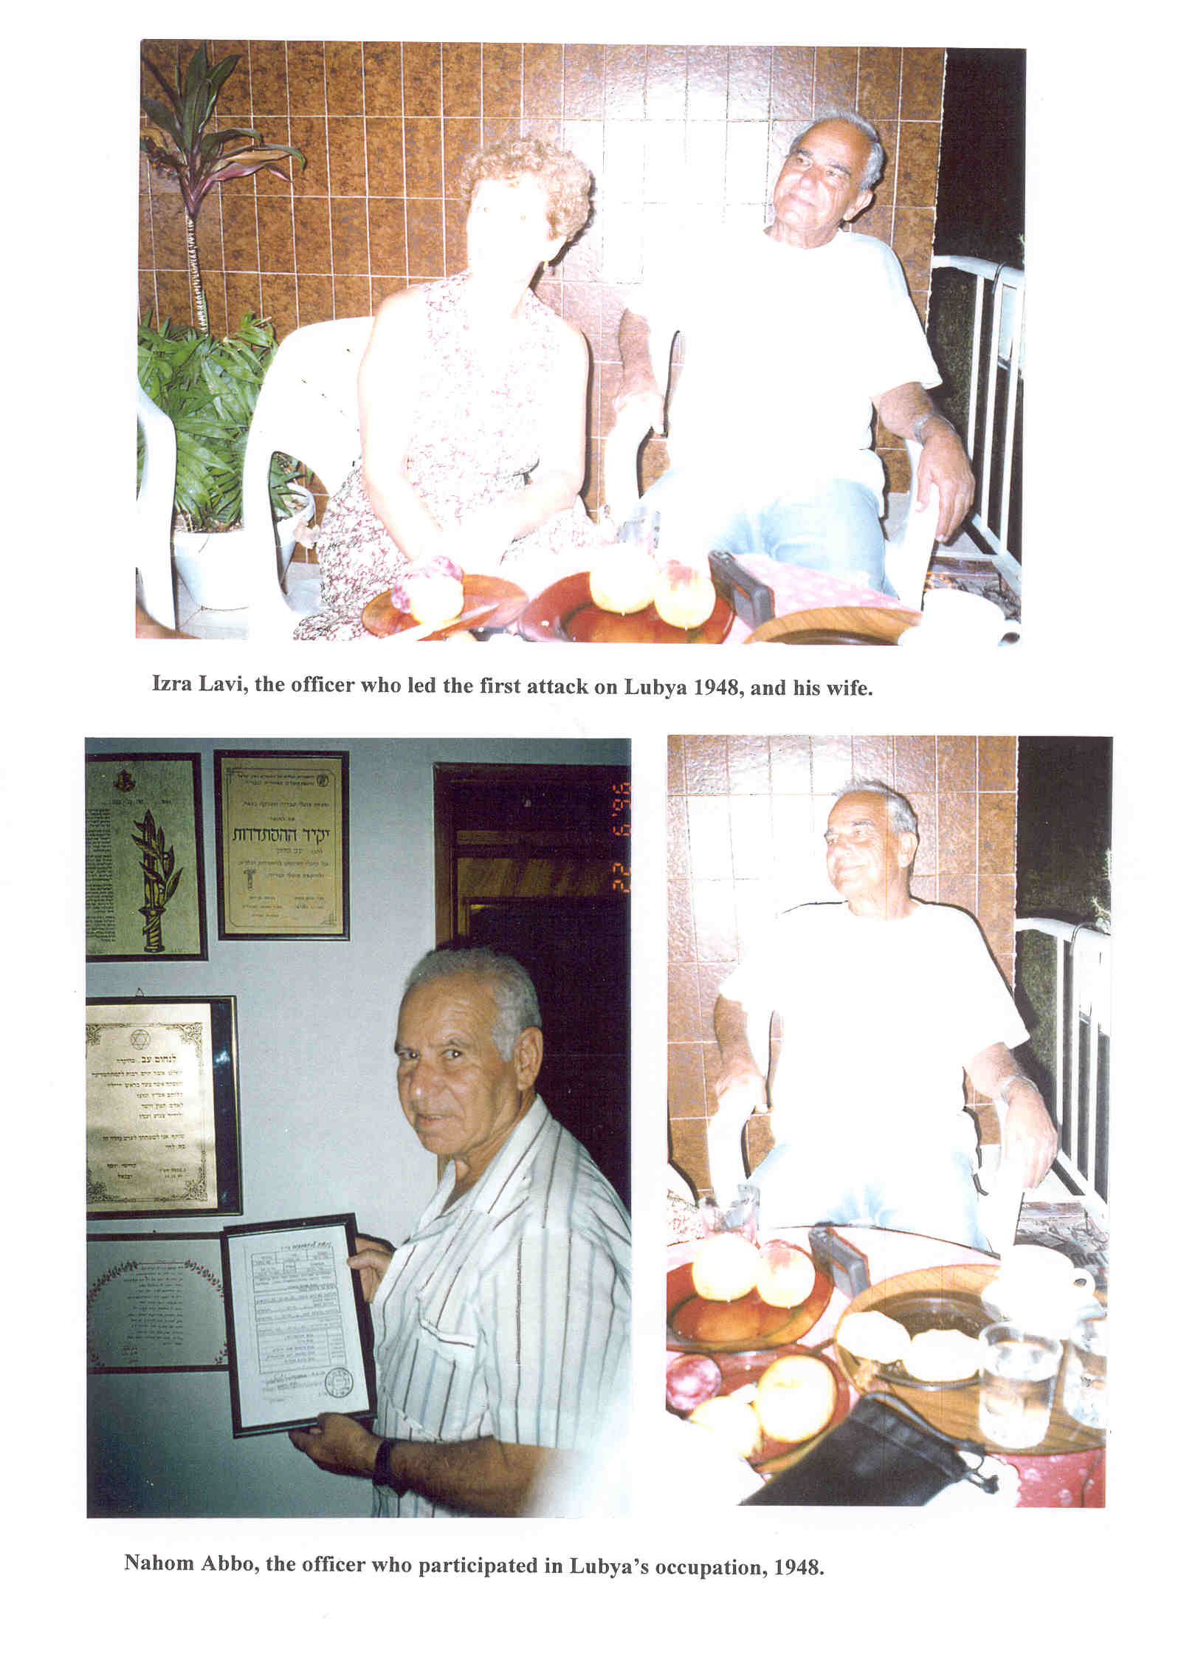

Slide 24
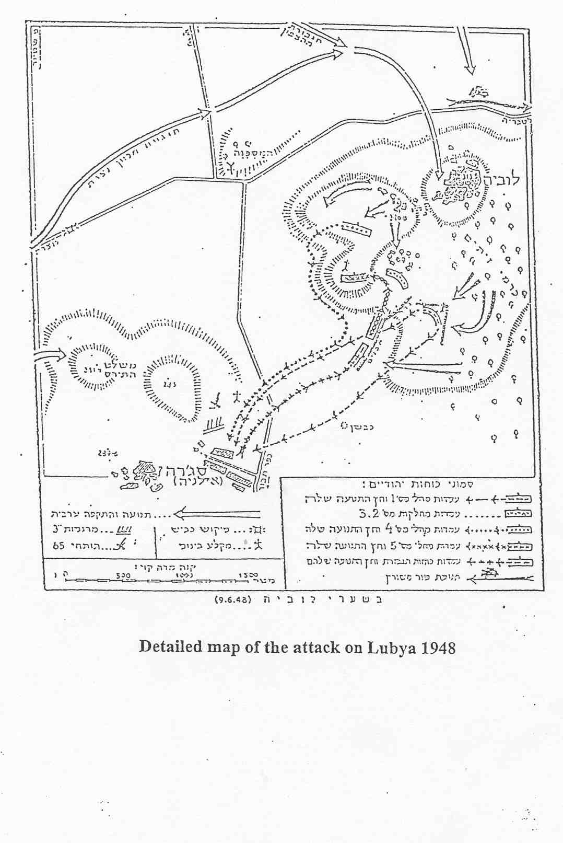

Slide 25
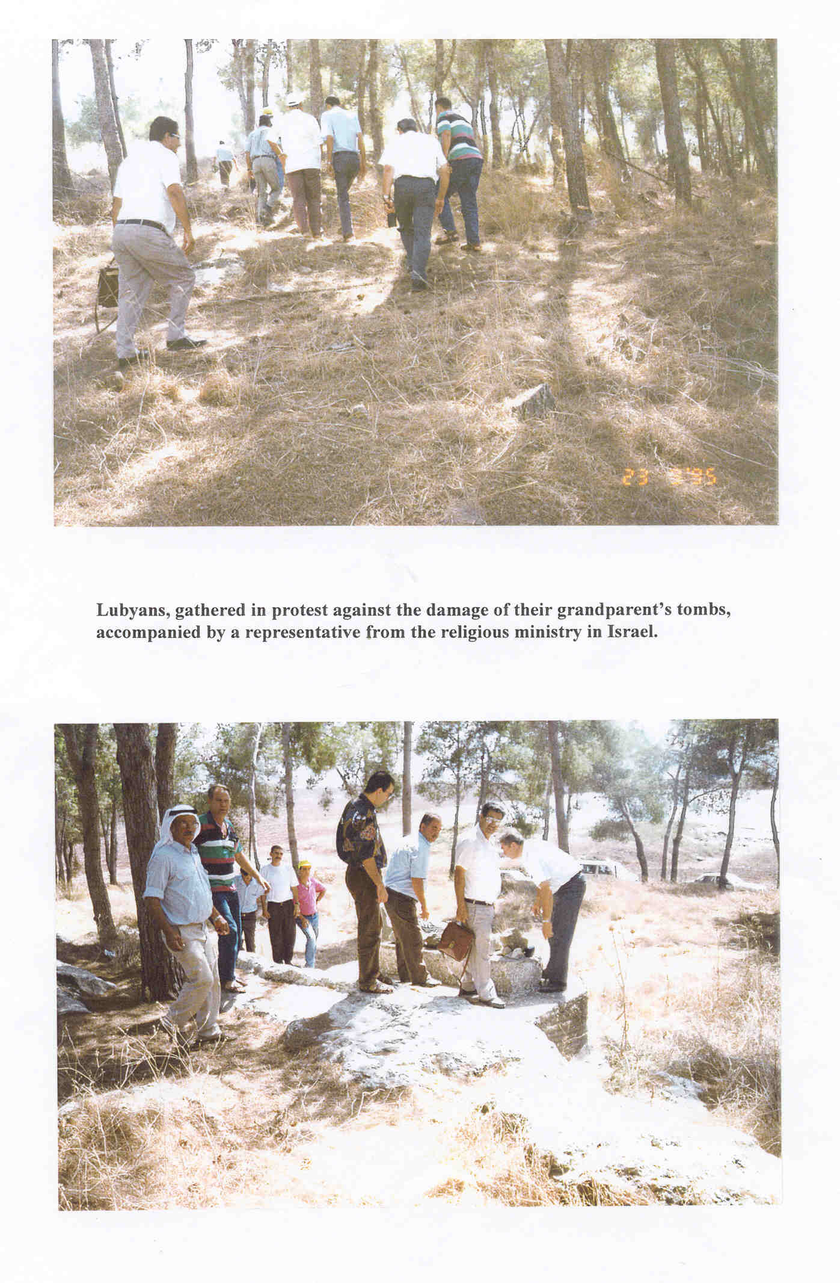

Slide 26
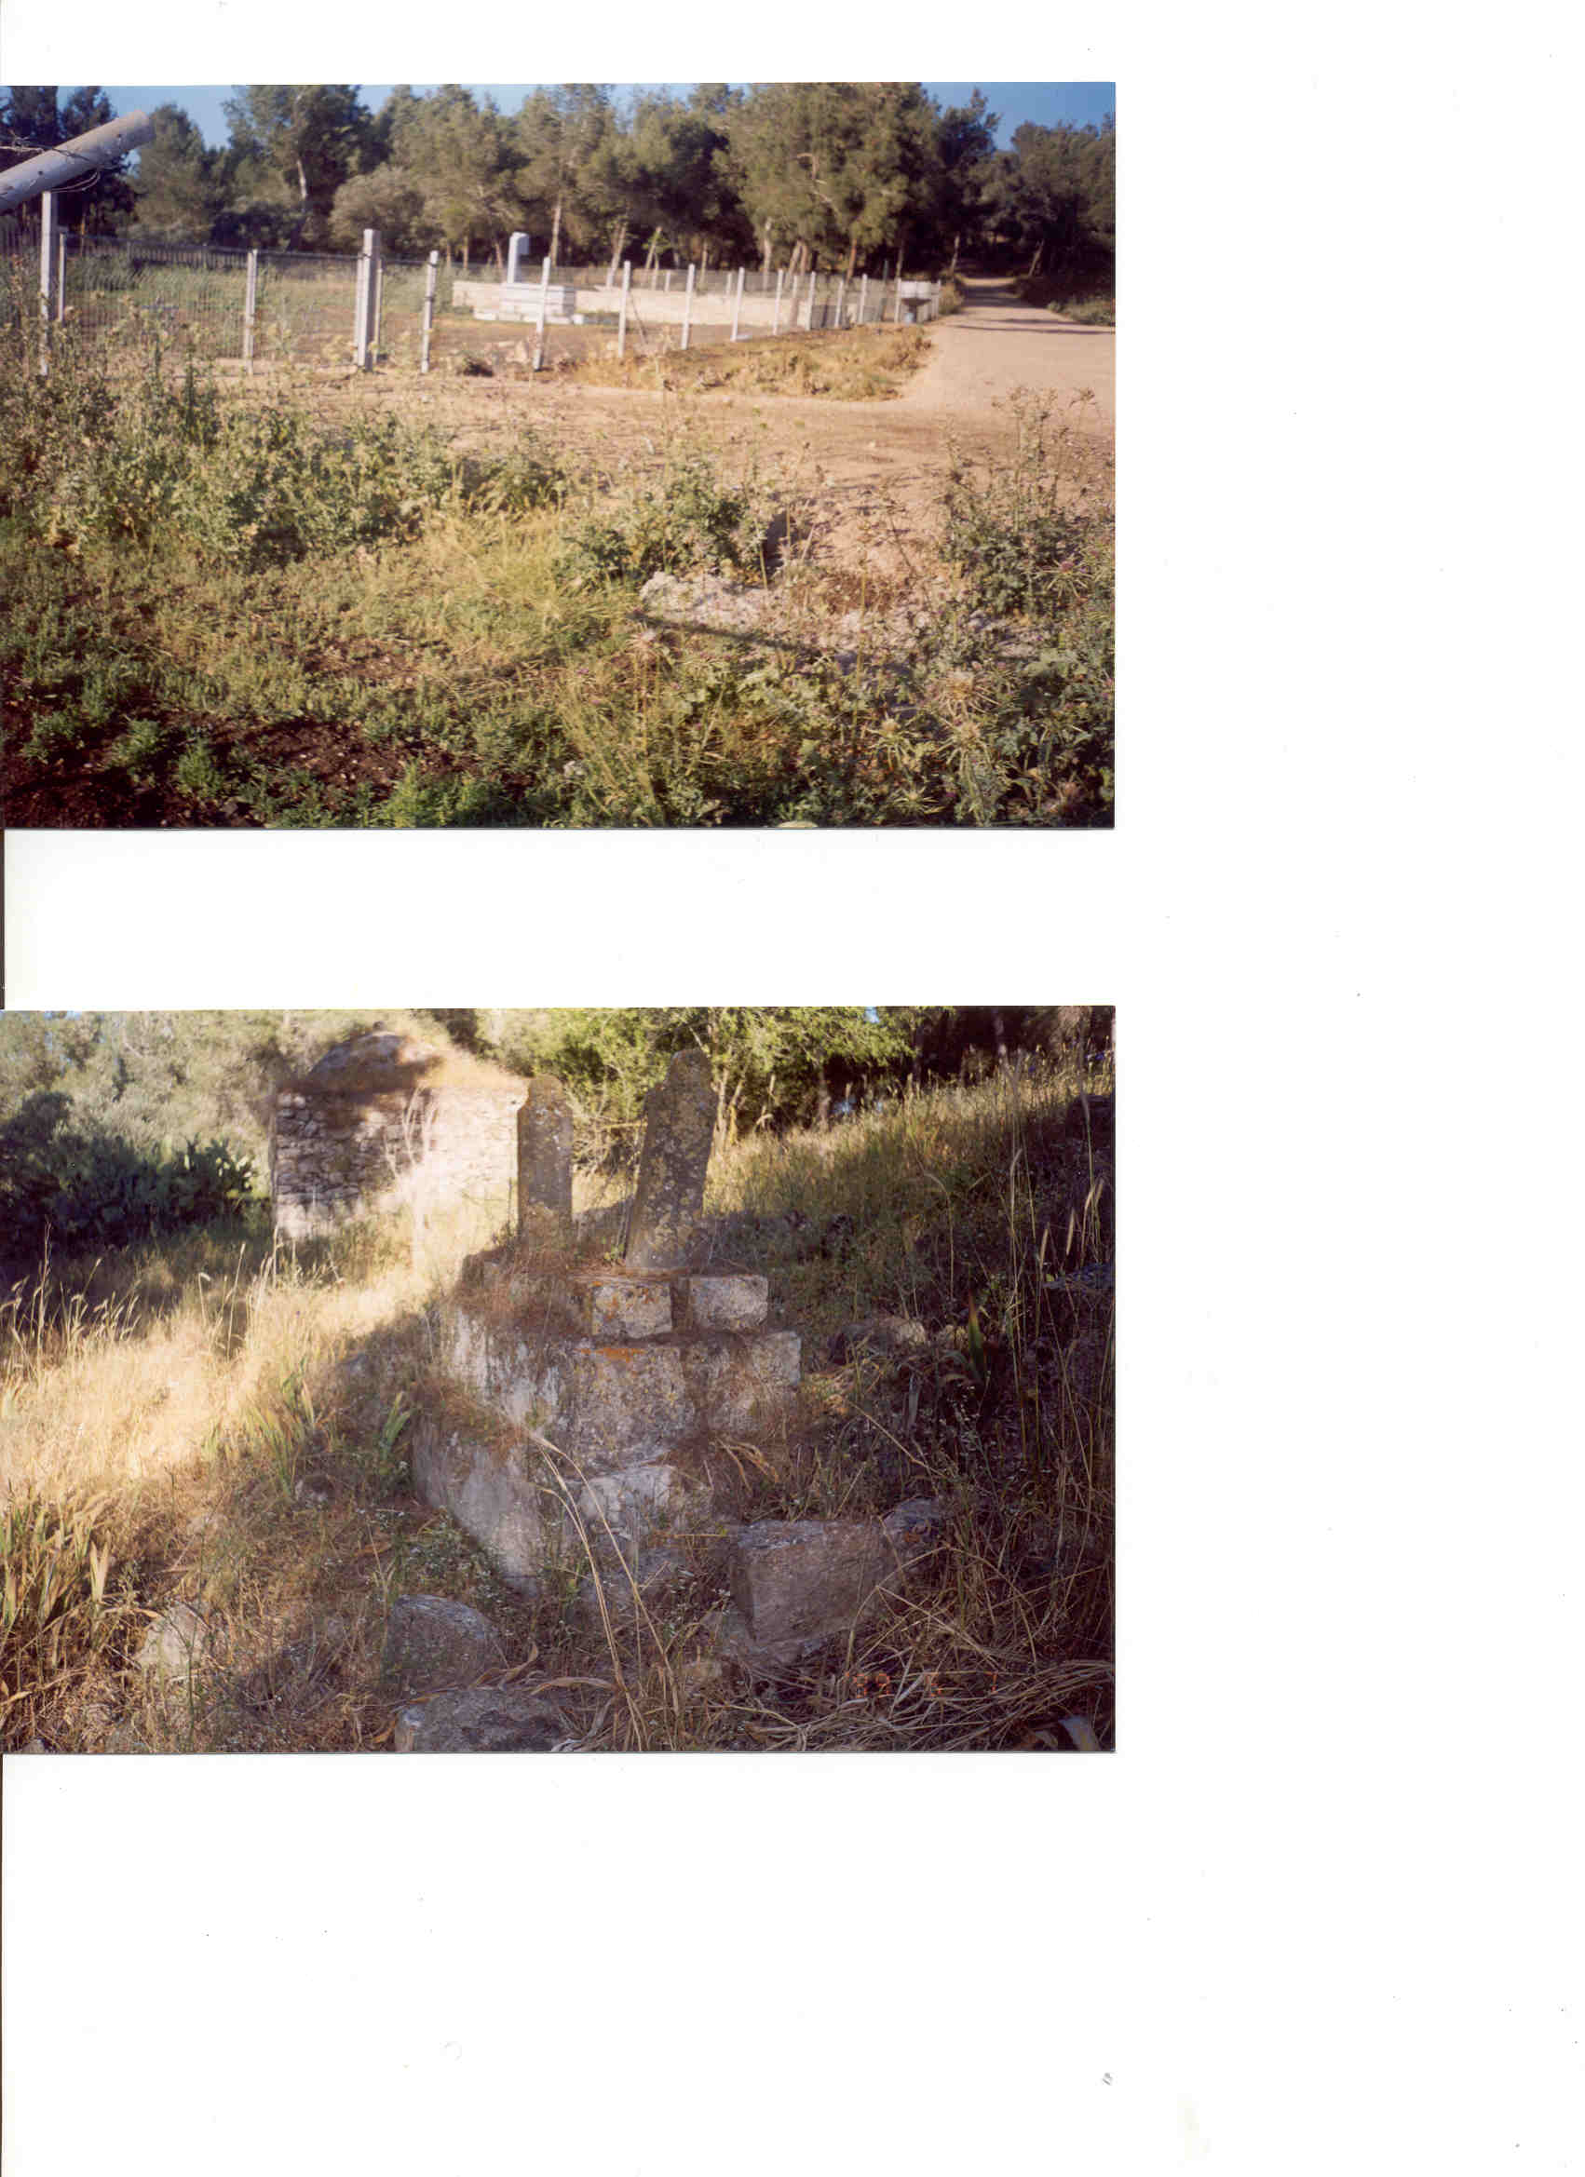
Above: Israeli graves newly built on Lubya’s land in the 90’s.
Below: Nearby, Lubyan cemetry left without care since 1948

Slide 27
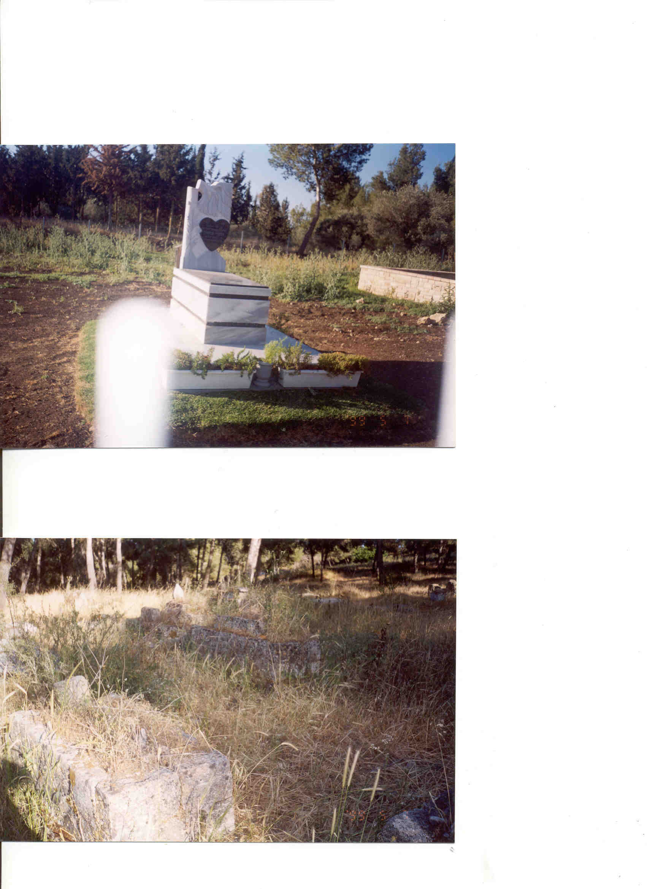
Israeli grave from the new settlement: Giv’at Avny on Lubya’s land
Lubyan cemetry from 1948

Slide 28
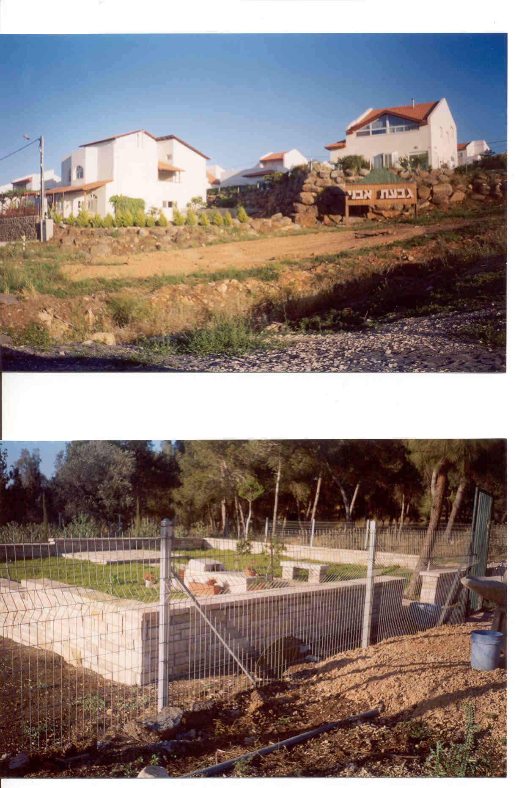
The new settlement and its cemetry

Slide 29
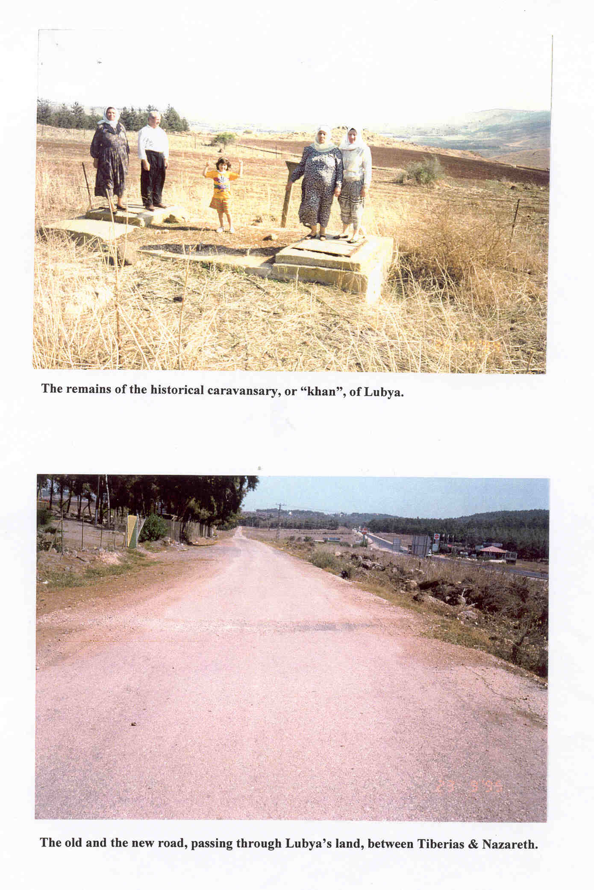

Slide 30
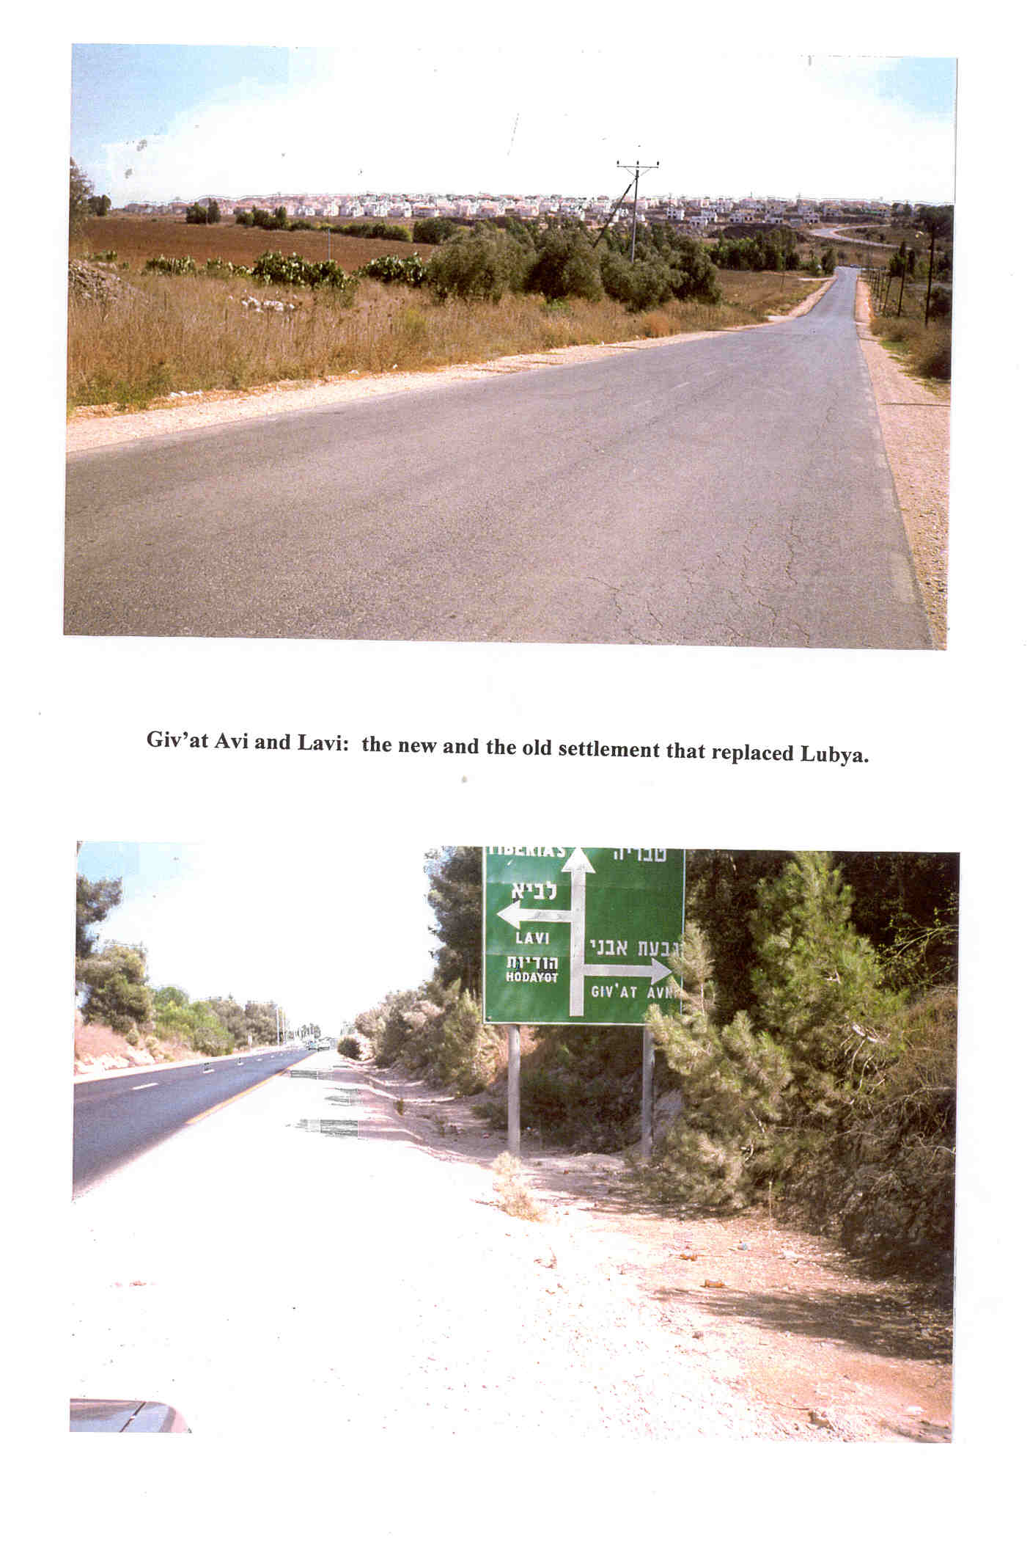

Slide 31
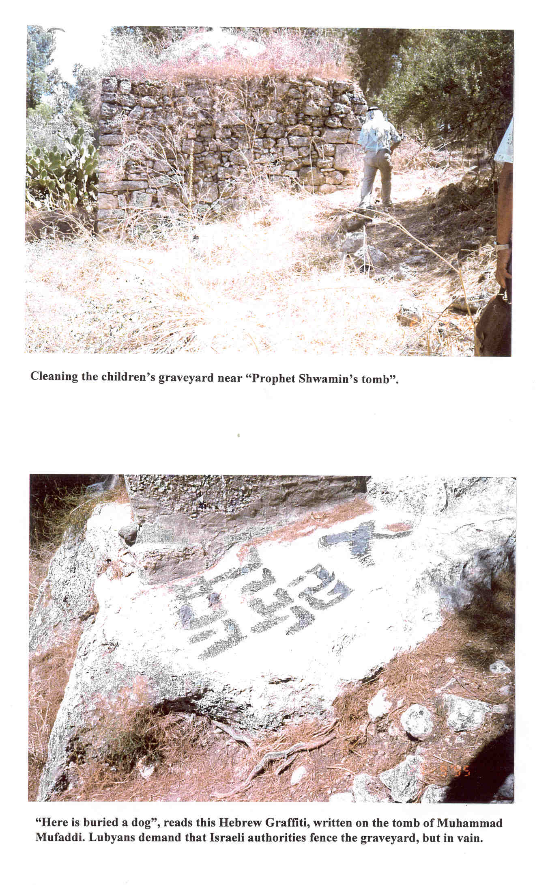

Slide 32
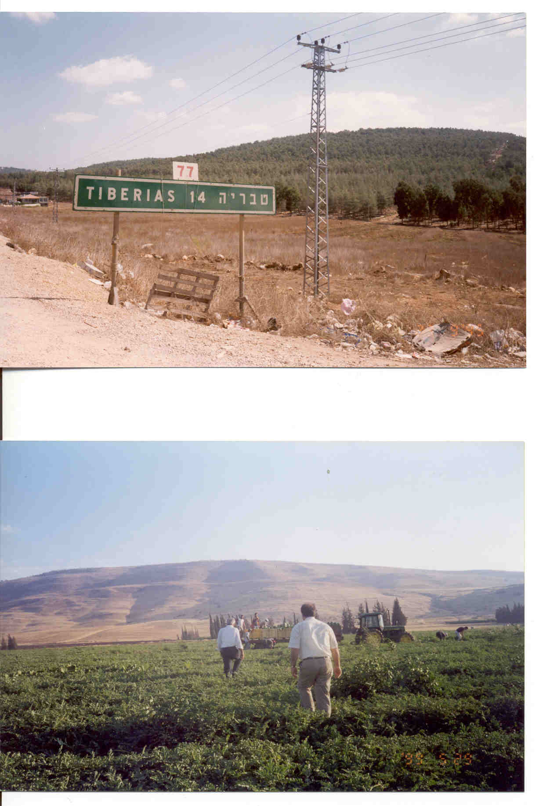

Slide 33
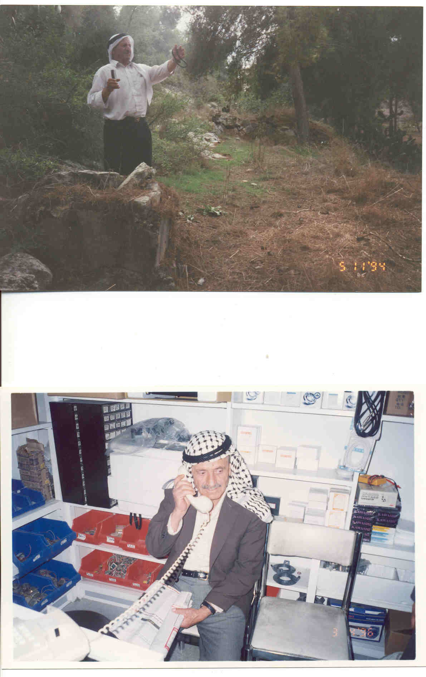
Naef Hassan, 72, died in Amman without any possibility of meeting his brother: visas are forbidden.

Slide 34
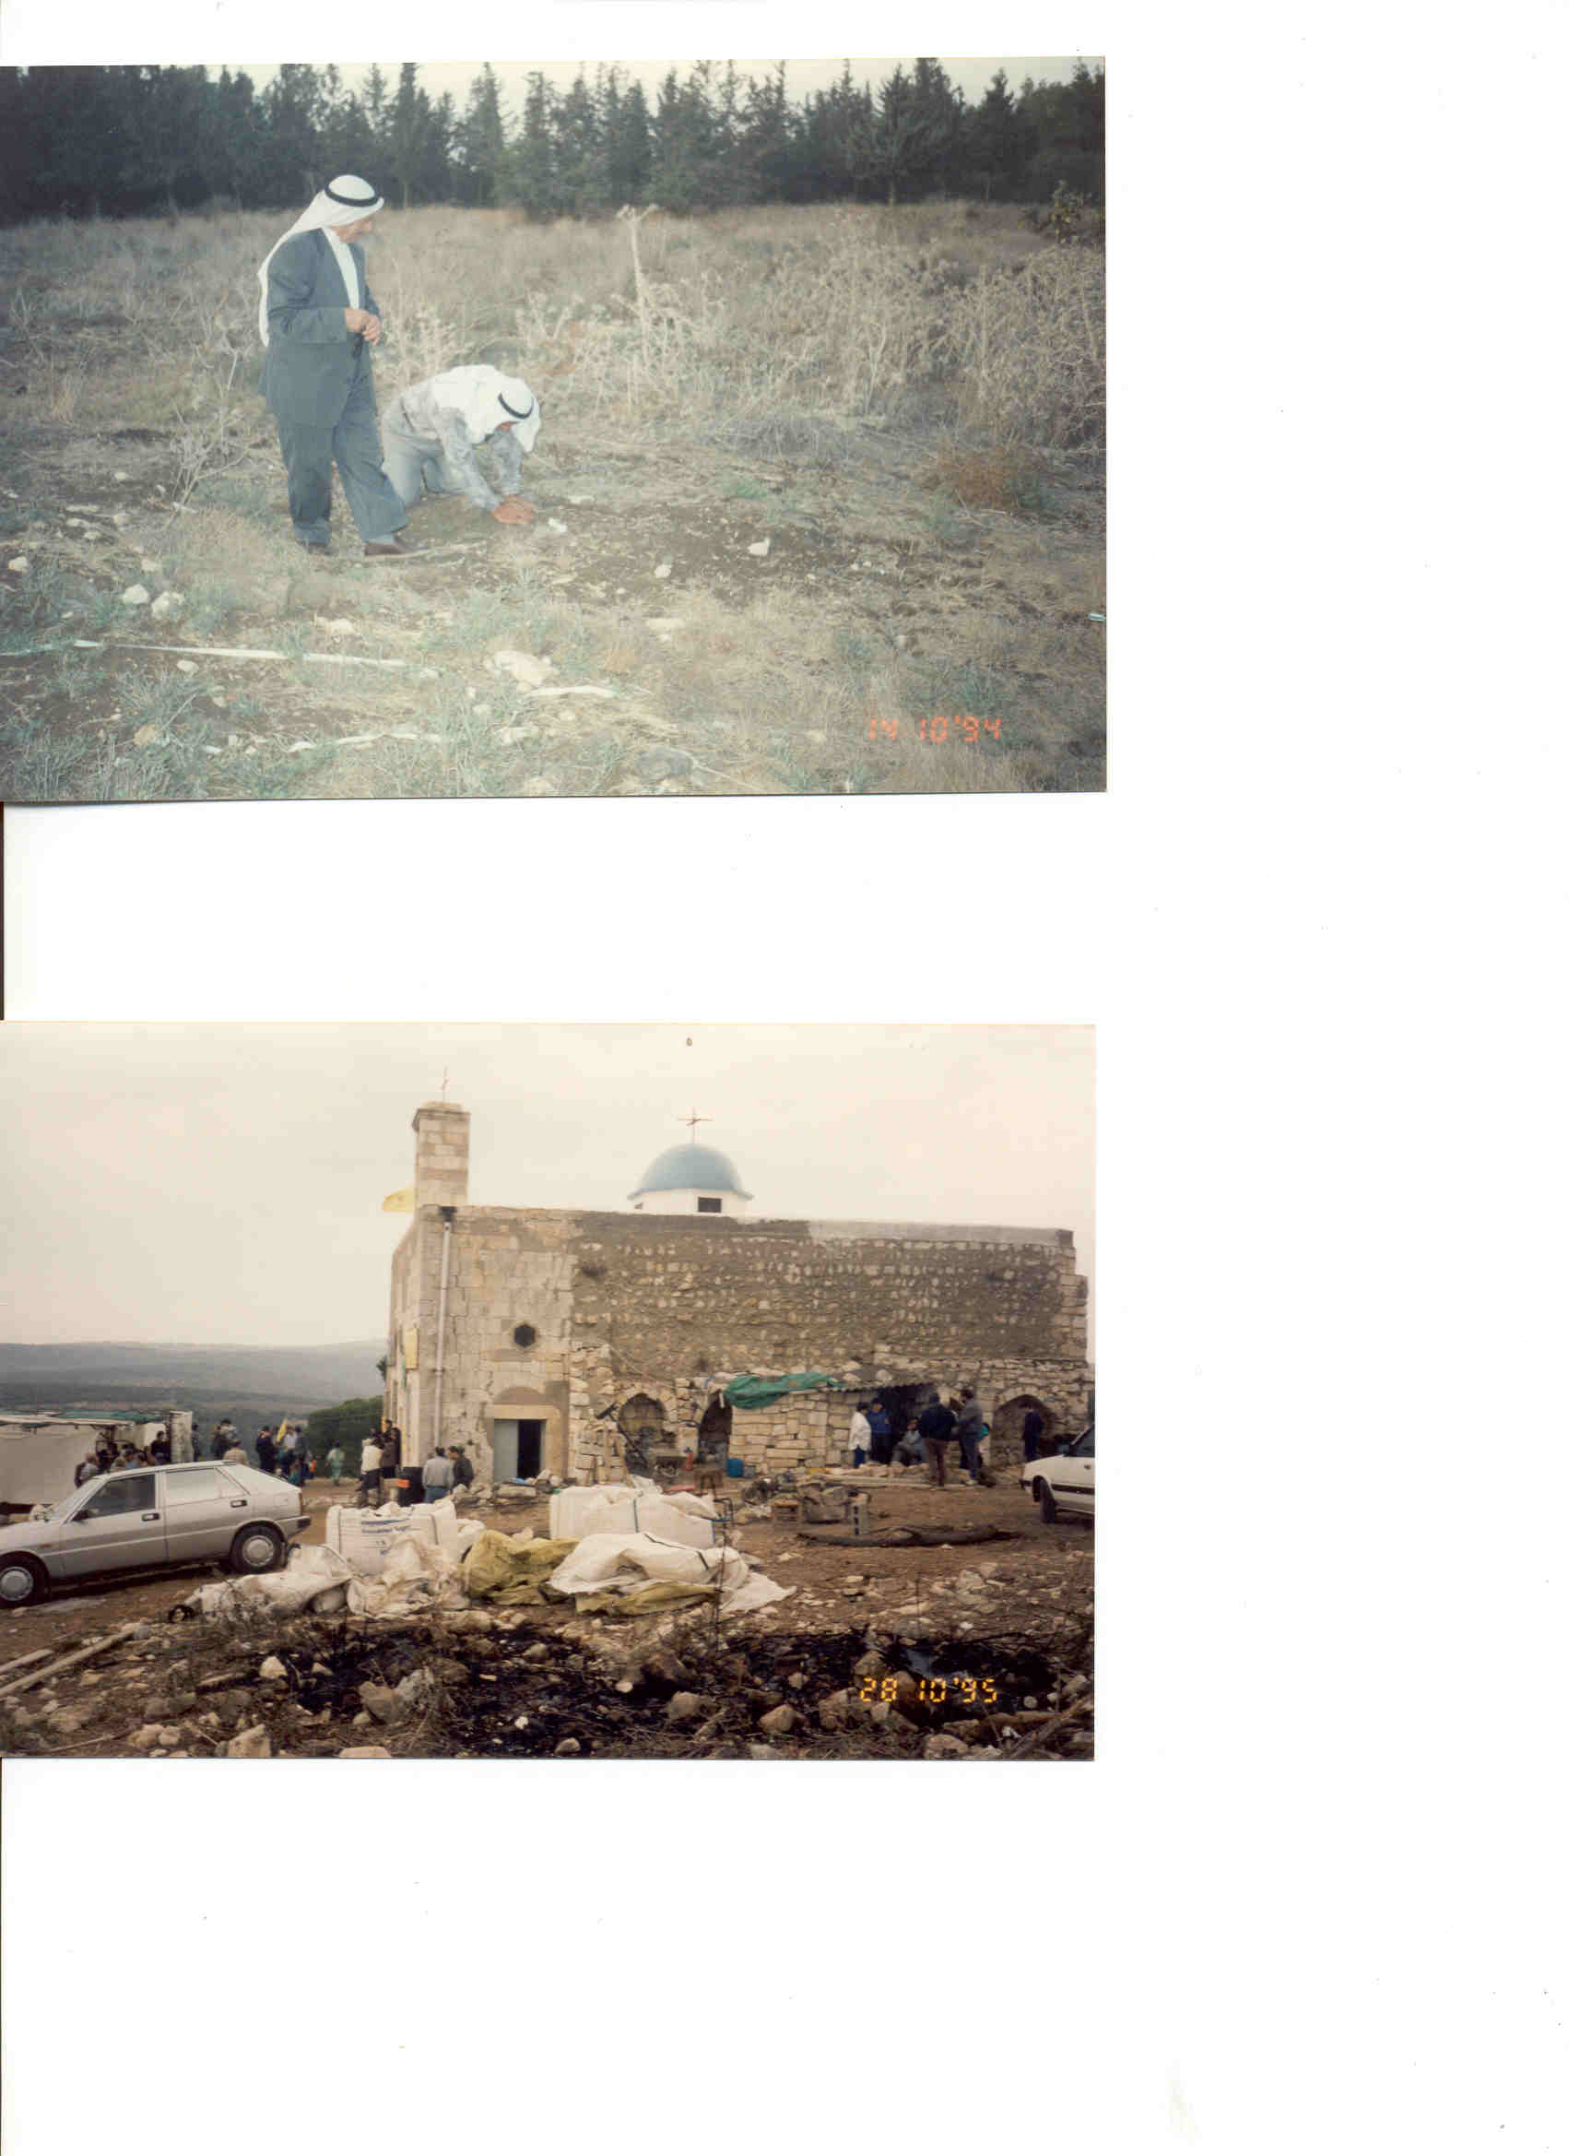
M.Ayed:Collecting a handful of earth from his land for smelling and remembering.

Slide 35
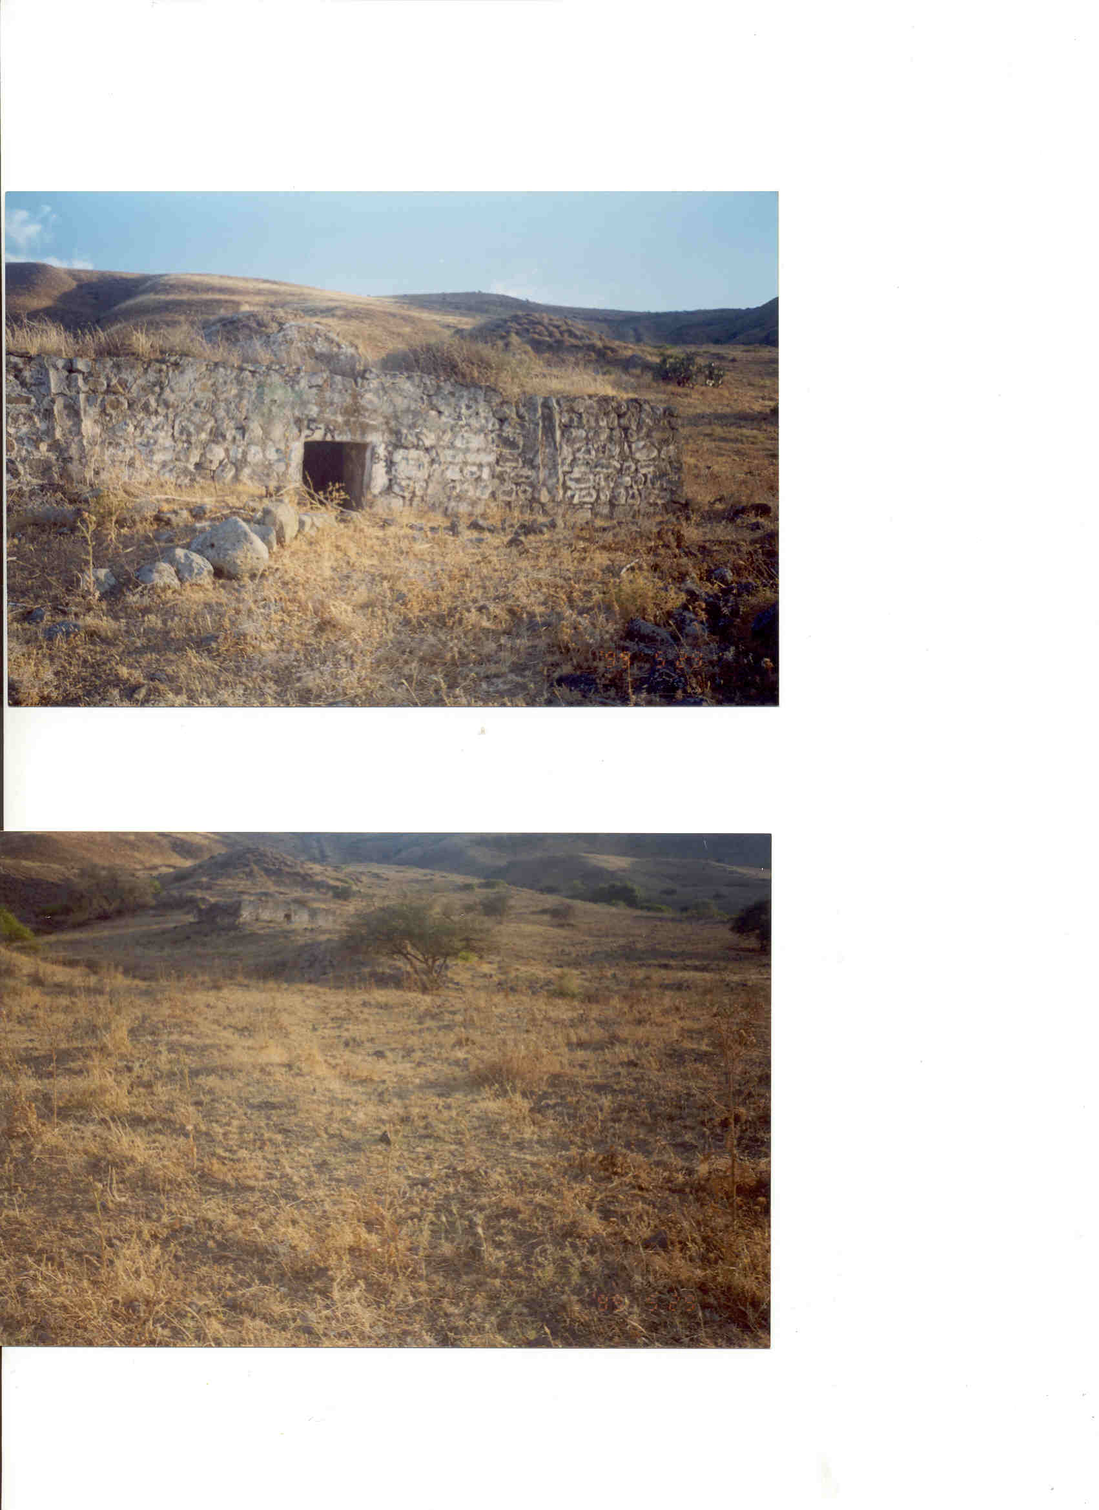
Makam Bassom where farmers store their agricultural tools

Slide 36
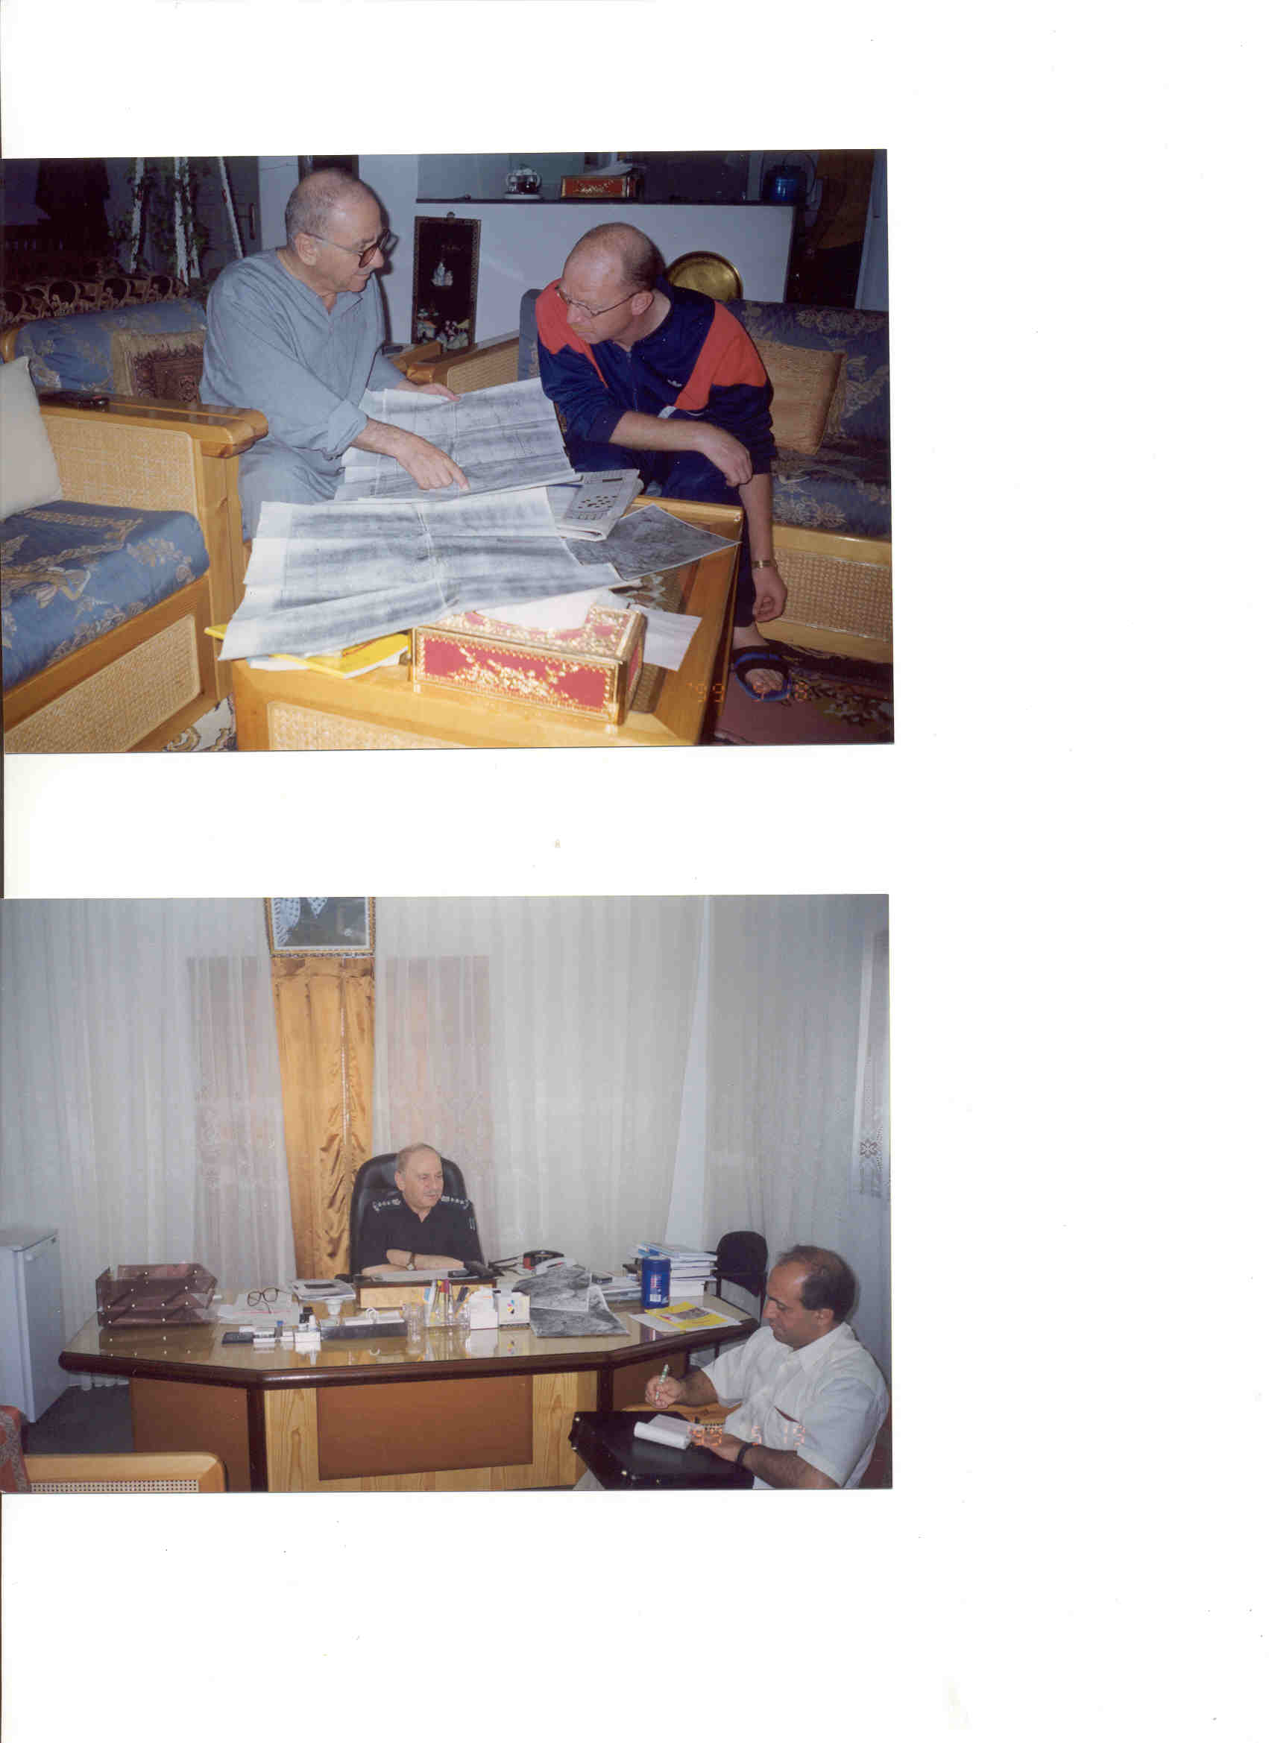
Abu Husam Hajjo showing his son Husam pictures of Lubya. Husam was prisoned 12 years in Israel for participation in a military operation, out of prison in 13.2.1997.

Slide 37
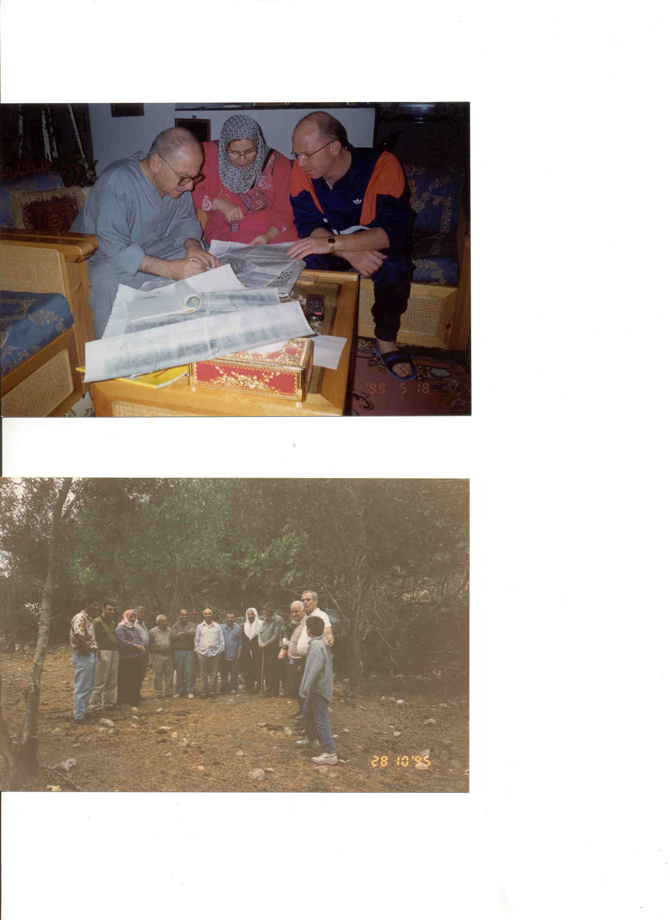
In Suhmata: 47 years after demolishing

Slide 38
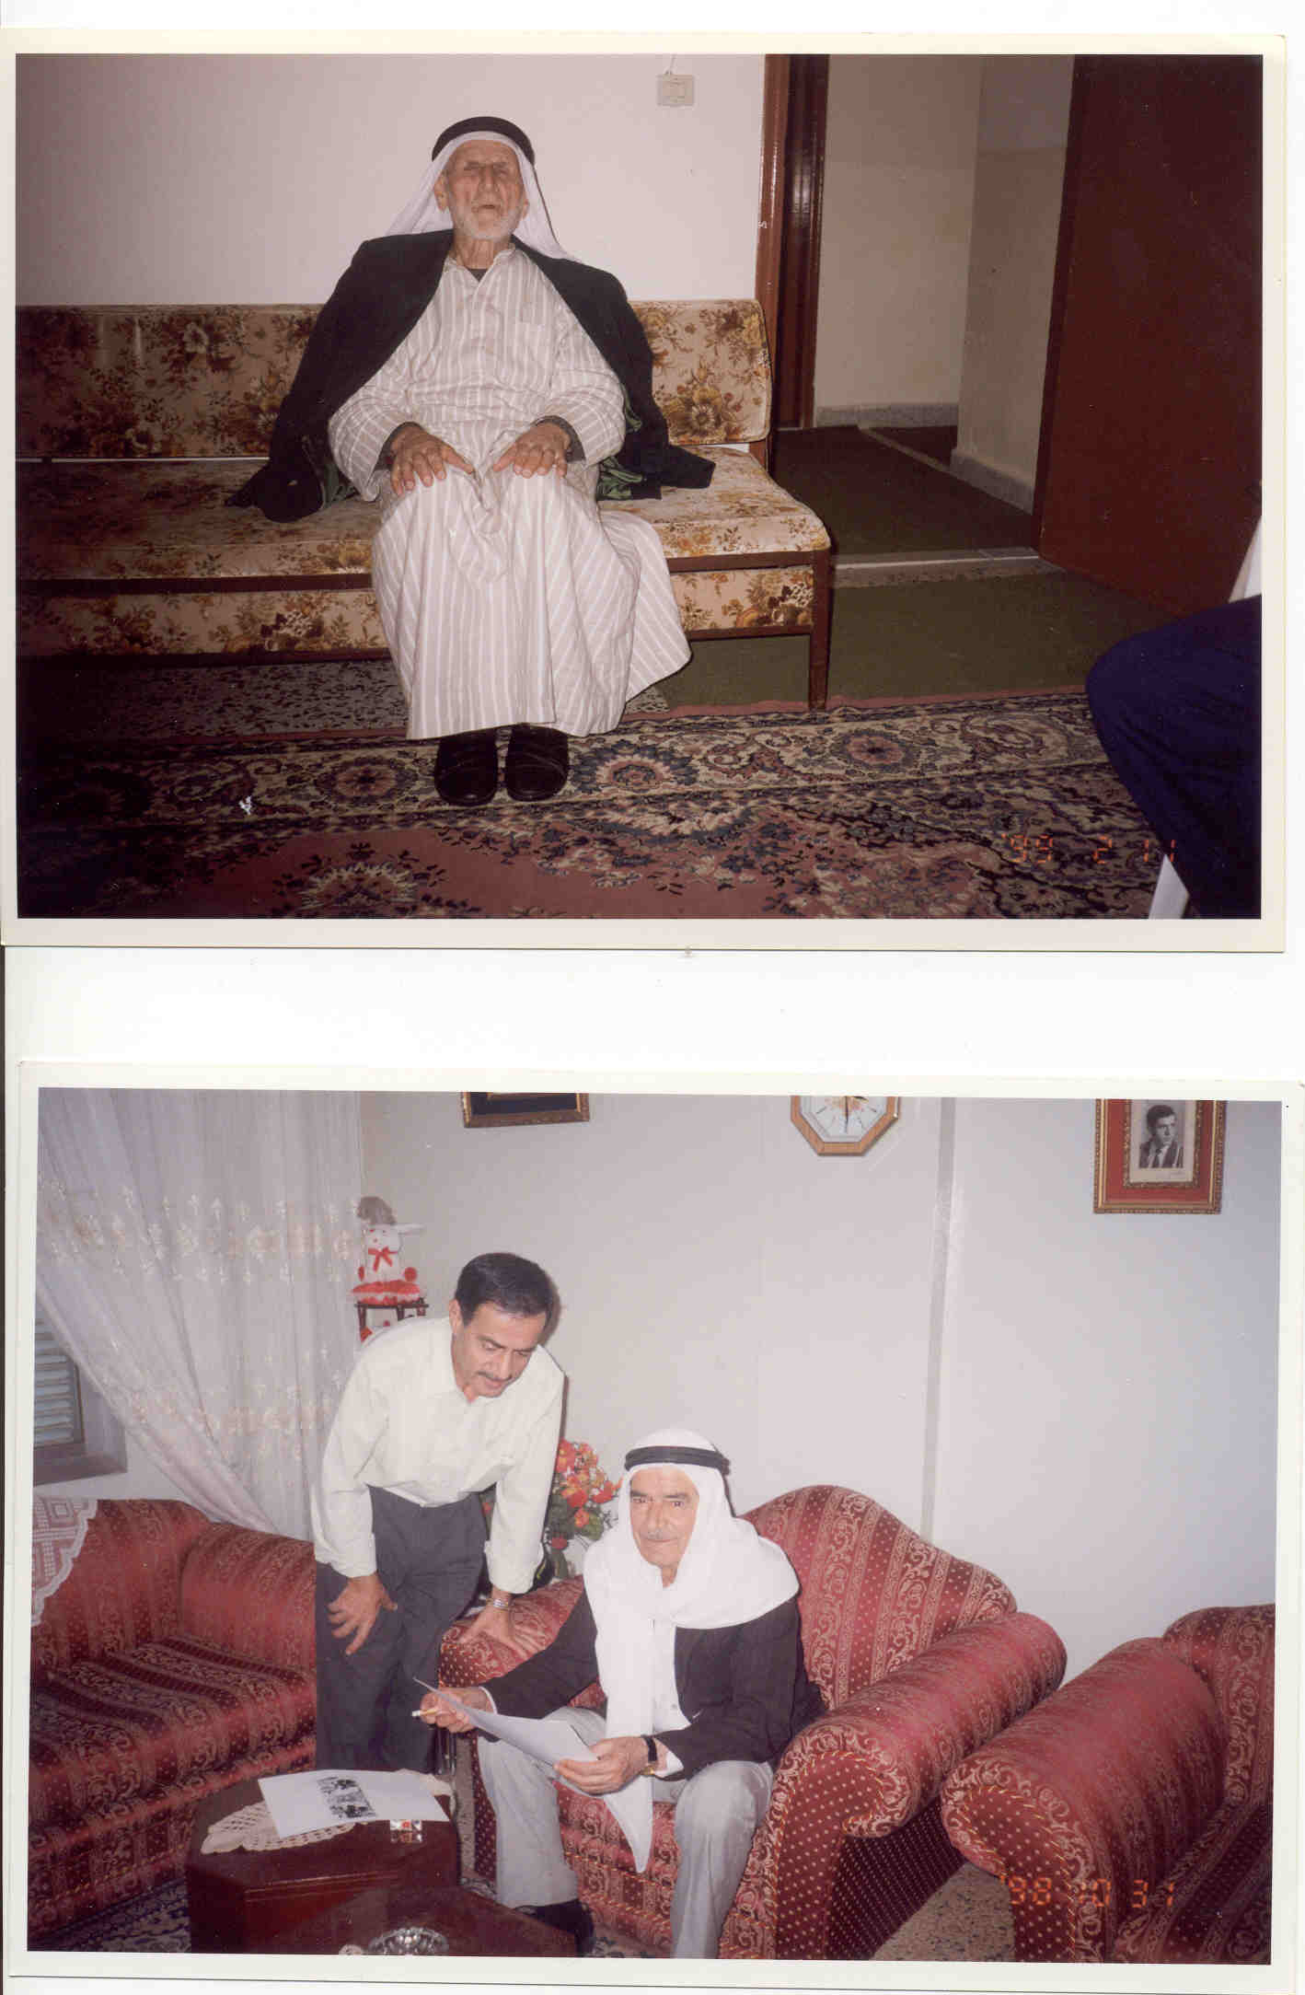
Below Dr. Husni and Abu Rasmi in Lebanon

Slide 39
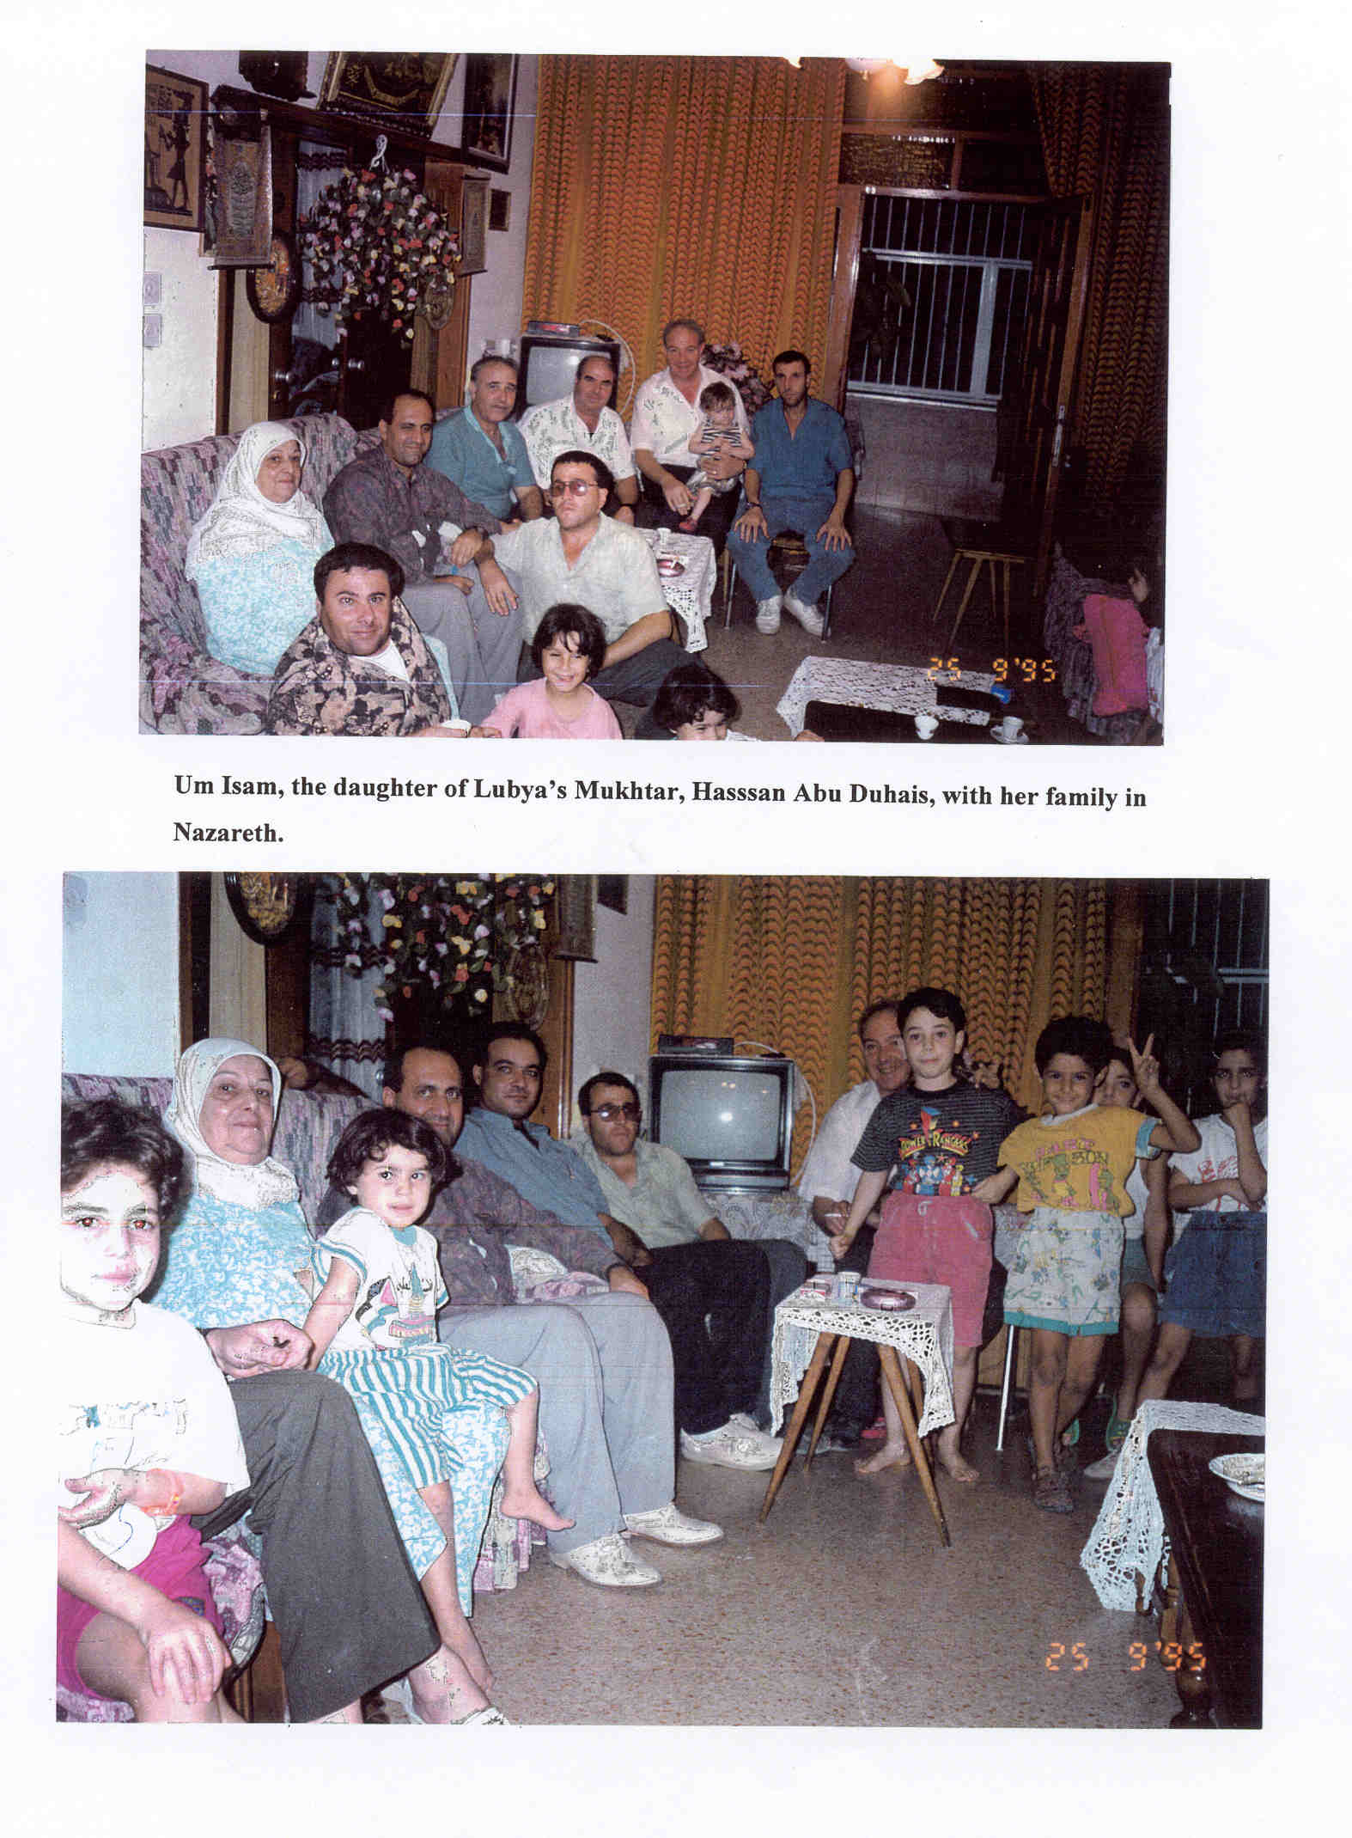

Slide 40
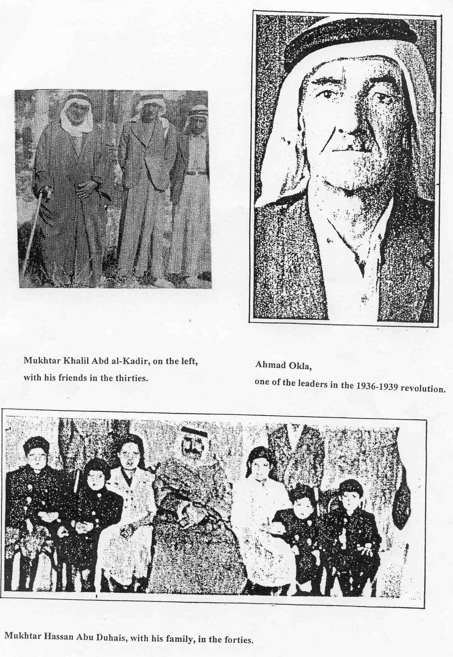

Slide 41
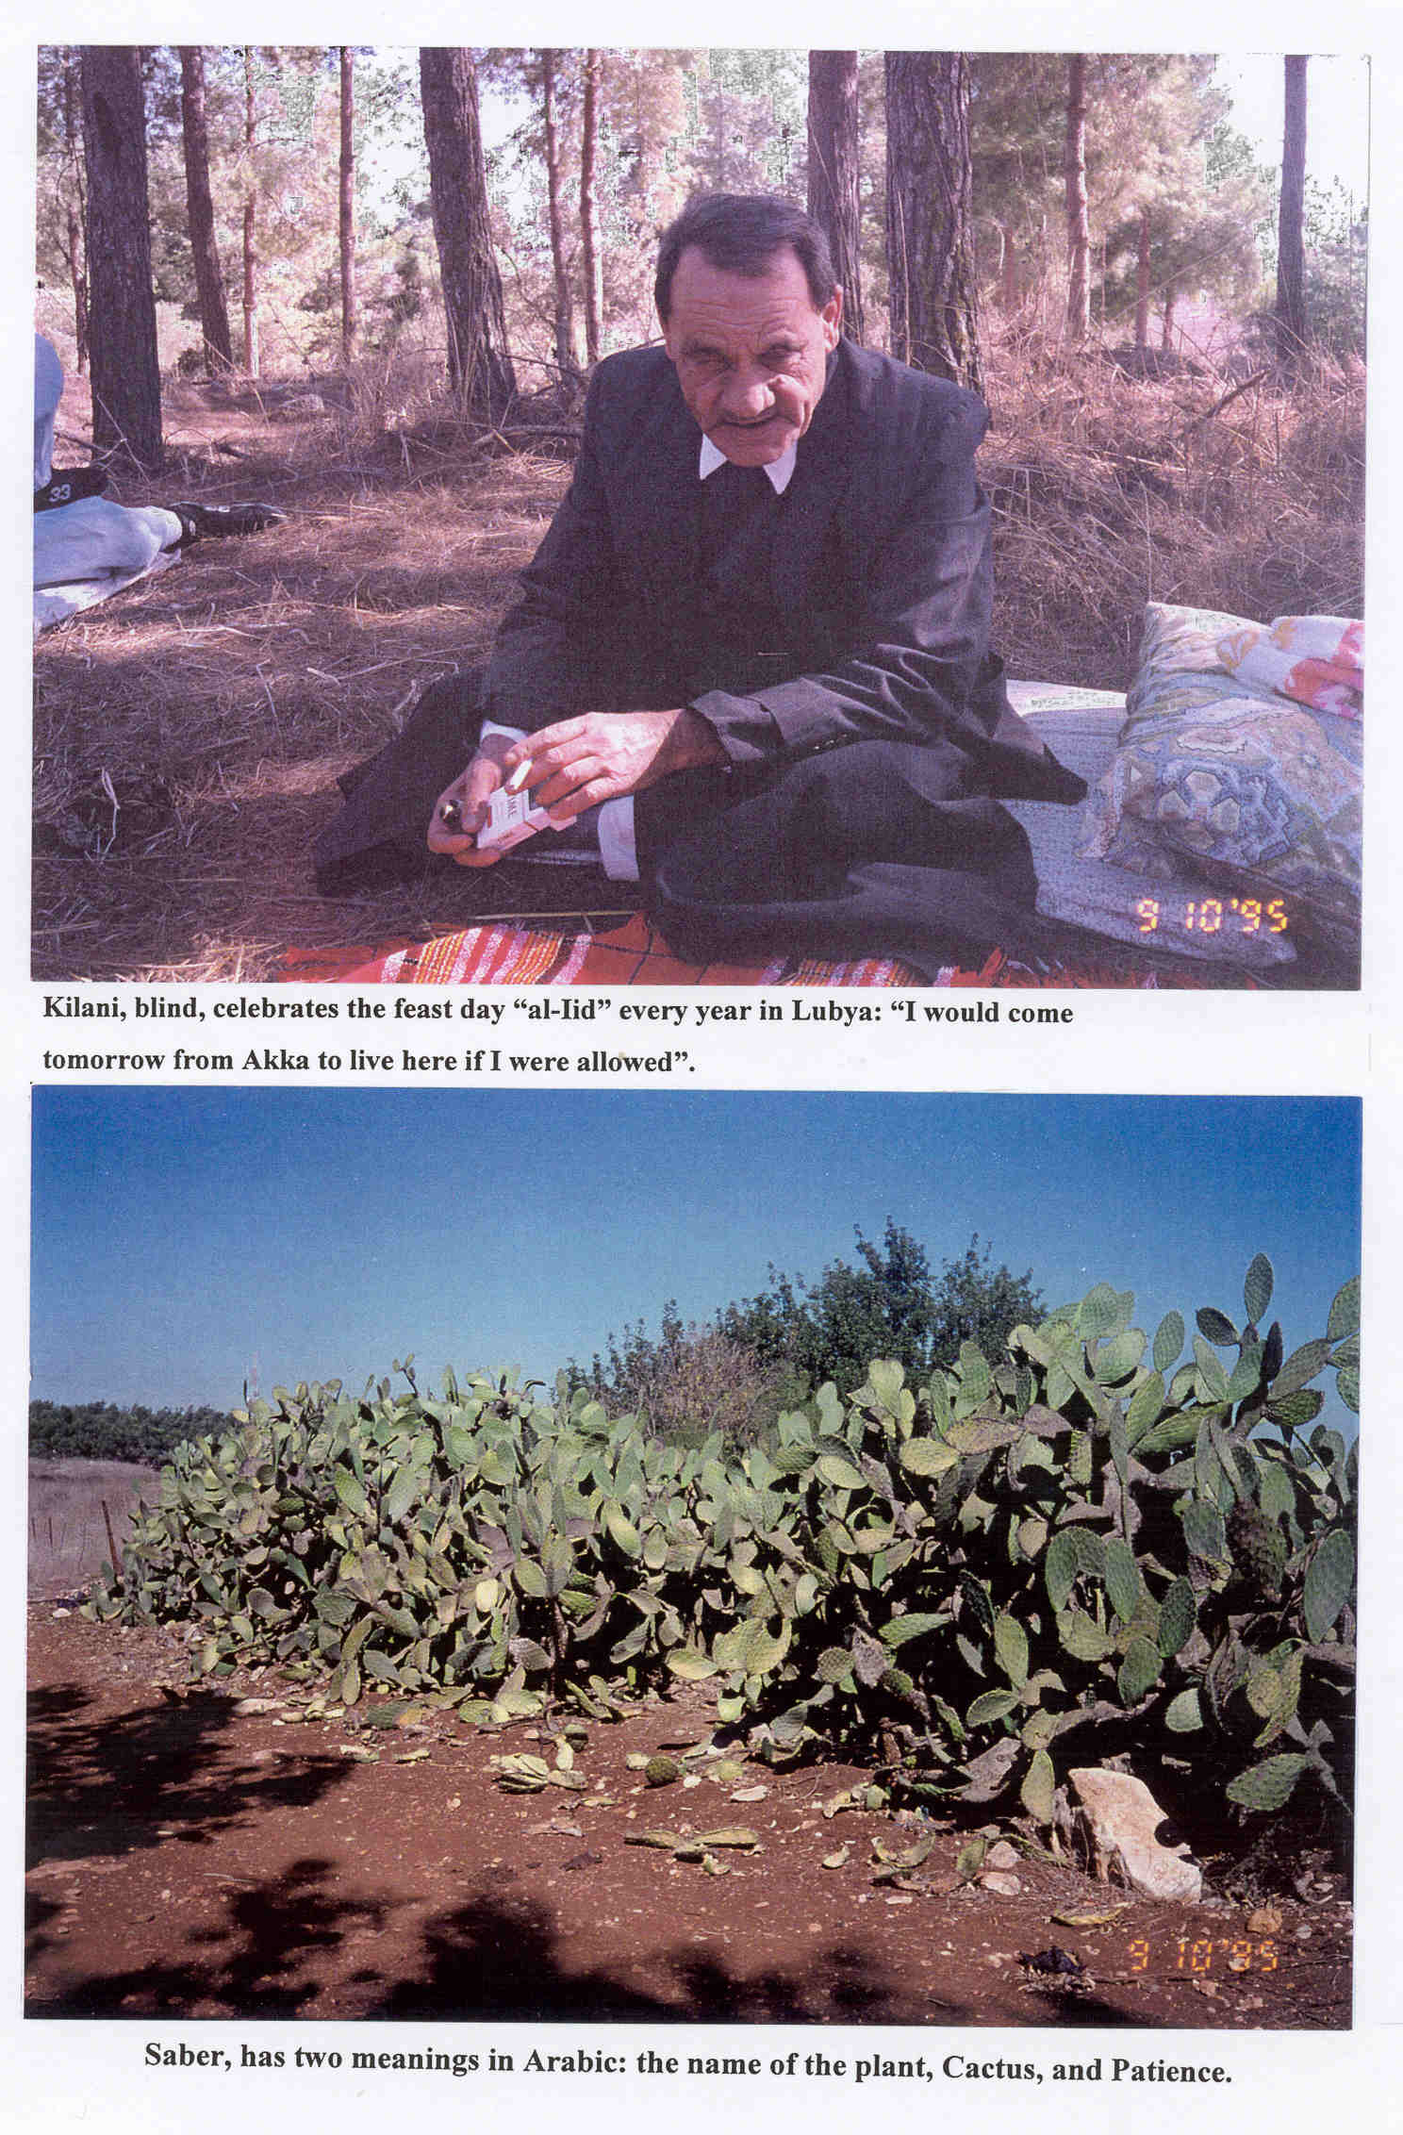

Slide 42
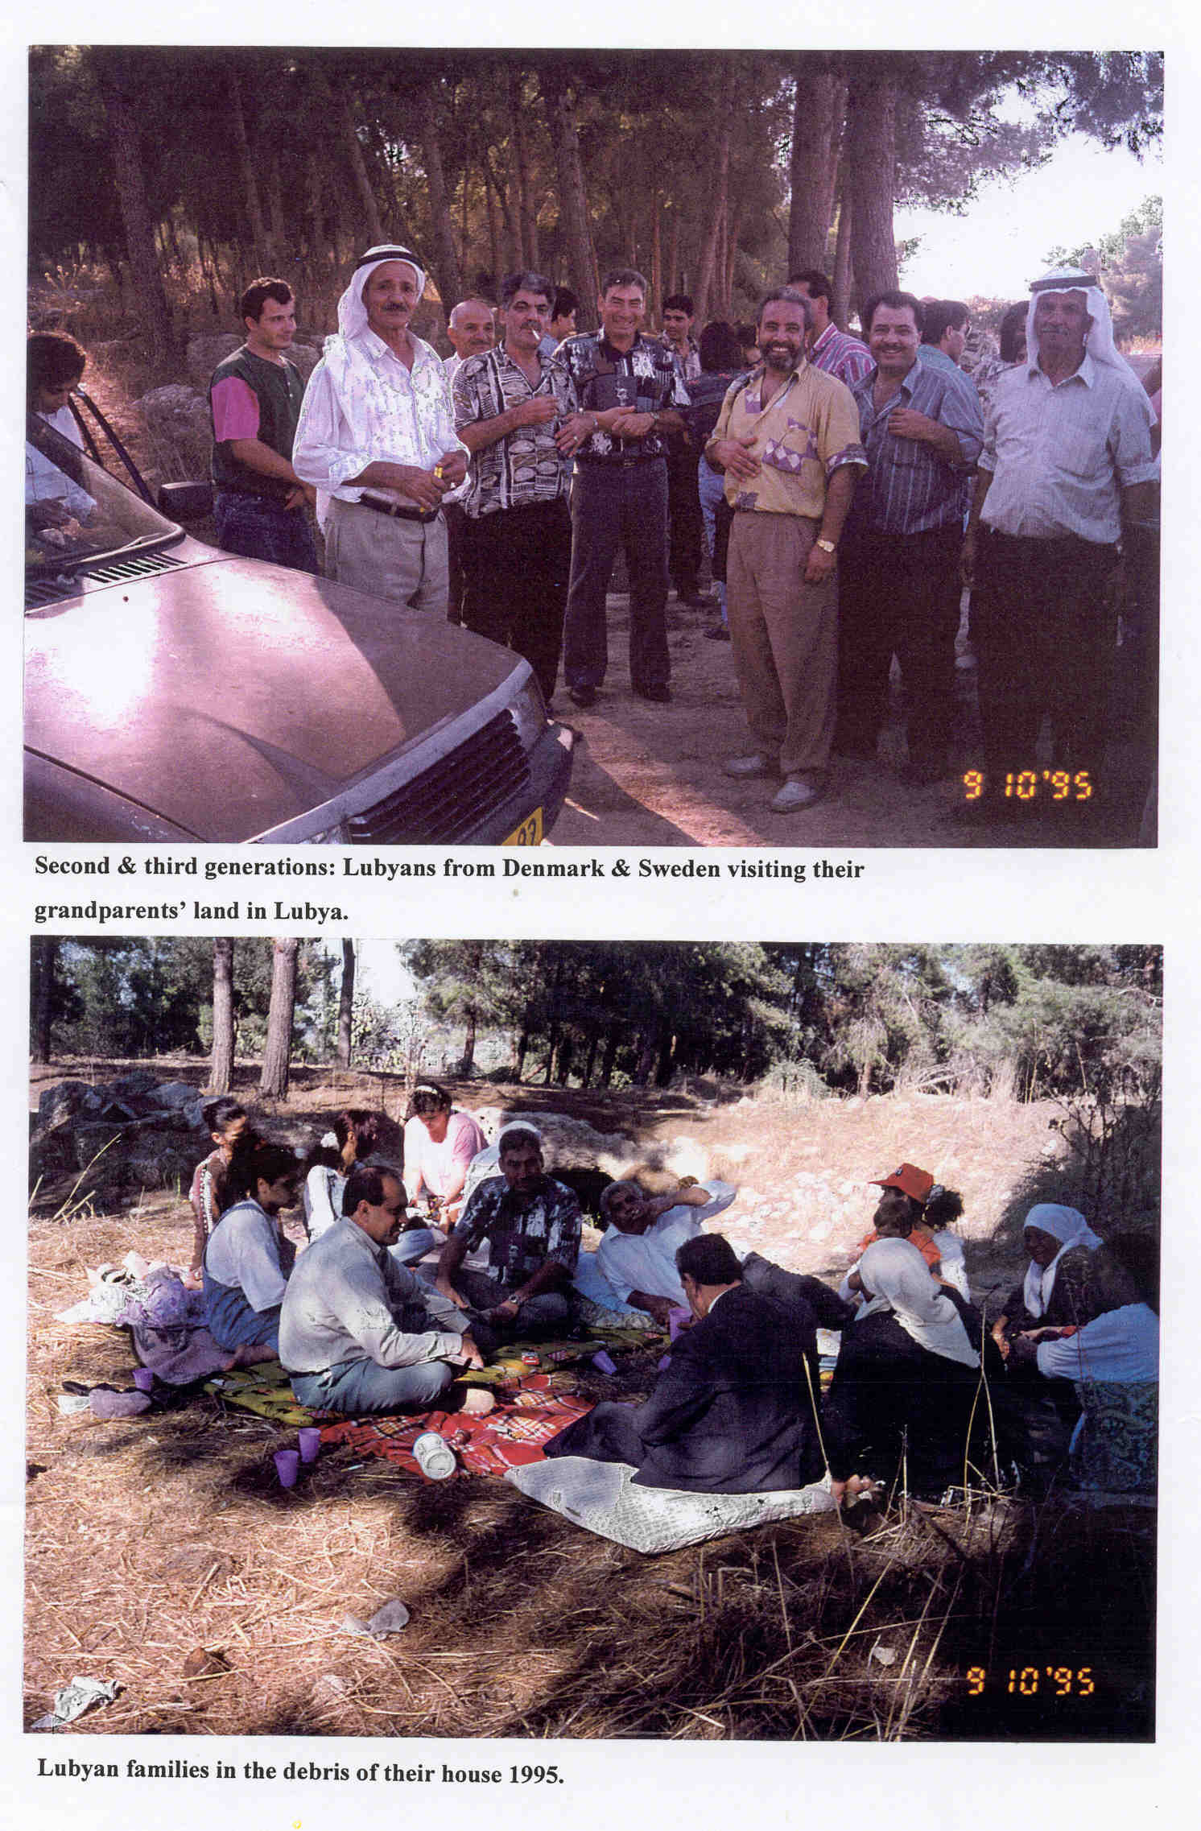

Slide 43
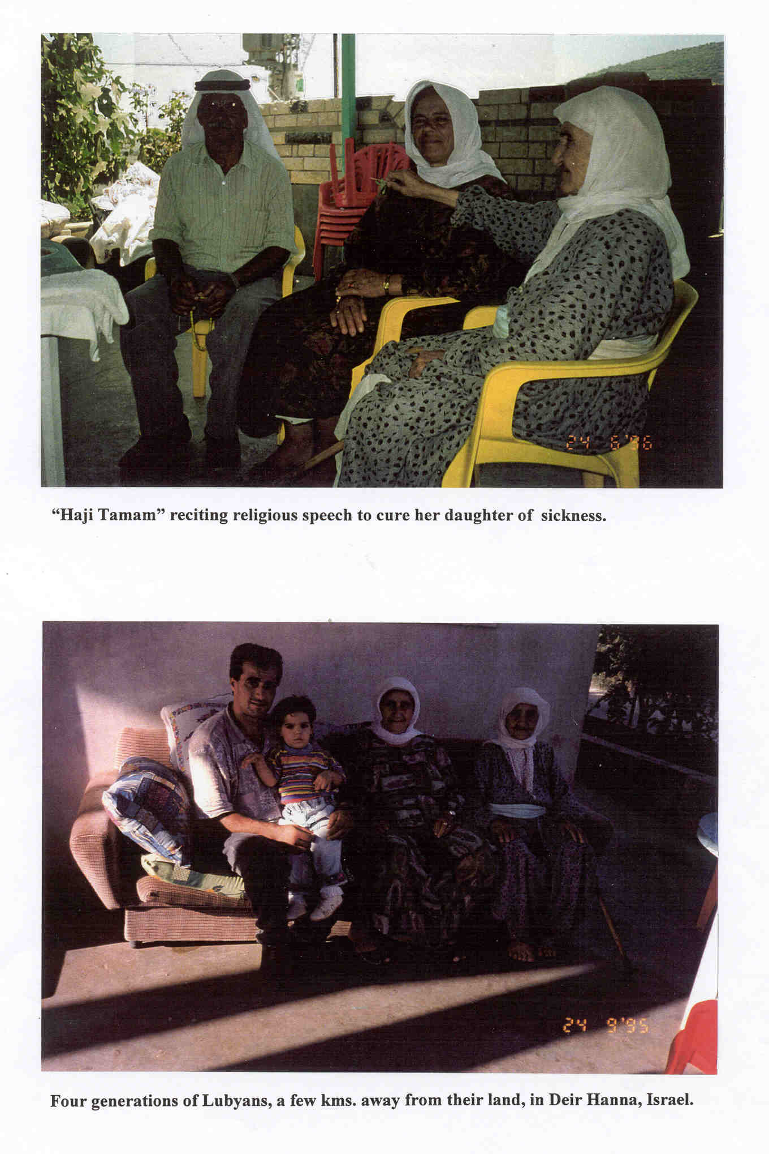

Slide 44
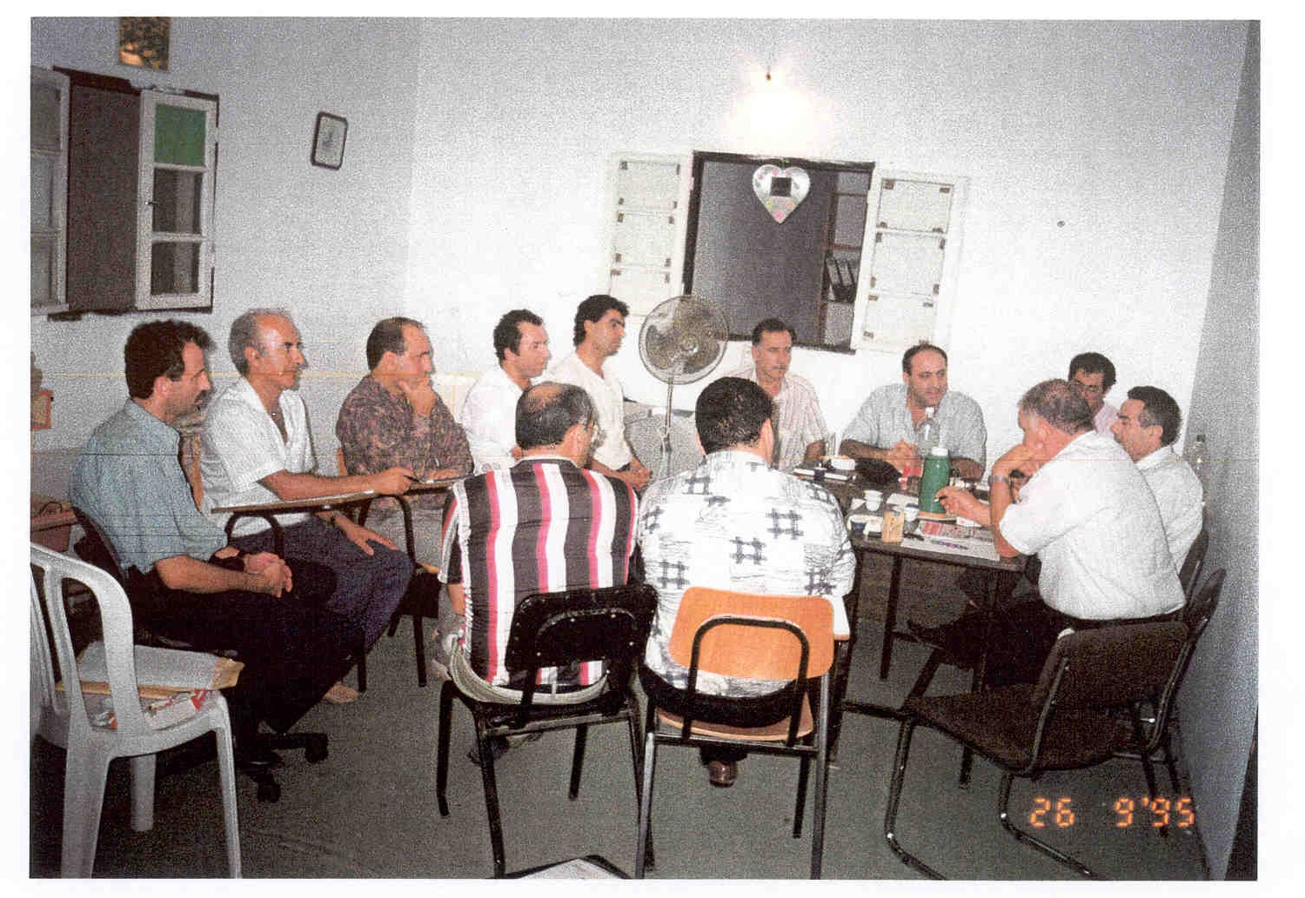
The meeting in Shafa-Amr of the Committee for Defending the Rights of the Refugees in Israel

Slide 45
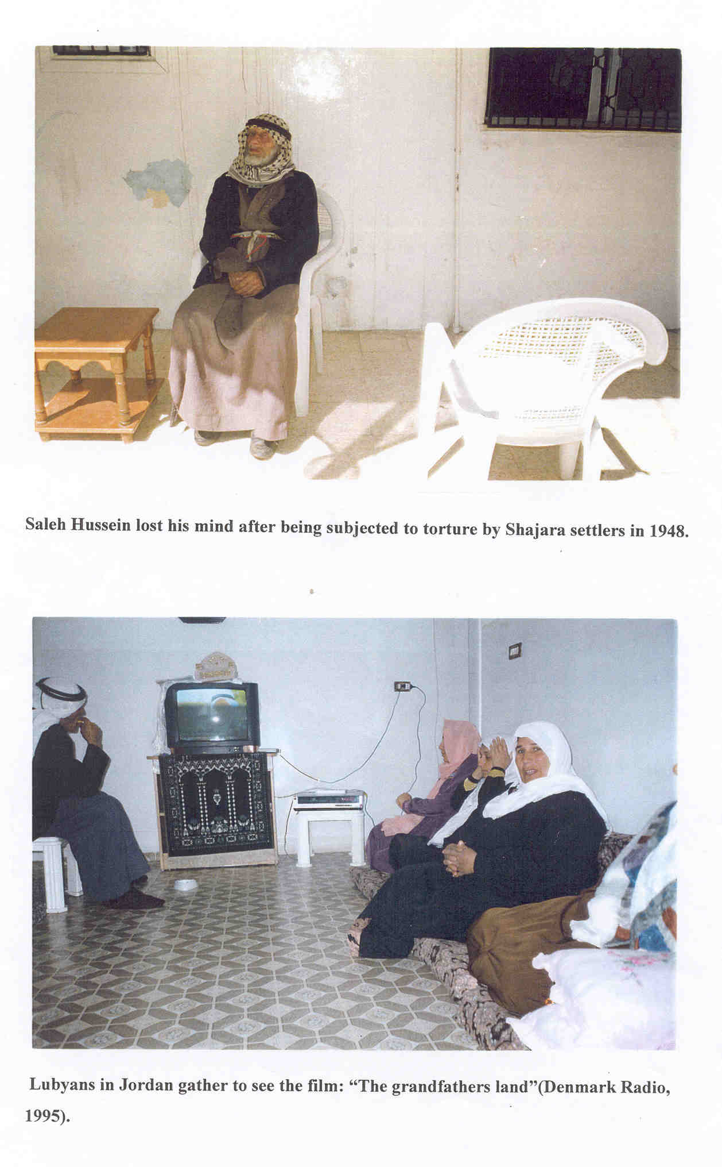

Slide 46
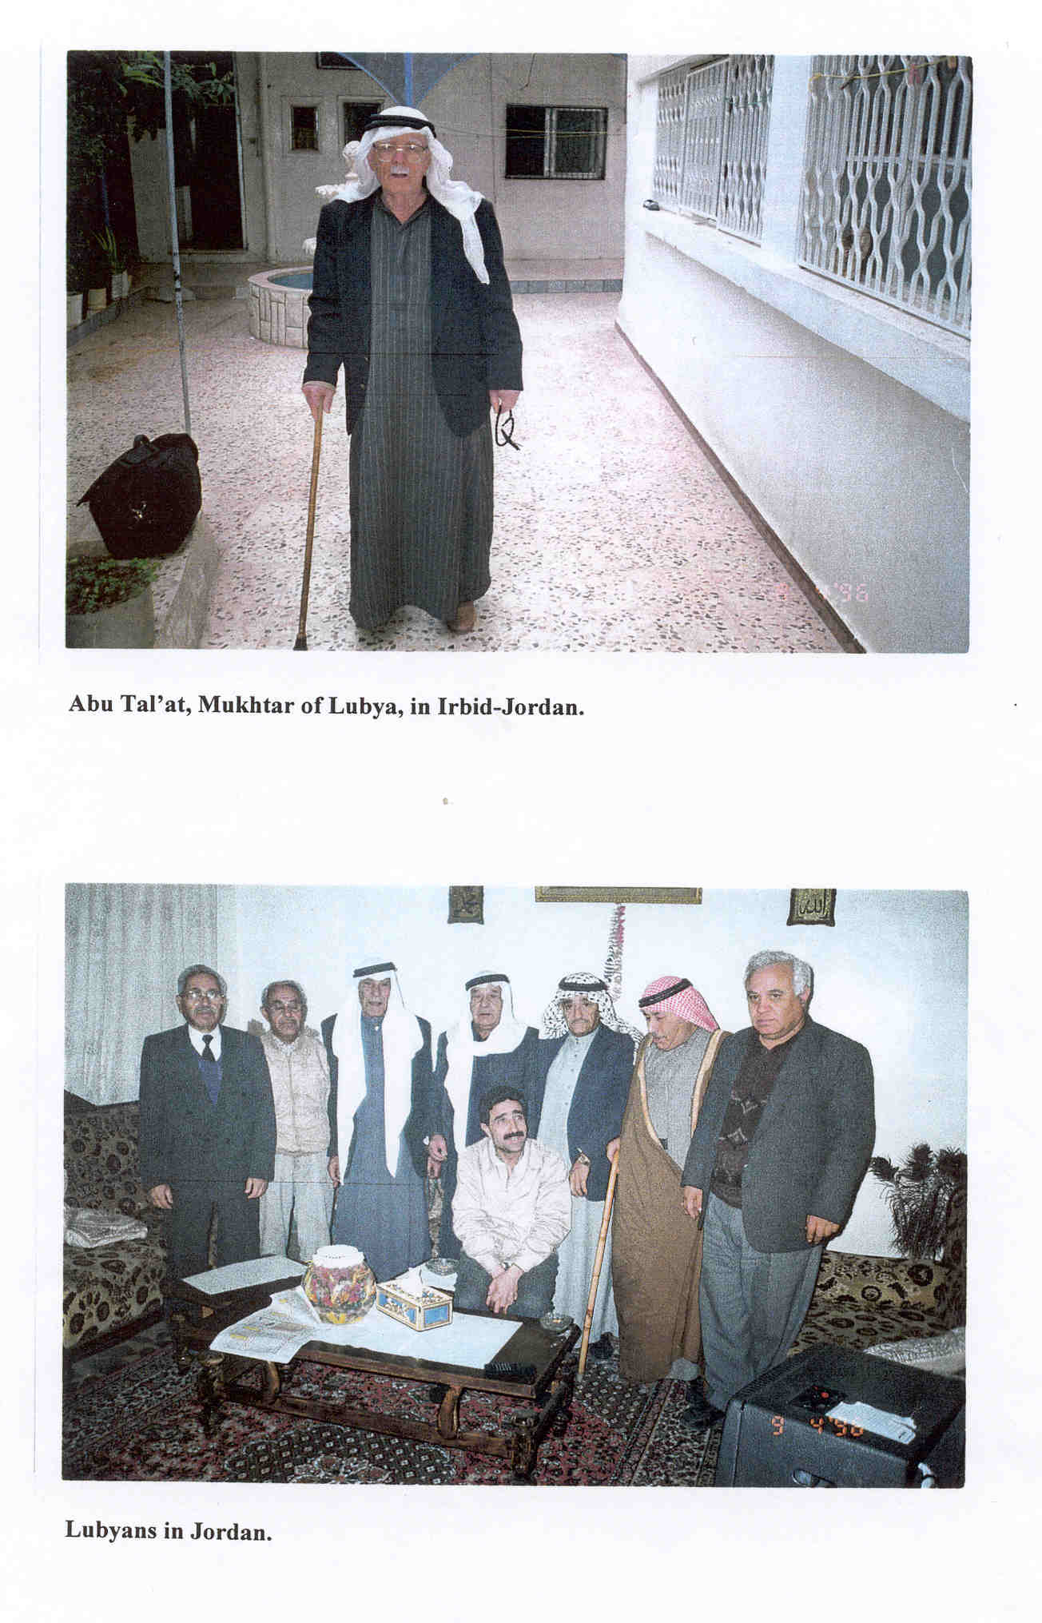

Slide 47
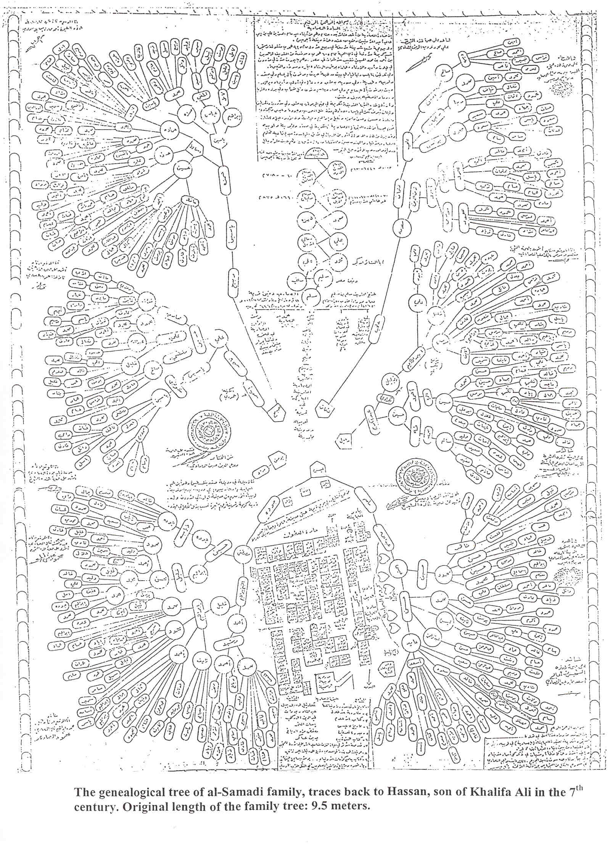

Slide 48
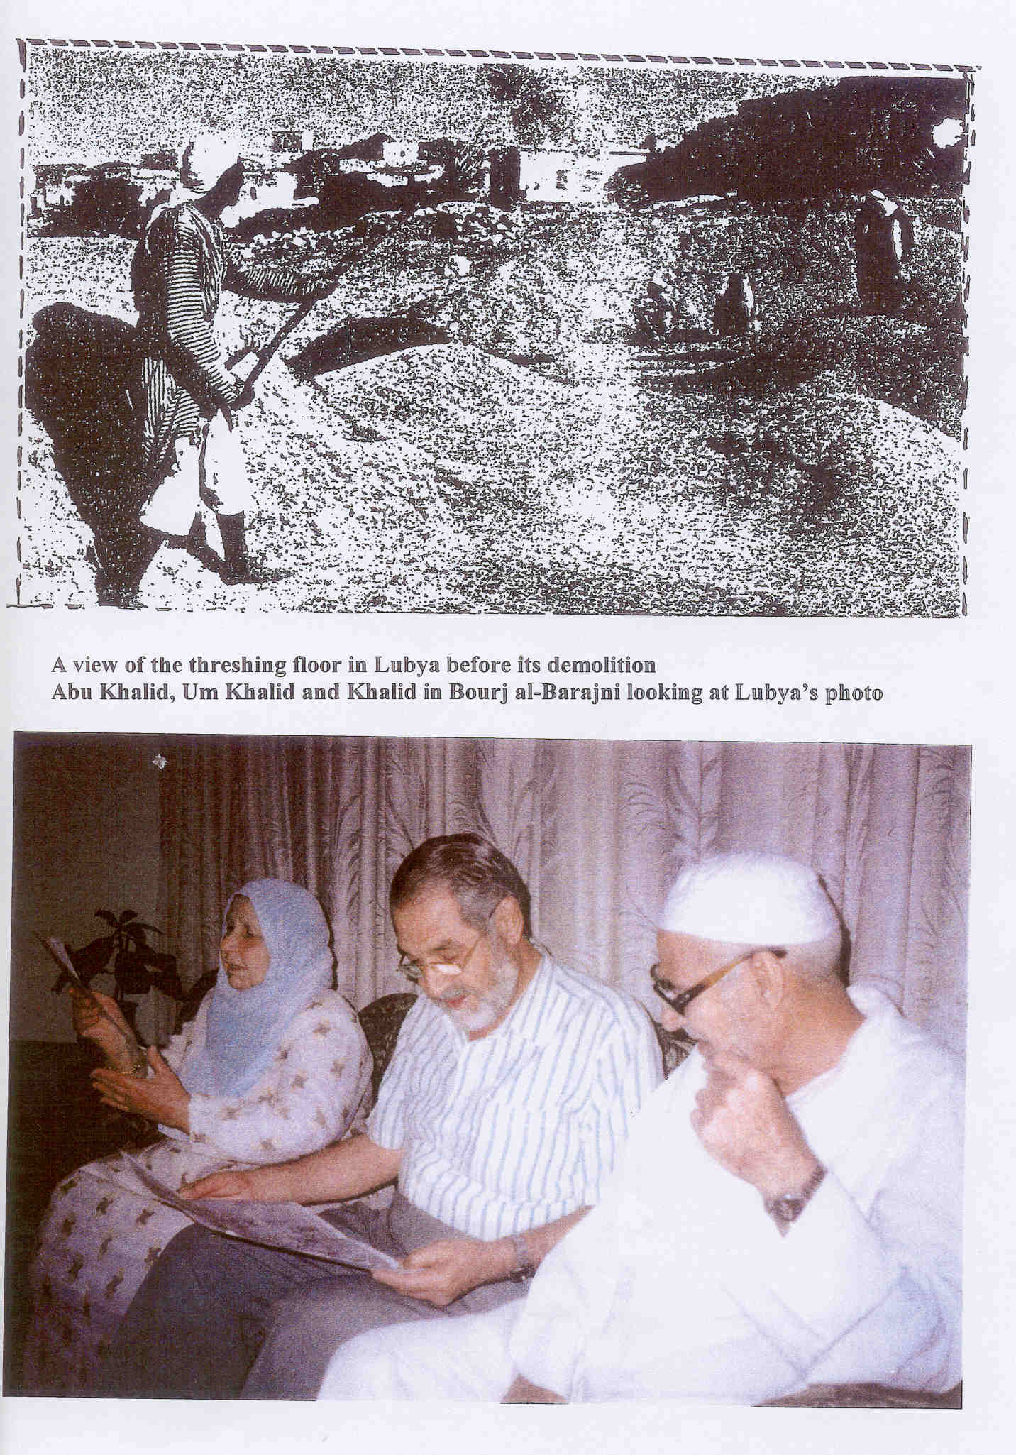

Slide 49
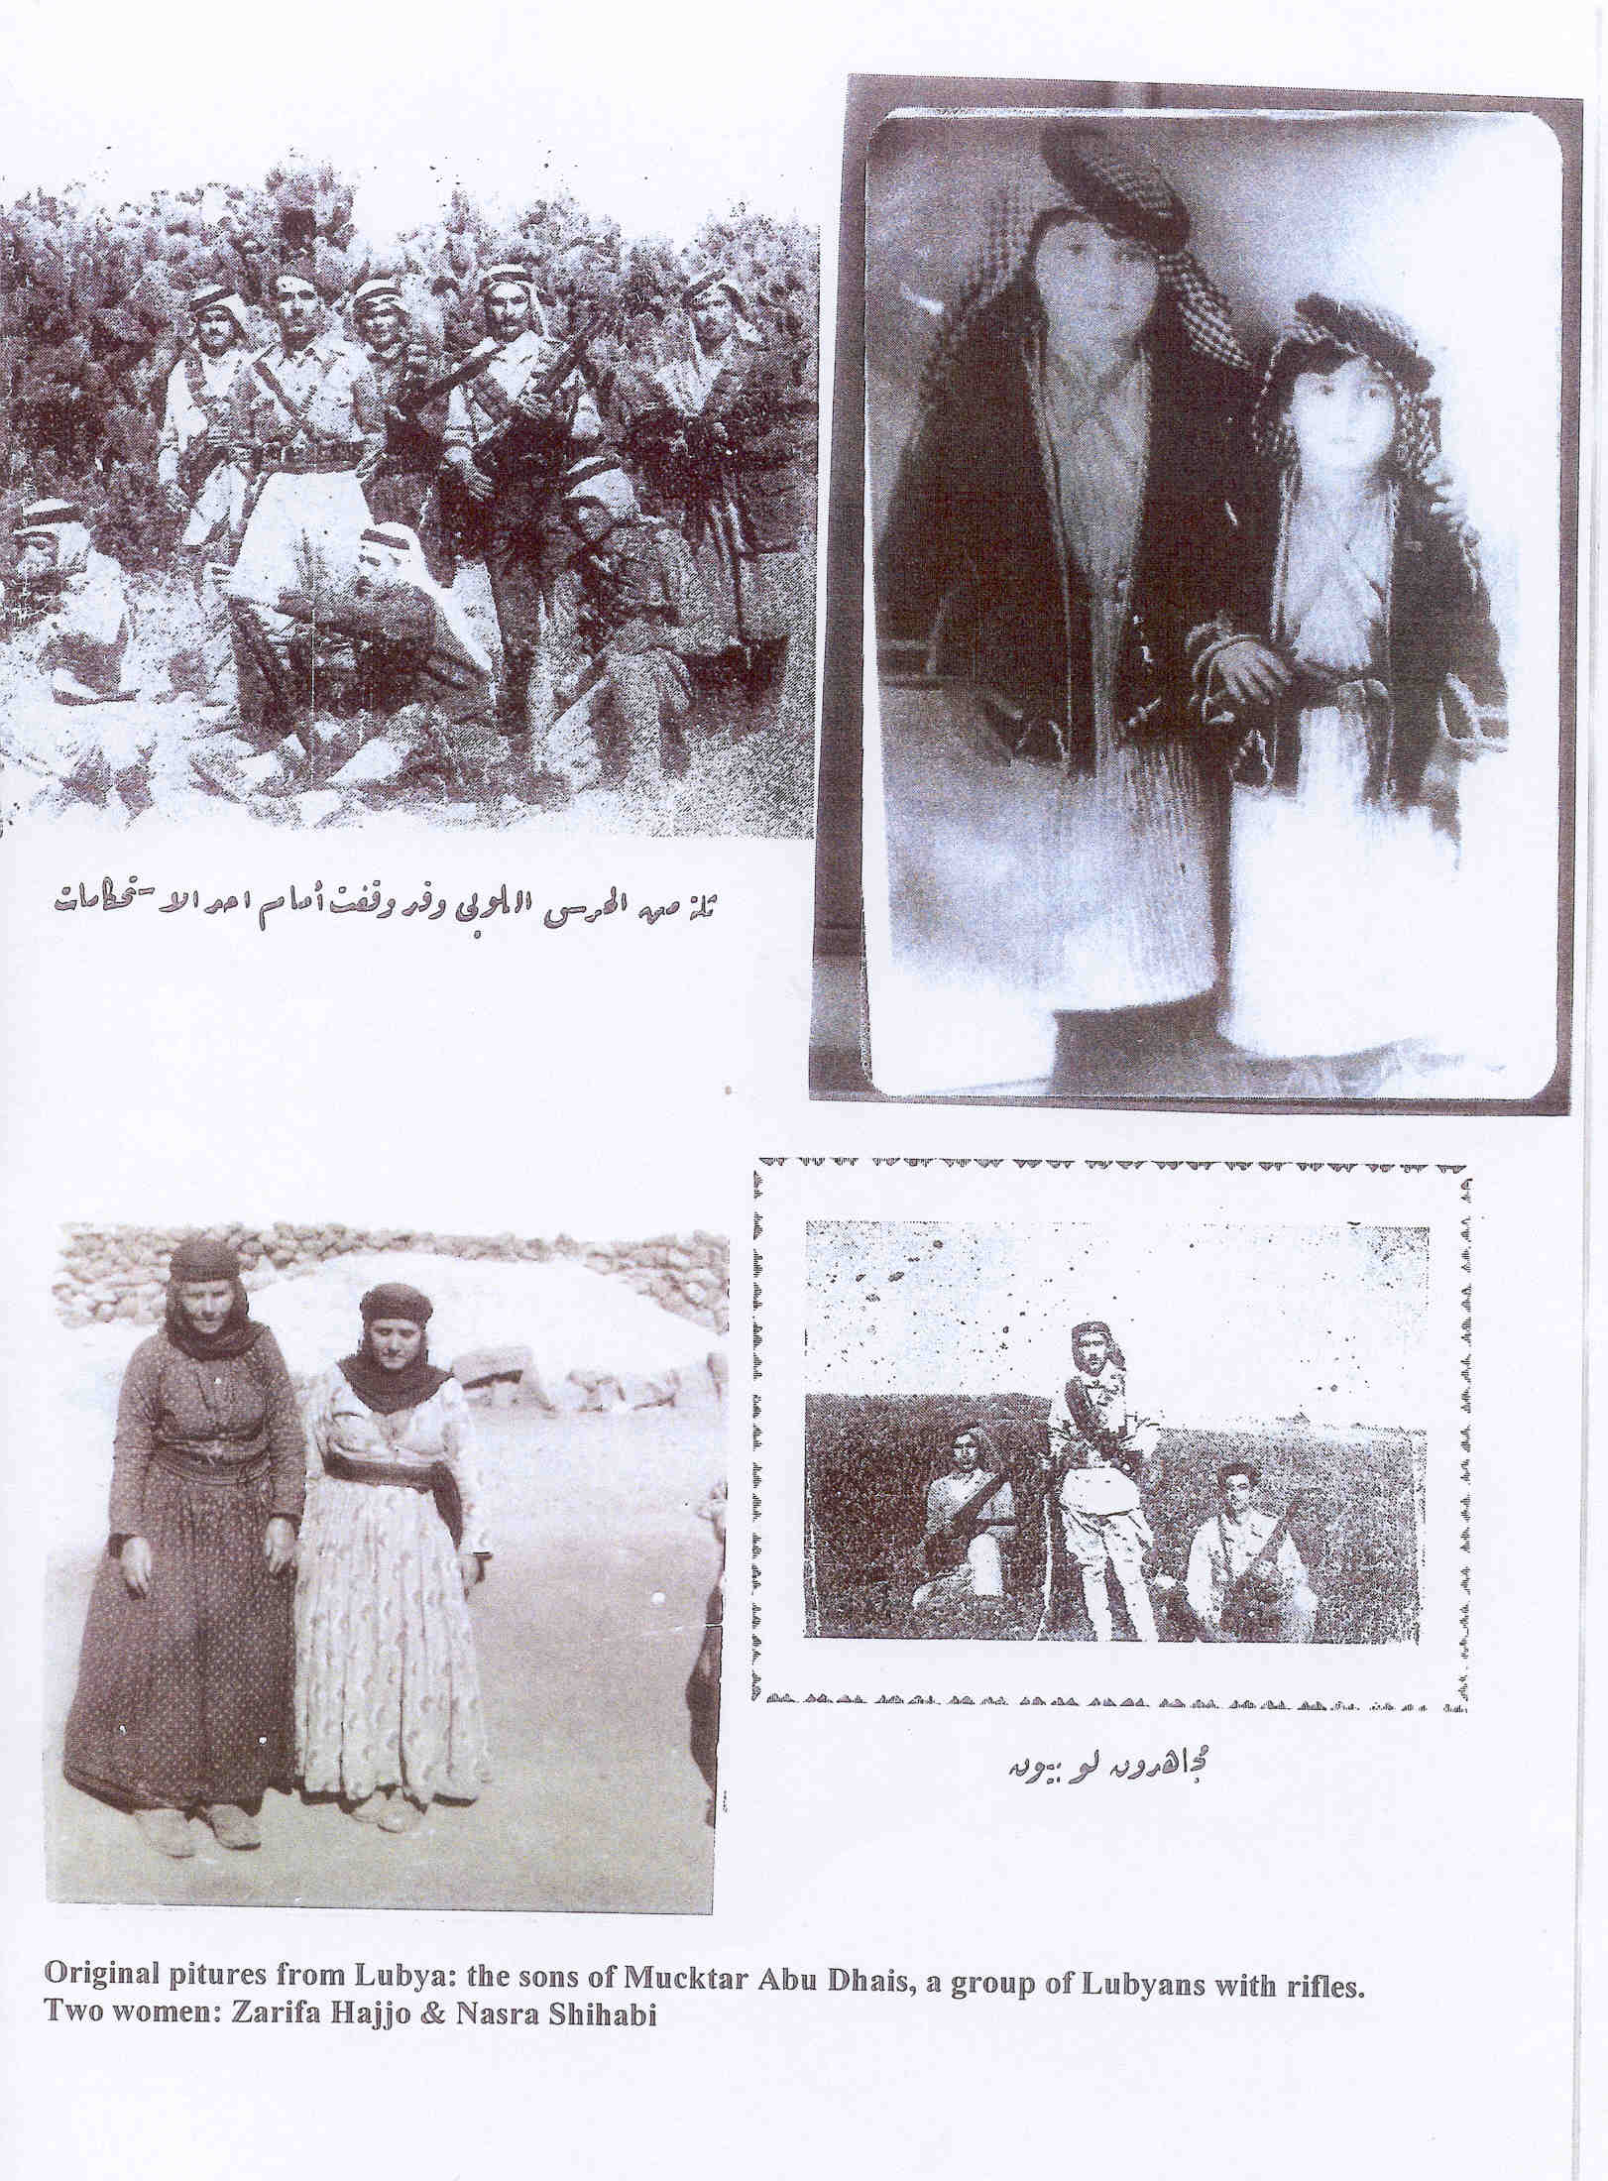

Slide 50
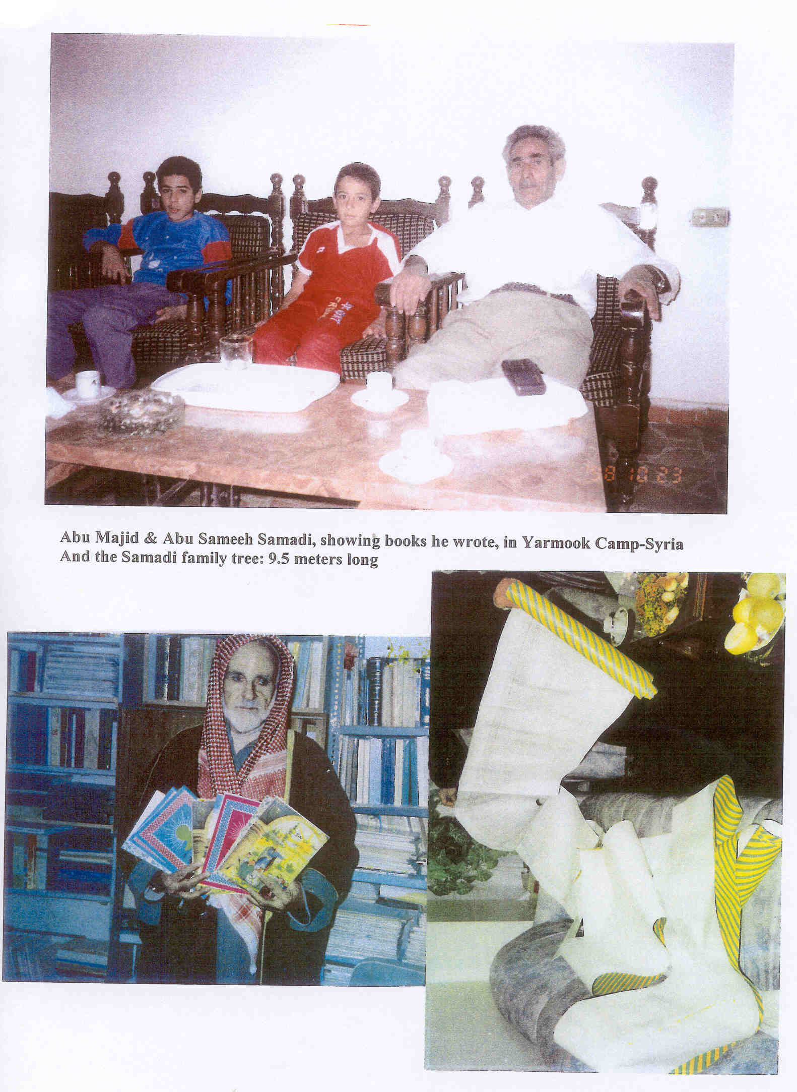

Slide 51
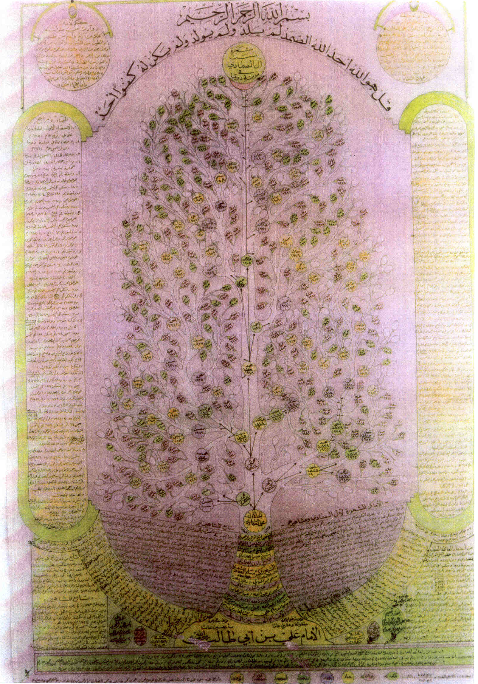

Slide 52
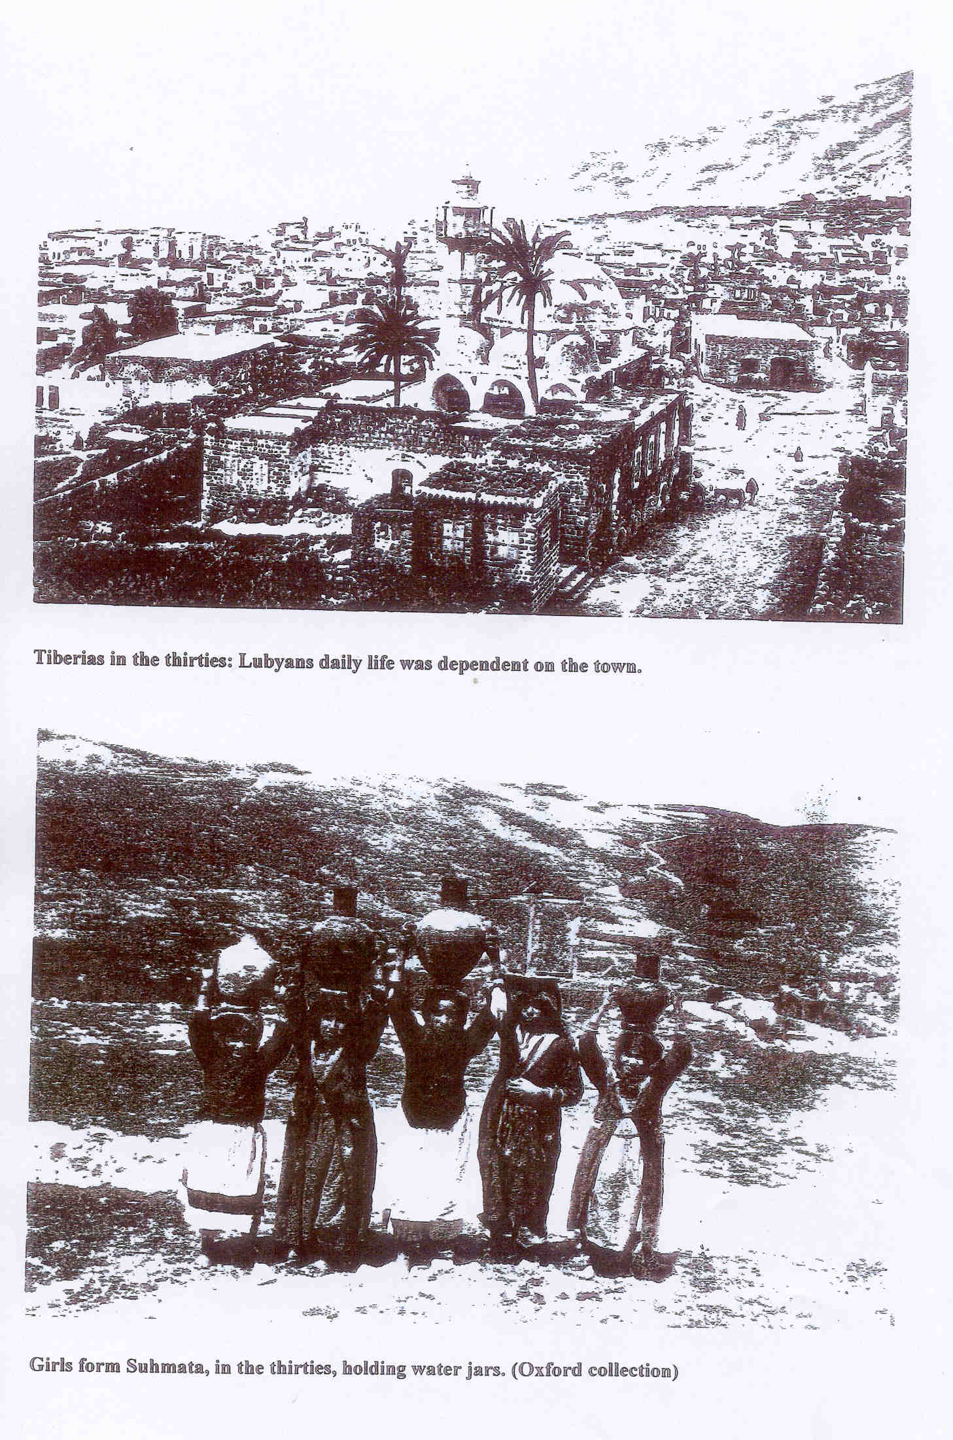

Slide 53
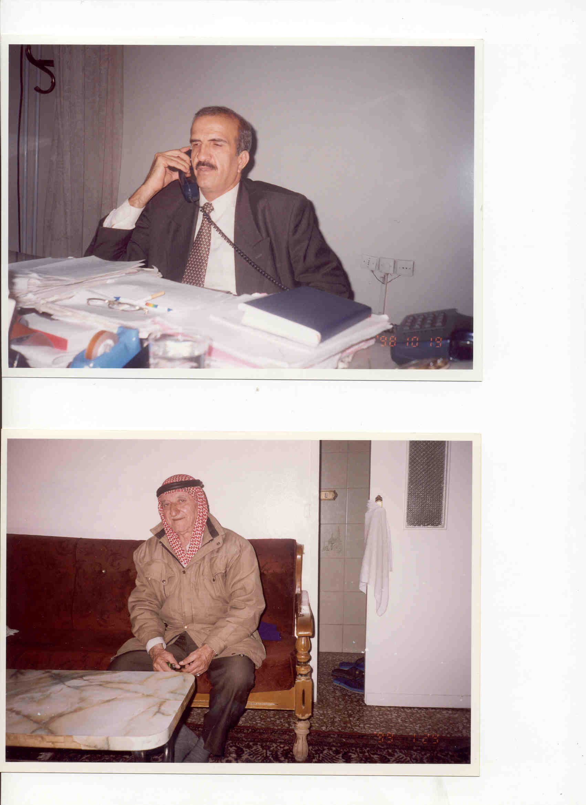
Above-Hamada: Mayor of al-Yarmook Camp
Abu al-Saeed: the first to visit his brothers in Deir Hanns in the sixties

Slide 54
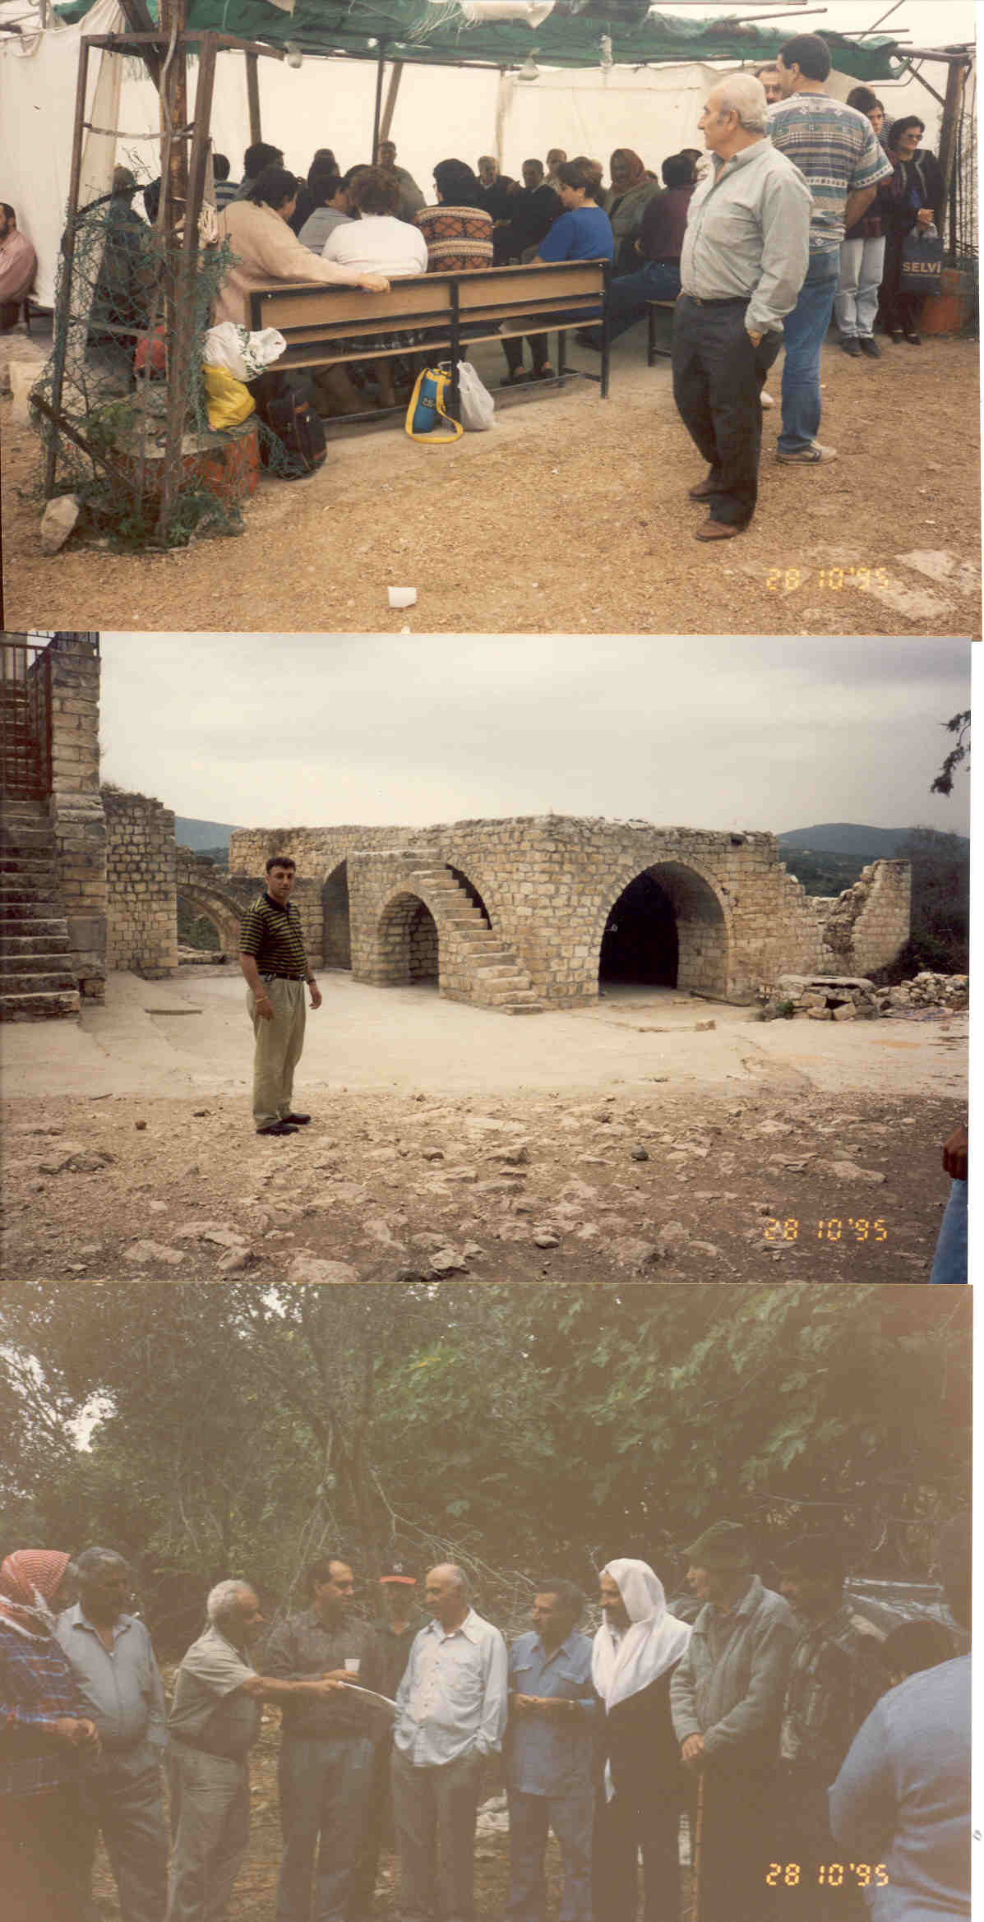
People from Iqrit, KufrBir’im & Suhmata: 47 years later commemorating their eviction

Slide 55

Lubya’s 240 Absentees

Slide 56


Slide 57


Slide 58


Slide 59


Slide 60


Slide 61


Slide 62


Slide 63


Slide 64


Slide 65


Slide 66


Slide 67


Slide 68


Slide 69


Slide 70


Slide 71


Slide 72


Slide 73


Slide 74


Slide 75


Slide 76


Slide 77


Slide 78


Slide 79
Notes:
”My Pledge of Solidarity”. Certificate of Apology

Slide 80

Demostration on the first of May on Lubya land, by Lubyans from Europe, Palestine and South African Delegation and Israelis as well.
Notes:
Ceremony of apology from South African Jews to Lubyans.

Slide 81


Slide 82

Around 20.000 gathered on Lubya debris-Named now South African Forest, commemorating the 66th anniversary of Nakba Day in 2014

Slide 83


