Slide 1
Jerusalem amid two Nakbas:1948-2023
Lubya Village ”Lieu de memoire” revisited
The 2nd international Conference on ”Jerusalem:Where to?”
Amman-Jordan
May 14-15-2025
Mahmoud Issa

Slide 2
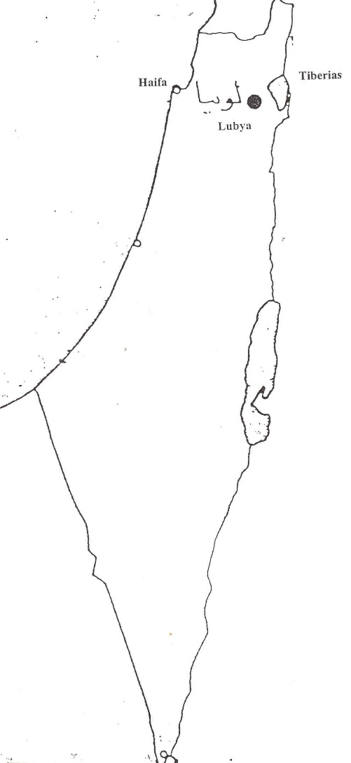
Lubya
Repository of silenced memories-as Crusaders defeat 4.July 1187. Jerusalem felt 2. October (Ibn al-Athir).

Slide 3
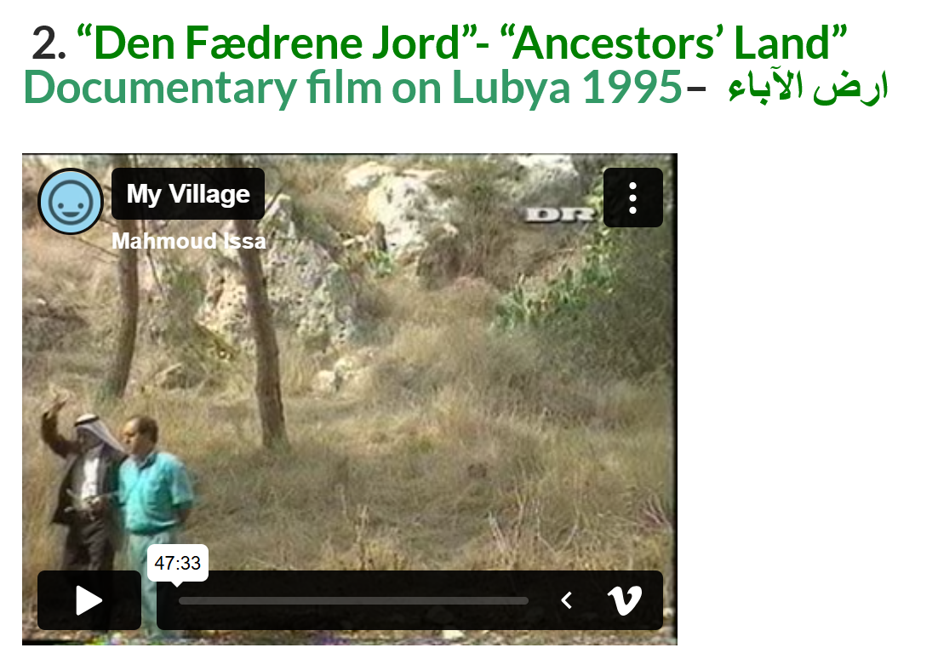

Slide 4
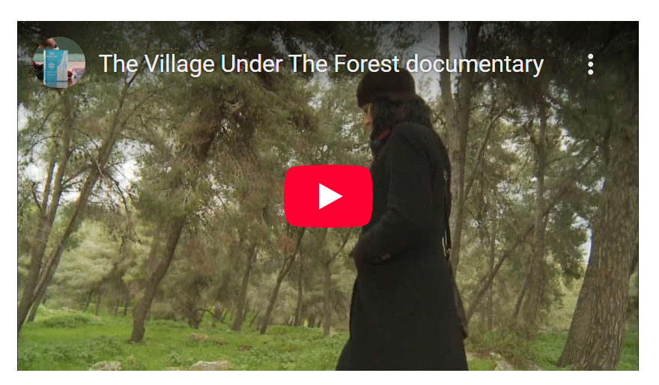
The Village (LUBYA) Under the Forest فيلم “القرية تحت الغابة
A documentary by Mark Kaplan & Heidi Grunebaum, from South African, protesting the renaming of Lubya’s ruins to “South African Forest” after its demolition and ethnic cleansing in 1948 – to obliterate the historiography of the village under greening policies-The film is based on my counselling and research.

Slide 5
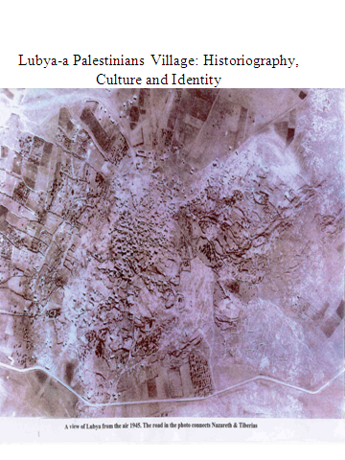
The Only Photo of Lubya Before Destruction
Documents on Lubya in British and Zionist archives in London, Jerusalem and Tel Aviv reveal the number of houses, wells, camels, cows, deeds of land and income of the people of the village.
Foto: 4.10.1945

Slide 6
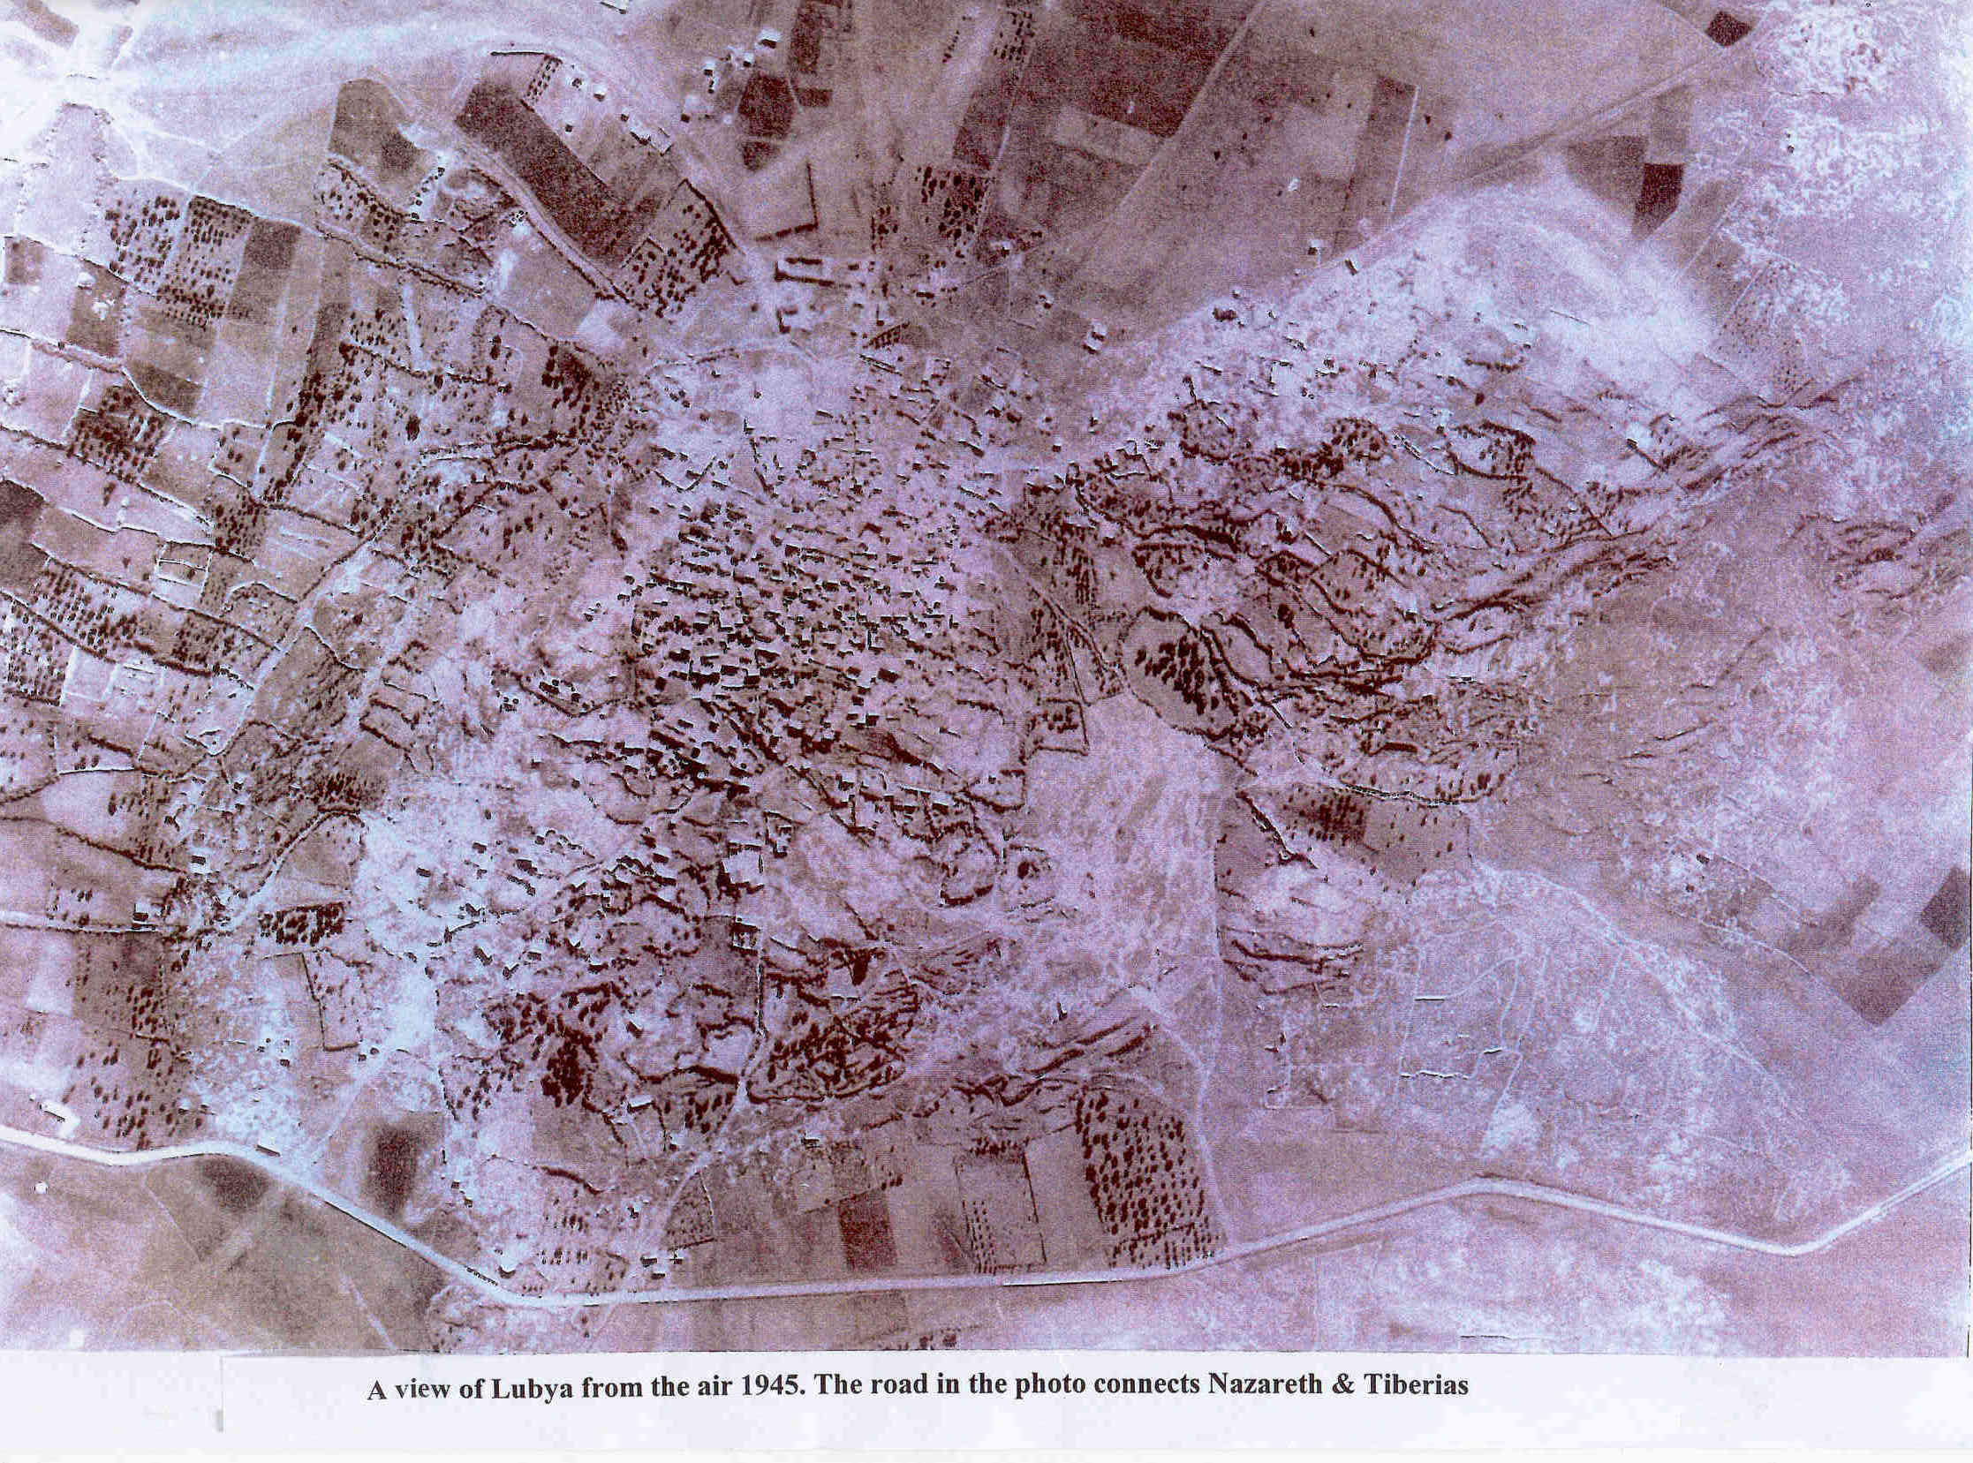
Lubya before destruction

Slide 7
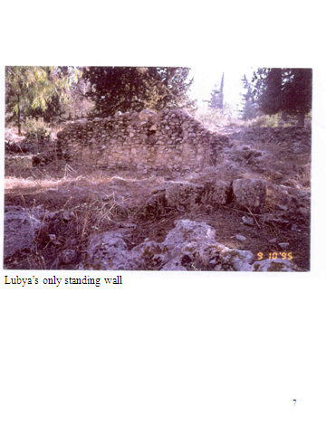
Memories of the Past the only standing wall
Out of 1000 demolished rooms in Lubya in 1948, all that remains for refugees, are merely memories of the past & landscape: the vertibral column of their existence.
Ethnic cleansing started in 1948 & now continued –online-in Gaza & West Bank Refugee Camps since 2023.

Slide 8
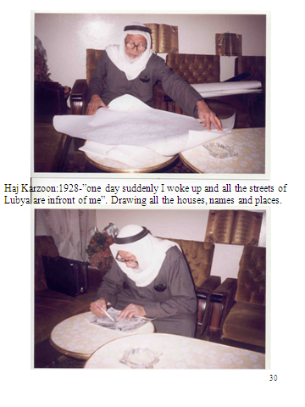
Haj Karzon and Map of Lubya
Oral history will remain one of the main sources of our perceptions and understanding of the various social and historical facts related to a specific time in a specific period, whenever classical historical means of analysis are unavailable. Film: “The Village under Forest” at mahmoud.dk

Slide 9
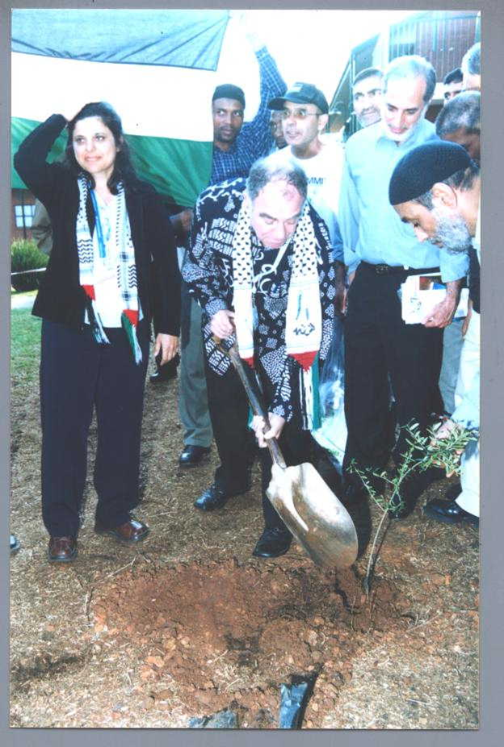
South African minister Ronnie Kasril´s Dedication to Lubya: planting olive tree
“Lubya: dedicated by the honourable minister, Ronnie Kasrils (minister of State Security in South Africa:

Slide 10
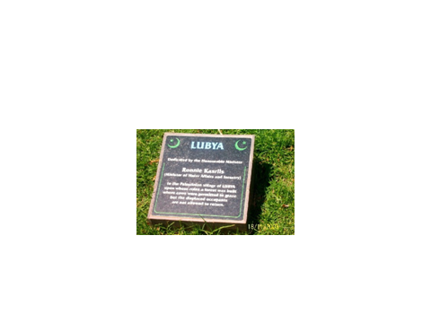
In Pretoria
Nelson Mandela’s words which are enshrined on the entrance of the apartheid museum in South Africa :
“To be free is not merely to cast off one’s chains, but to live in a way that respects and enhances the freedom of others”.

Slide 11
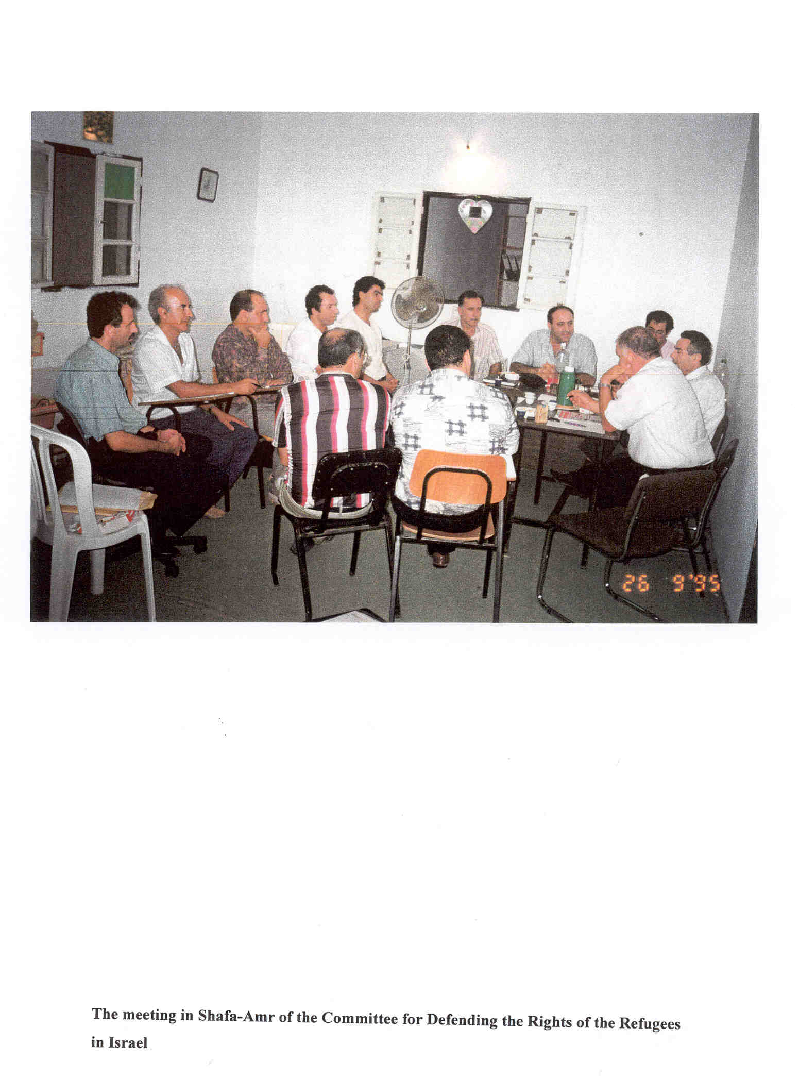
Memory of Three Different Kinds of Exile case of app. 15 million Palestinians
Internal exile
Exile by choice, or voluntary migration,
Exile by uprooting or forced migration
Foto of the Association for the defence of the rights of the displaced people (ADRID)

Slide 12
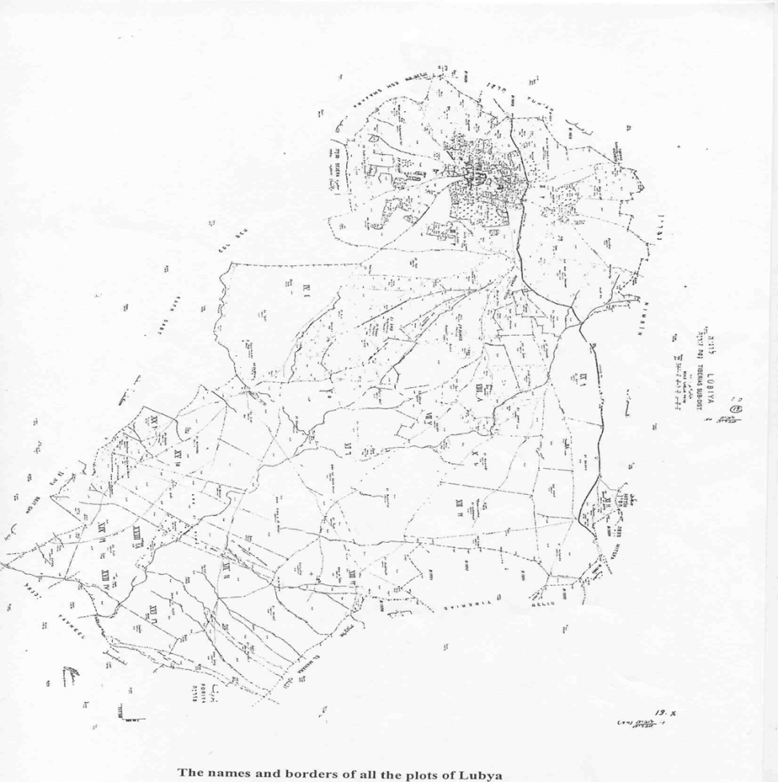
Today, Palestinians in Israel Own Only 5% of the historical land of Palestine
The acquisition of land by Zionist colonization associations, began to affect Lubya in 1892

Slide 13
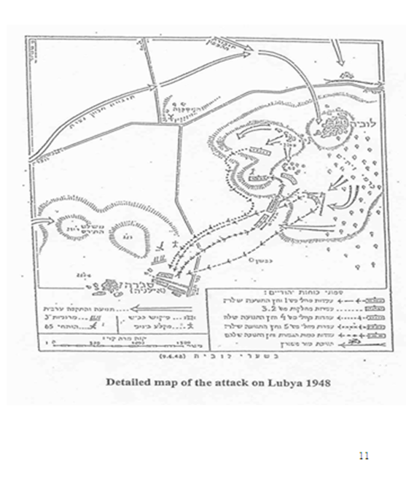
Ethnic Cleansing
675 villages and hamlets and eleven urban neighborhoods were systematically and deliberately evacuated and demolished.
Here is a map of the battle against Lubya in 1948

Slide 14
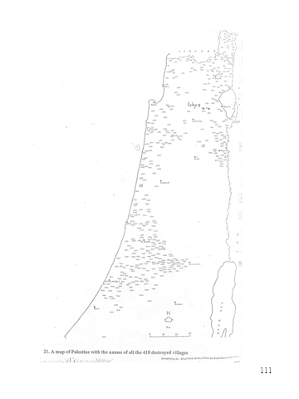
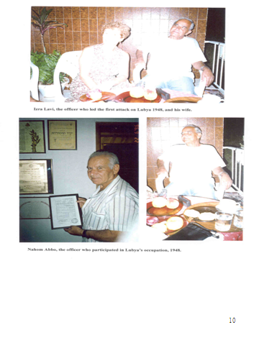
Officers Who Occupied Lubya

Slide 15
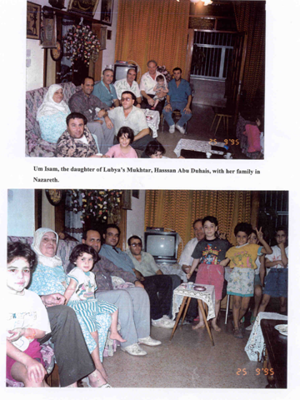
Necessity of Oral History to Recover Hidden Histories of the Past
The neglected narratives and memories of the marginalized and alienated are invisible to official historiography.

Slide 16
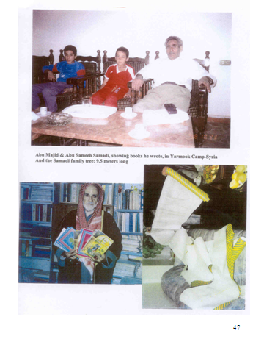
Around 50.000 Living in 23 Countries
Refugees from Lubya live and reside in as many as twenty-three countries around the world
Fayiz Fawaz and Abu Sameeh(from Yarmook refugee camp) geneological tree of his family-tracing back to Hassan, son of the fourth Khalif in Islam

Slide 17
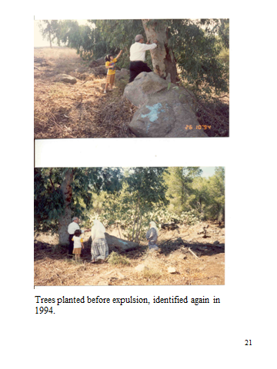
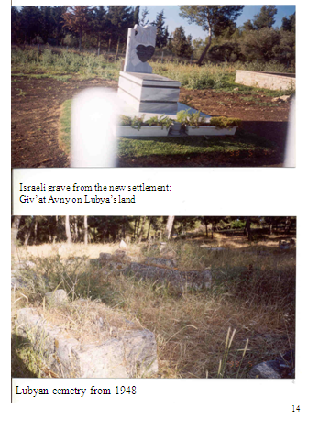
Graveyards: Past and Present
Father found a tree he planted when young

Slide 18
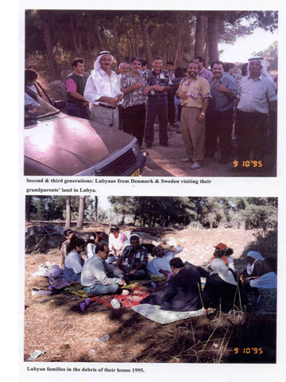
The Routes of Memory Among three generations
Lubya museum on-line
http://mahmoud.dk
- The old people of Lubya were a living library which told the history of the village in detail.

Slide 19
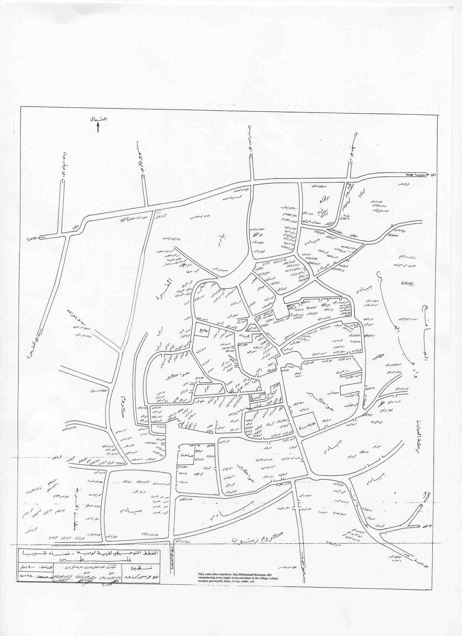
Haj Karzon mental Map of Lubya before destruction

Slide 20
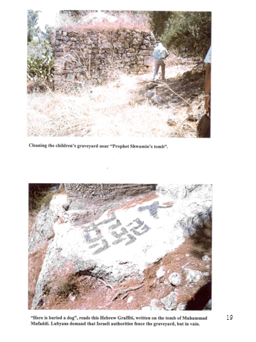
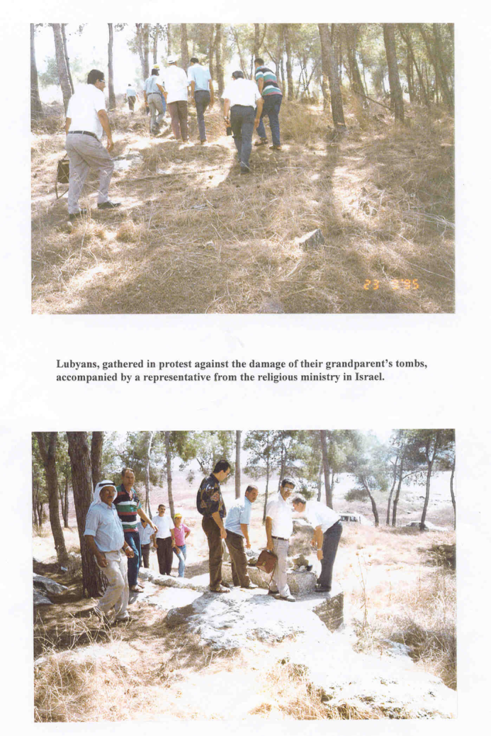
Debris of Lubya´s Cemetery
- Forbidden even to repair

Slide 21
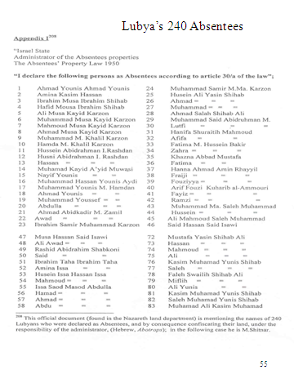
Lubya’s 240 Absentees & Conqueror’s Cynical Statement
“The most adaptable and best survivors would ‘manage’ by a process of natural selection. The others will waste away. Some will die but most will turn into human debris and social outcasts and will probably join the poorest classes of Arab countries.”

Slide 22
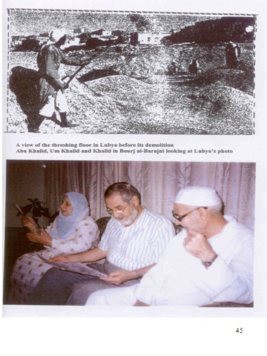
Suppressed Memories - Khalid Said Vivid Memory After 42 Years in Exile
After 42 years Khalid Said visited Lubya found his family´s home debris although he was only 8 years old in 1948, when he left Lubya.

Slide 23
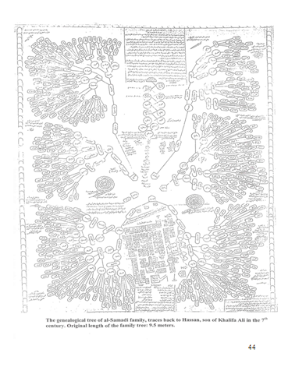
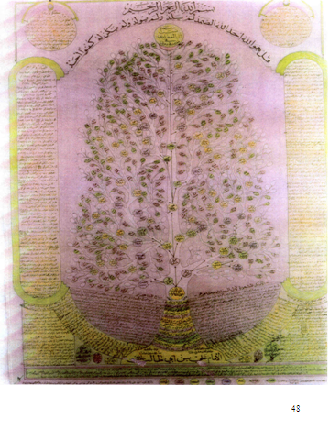
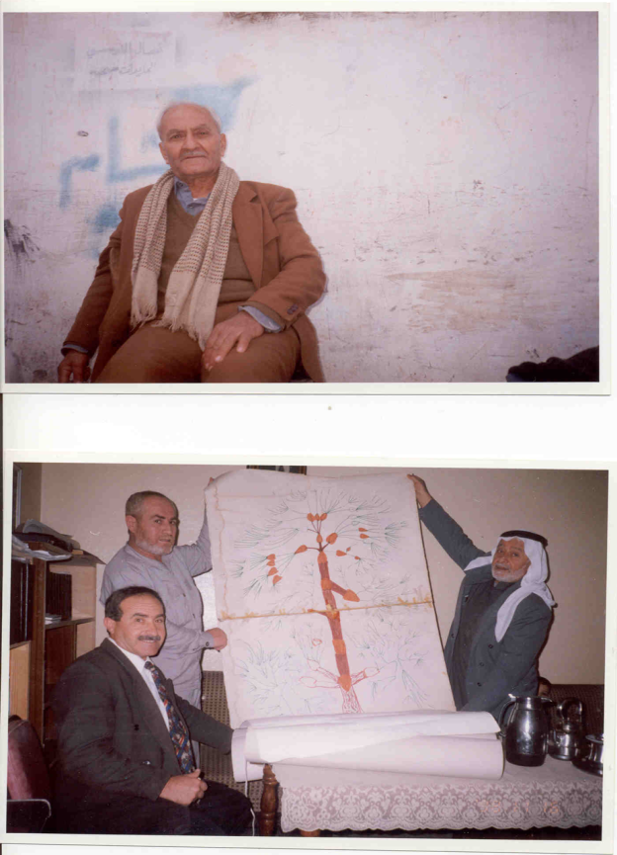
Geneological Tree of Samadi & Atwat Families-Abu Dhais residing in Hama’s refugee camp author of a book on Lubya

Slide 24
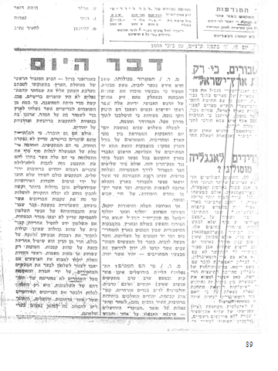
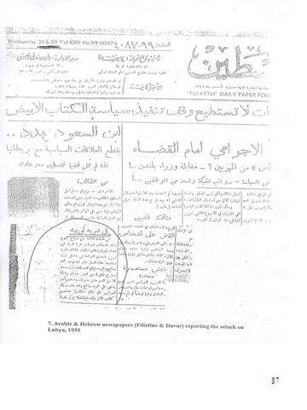
Attack on Civilians 1939

Slide 25
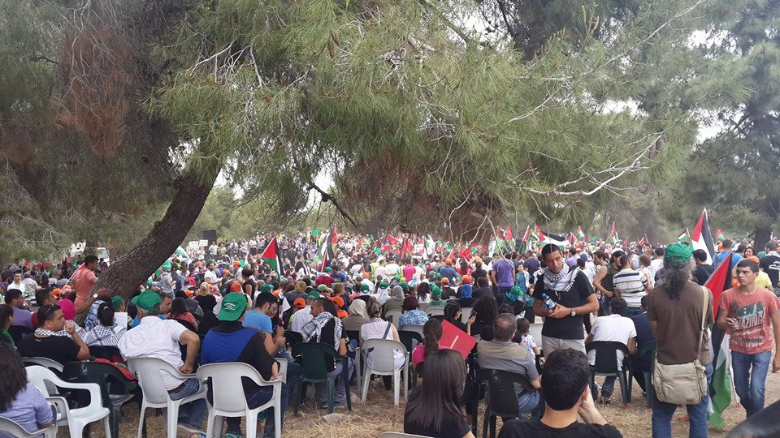
Around 20.000 gathered on Lubya debris-Named now “South African Forest”, commemorating the 66th anniversary of Nakba Day in 2014

Slide 26
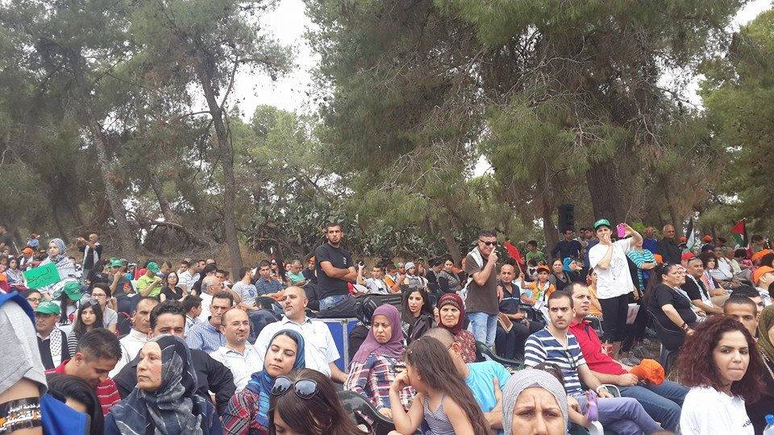

Slide 27
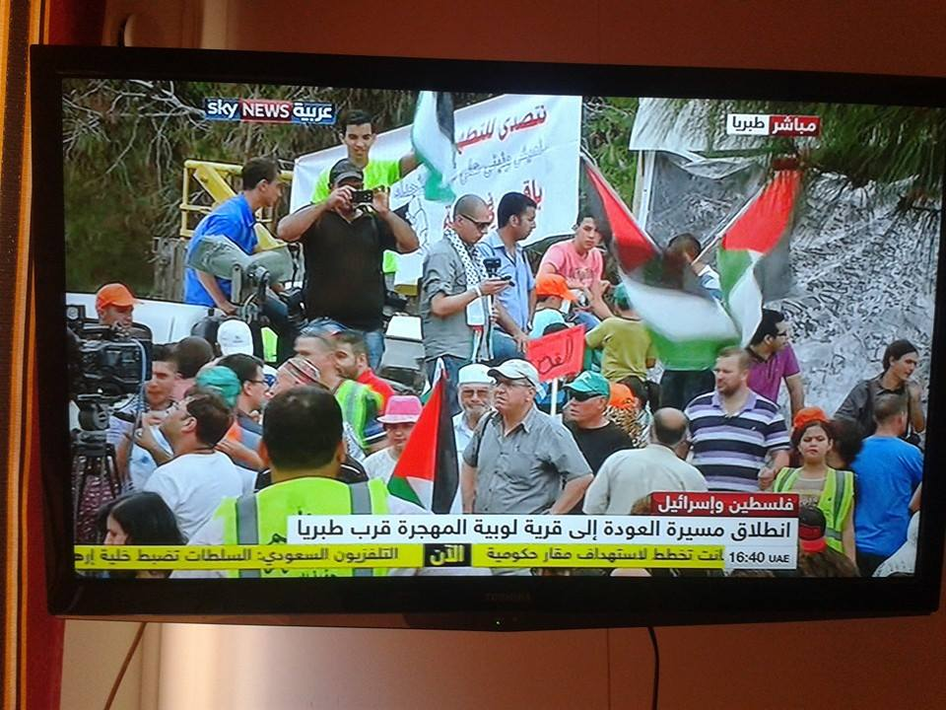
Reports about the Event in Lubya 2014

Slide 28
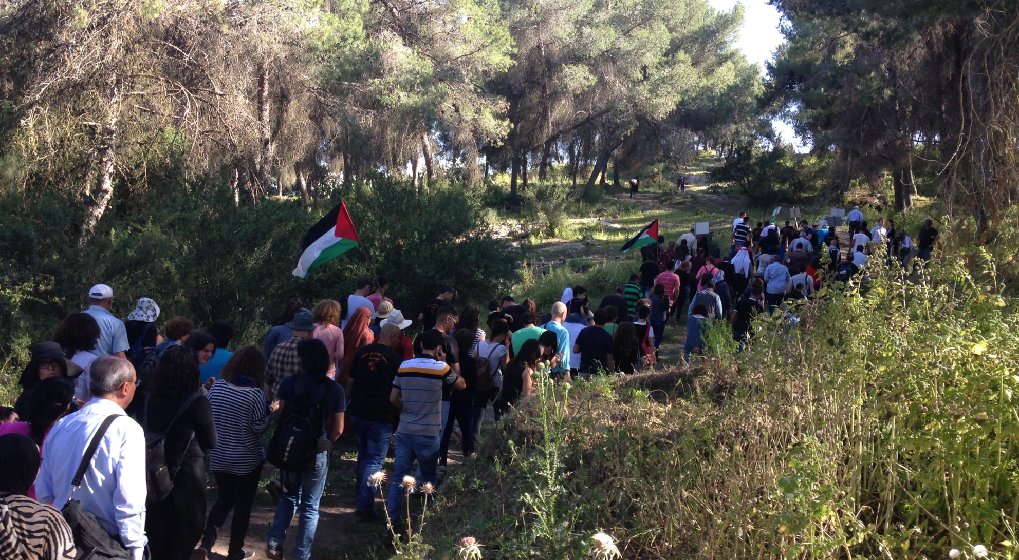
Demonstration on the first of May 2015 on Lubya land, by Lubyans from Europe, Palestine and South African Delegation and Israelis as well.
Notes:
Demostration on the first of May on Lubya land, by Lubyans from Europe, Palestine and South African Delegation and Israelis as well.

Slide 29
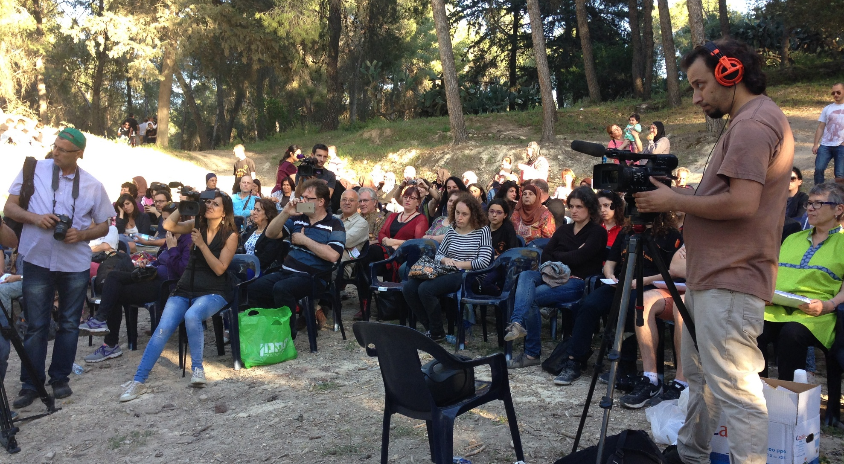
Apology ceremony

Slide 30
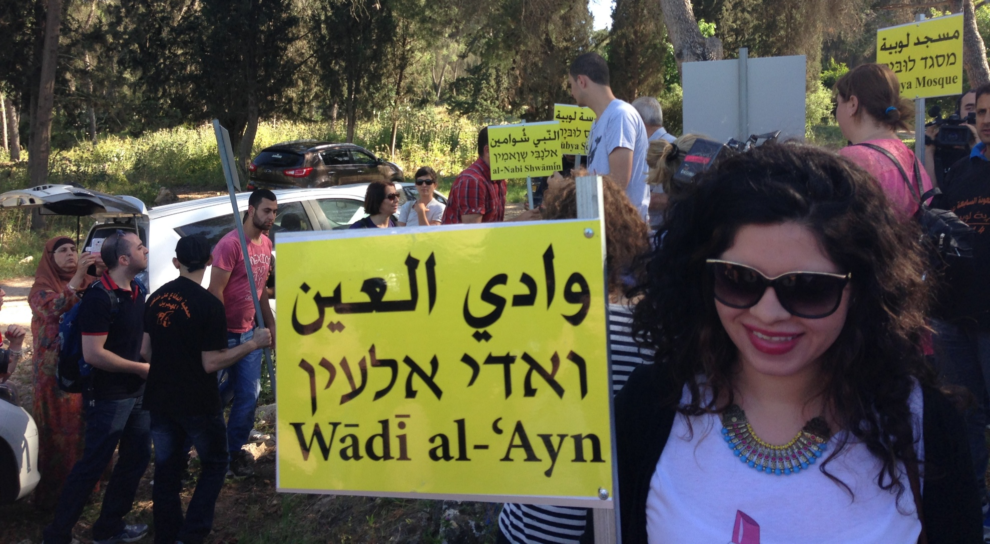
Third Generation Remembering: Graveyard, Mosque, School & Debris of houses.

Slide 31
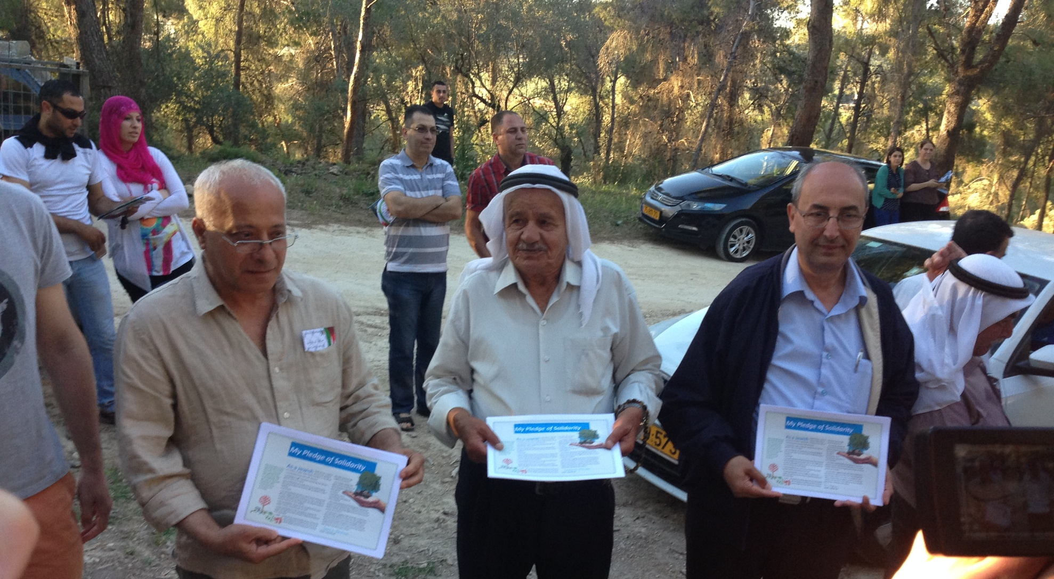
”My Pledge of Solidarity”. Certificate of Apology signed by more than 200 SA. - acknowledging the Nakba
Notes:
”My Pledge of Solidarity”. Certificate of Apology

Slide 32
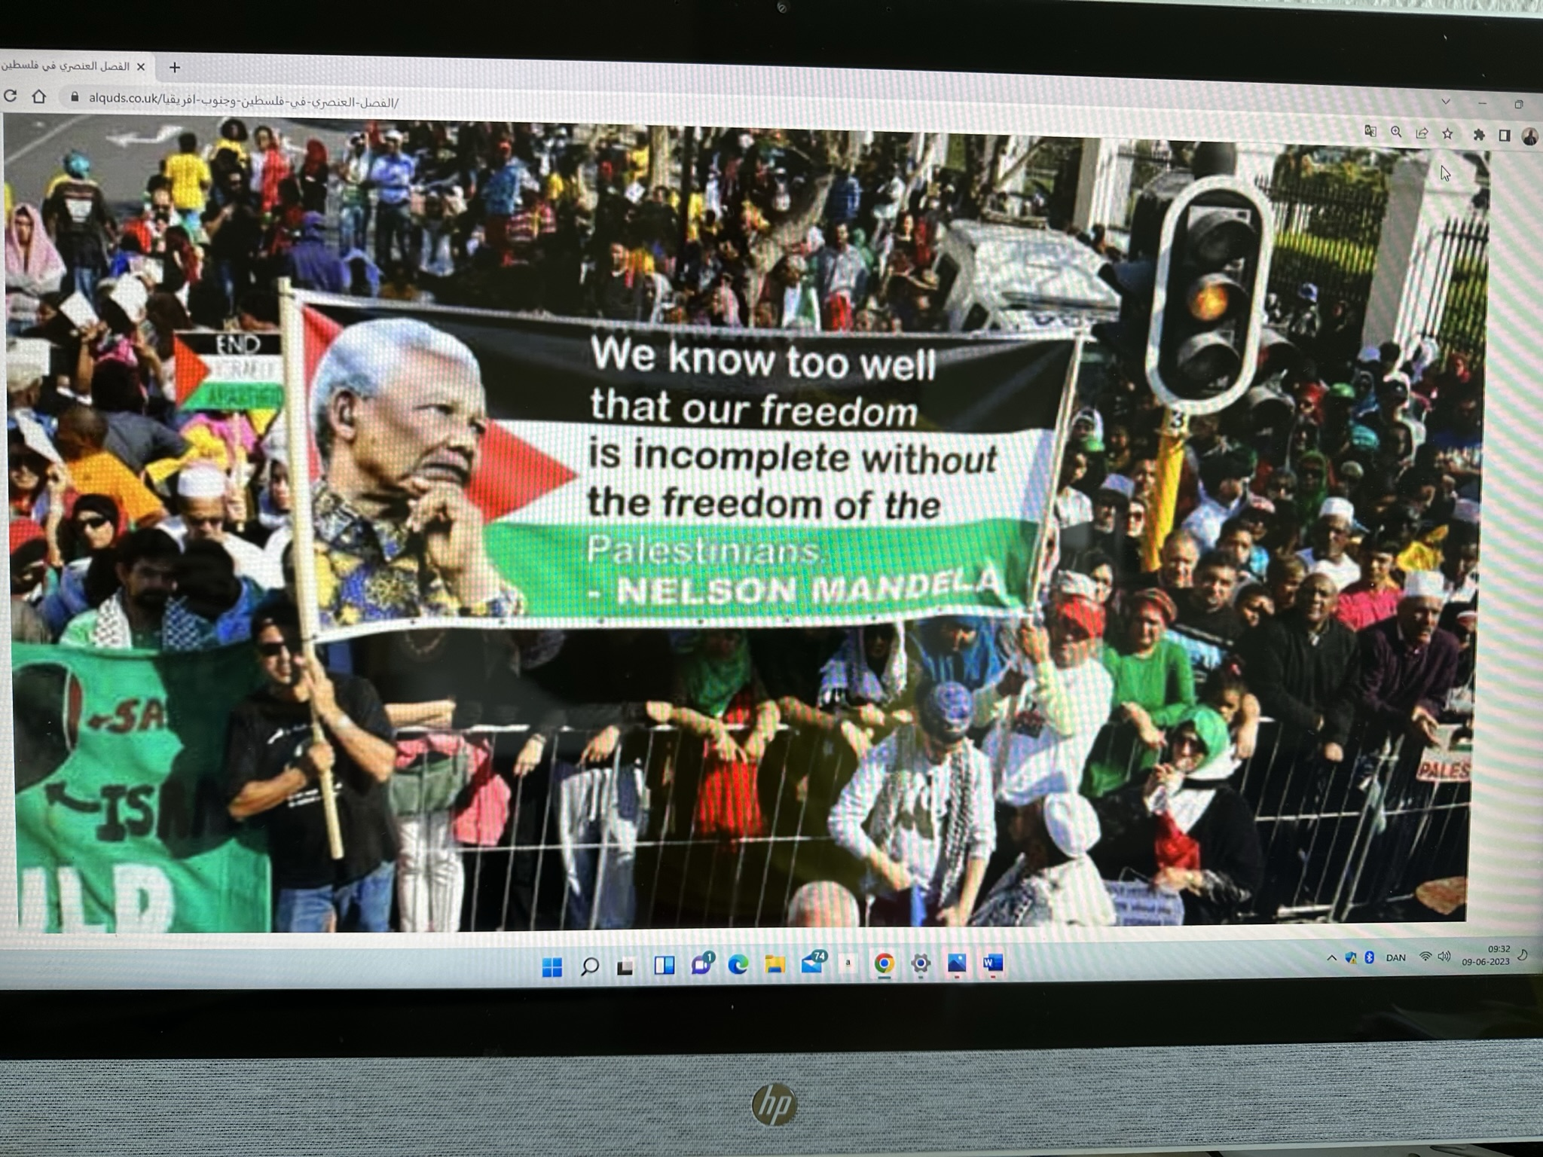

Slide 33
Rebuilding Lubya 2021
Common project between Jordan & Palestine Univ. Architects
اعادة بناء لوبيه 2021
They Destroy, We Rebuild

Slide 34
